Slide 1
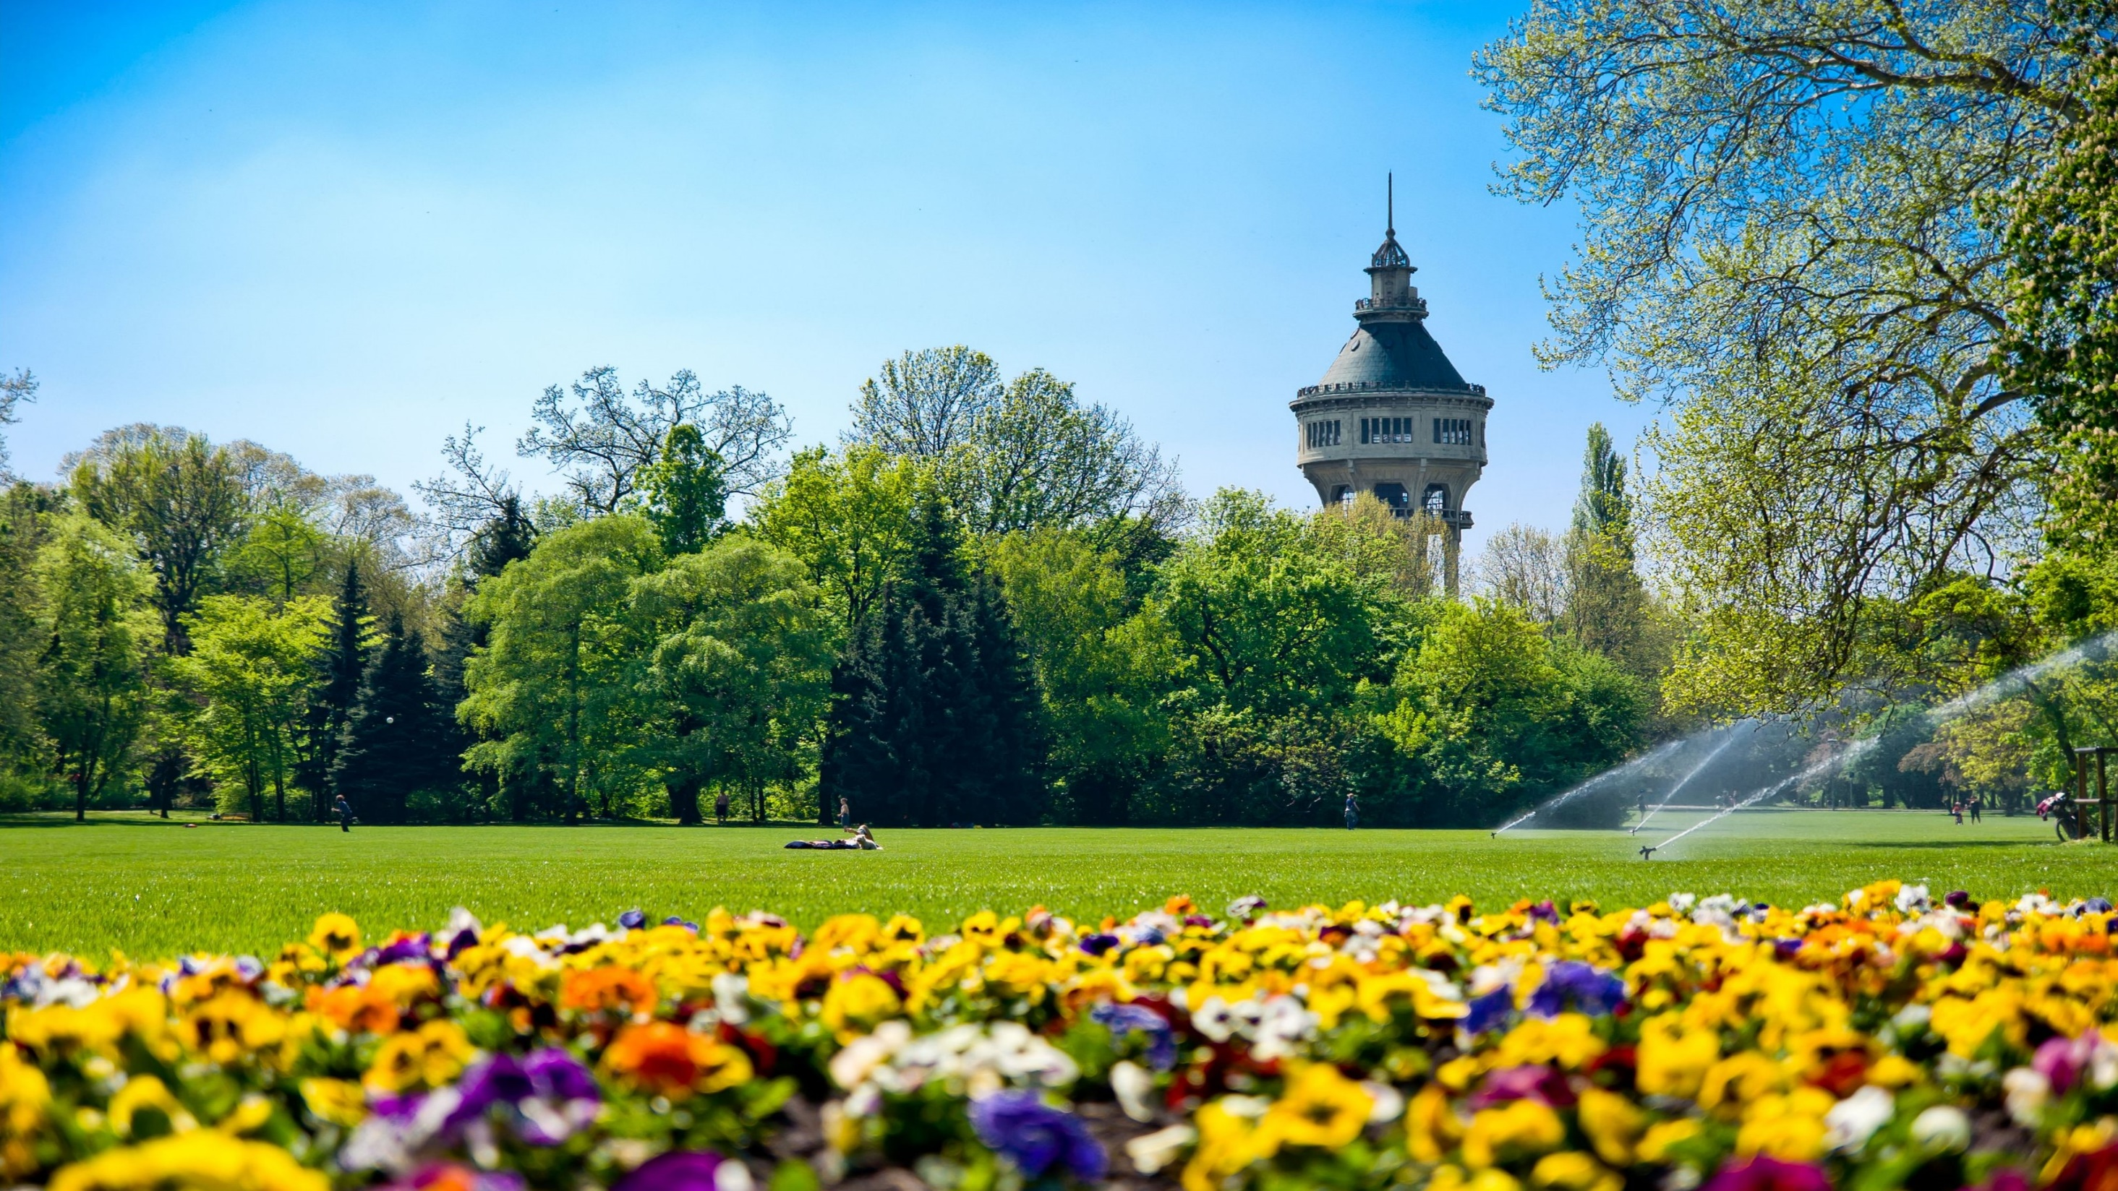
2016
Winter/Spring semester
Presents…

Slide 3
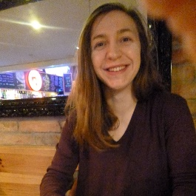
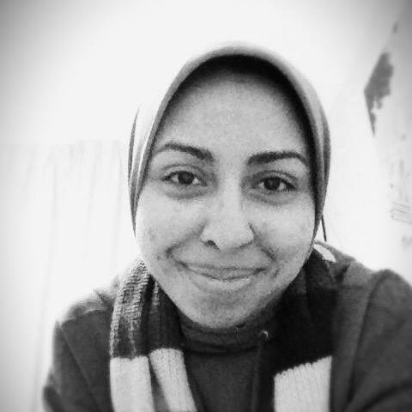
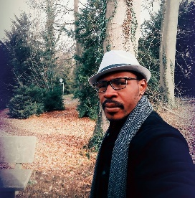
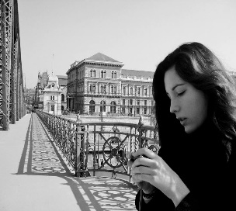
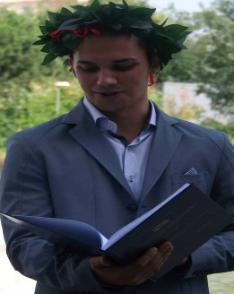
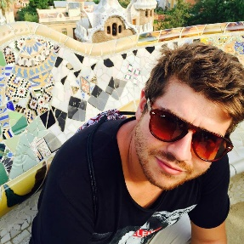
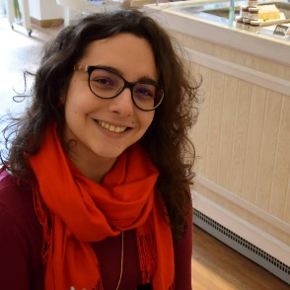
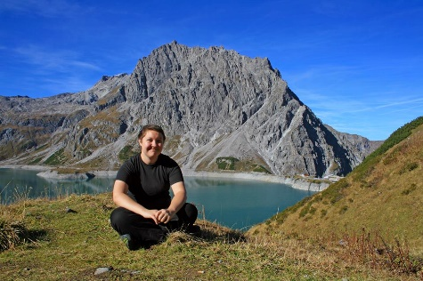
Die Teilnehmer…
Pauline Pierrot
Yomna E. Abbass
Paul-Junior Dilubenzi
Amélie Daloz
Stefano Angelucci
Cristian Bianco
Flavia Monarchi
Anja Pfeiffer

Slide 4
Erste Woche…
A1: Metalexikographie

Slide 5
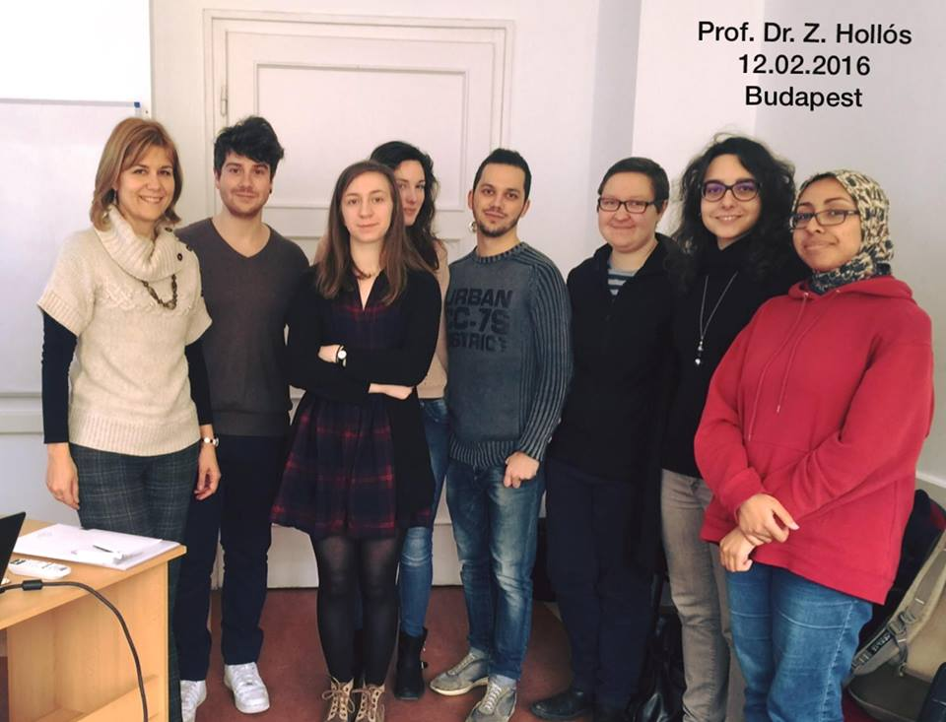
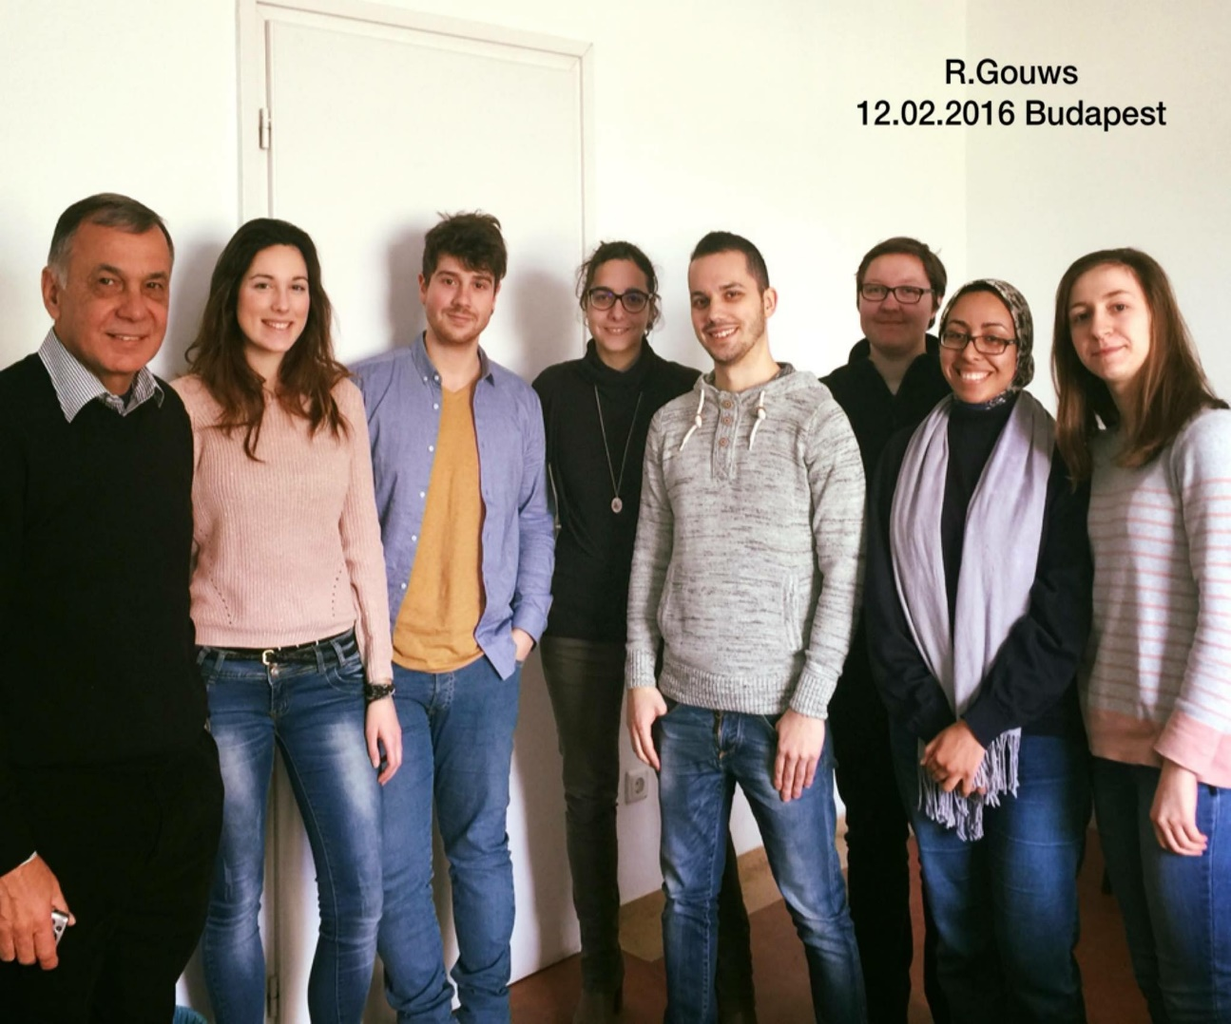
Rufus H. Gouws & Zita Hollós

Slide 6
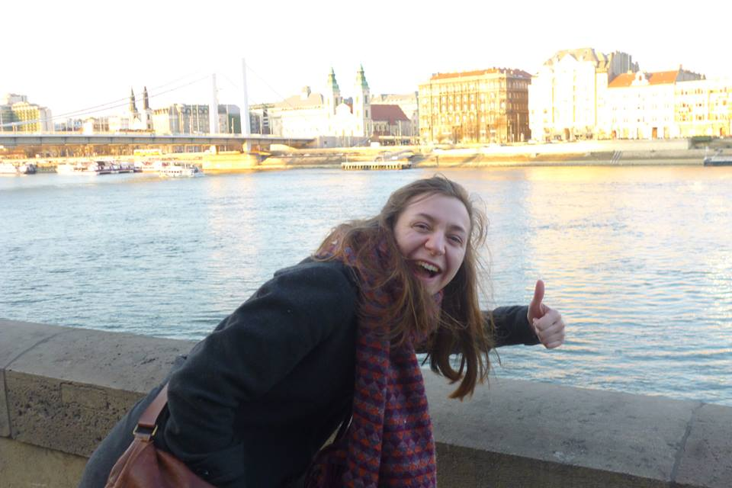
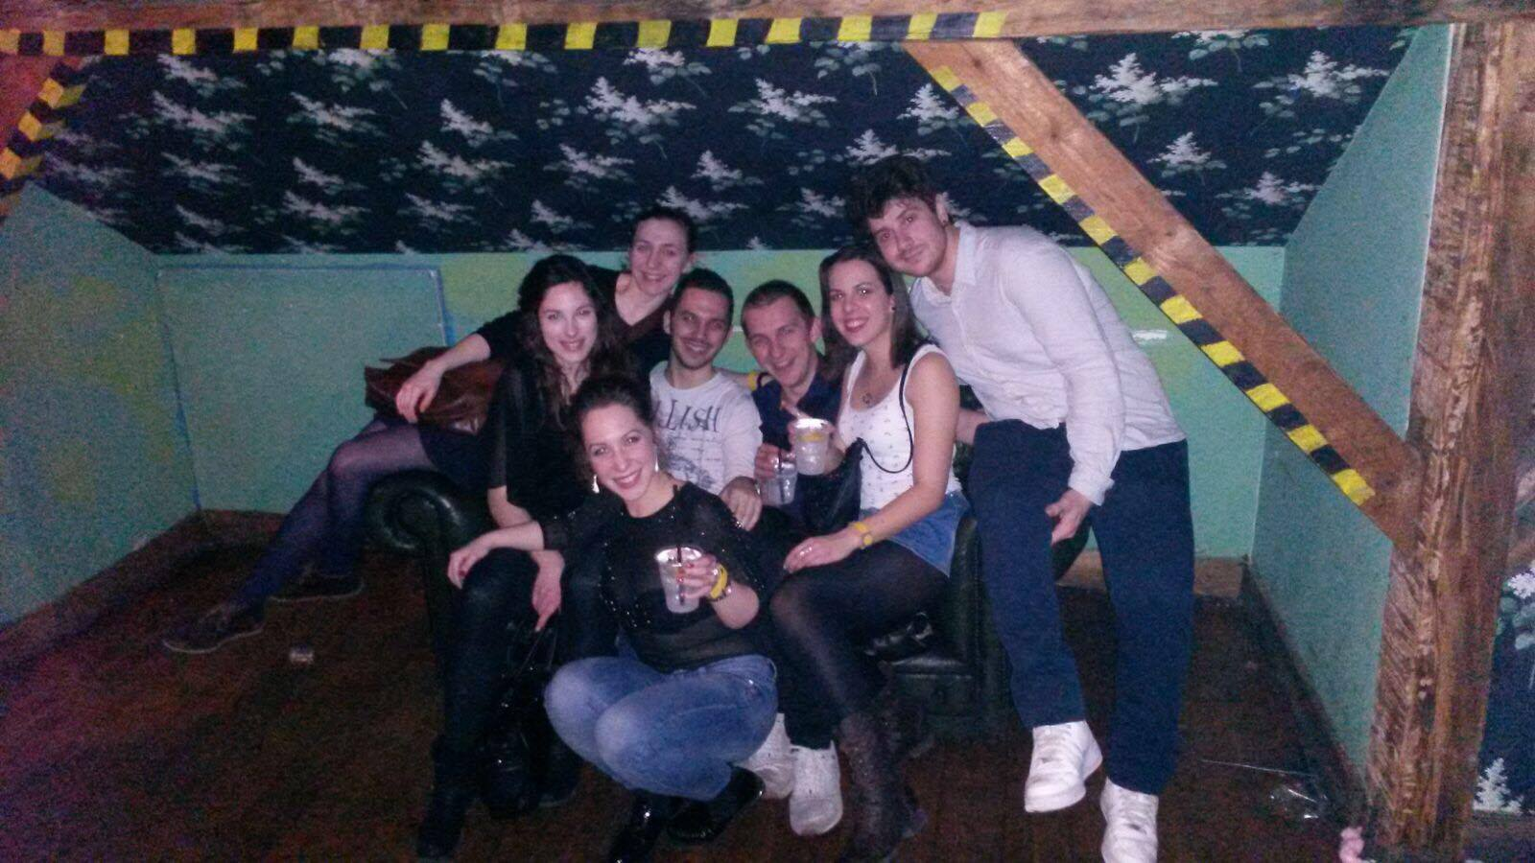
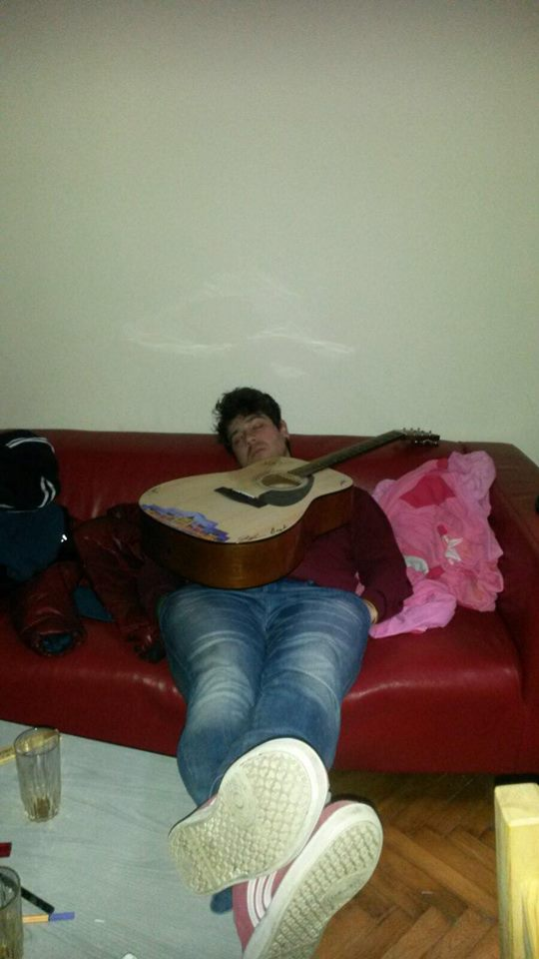
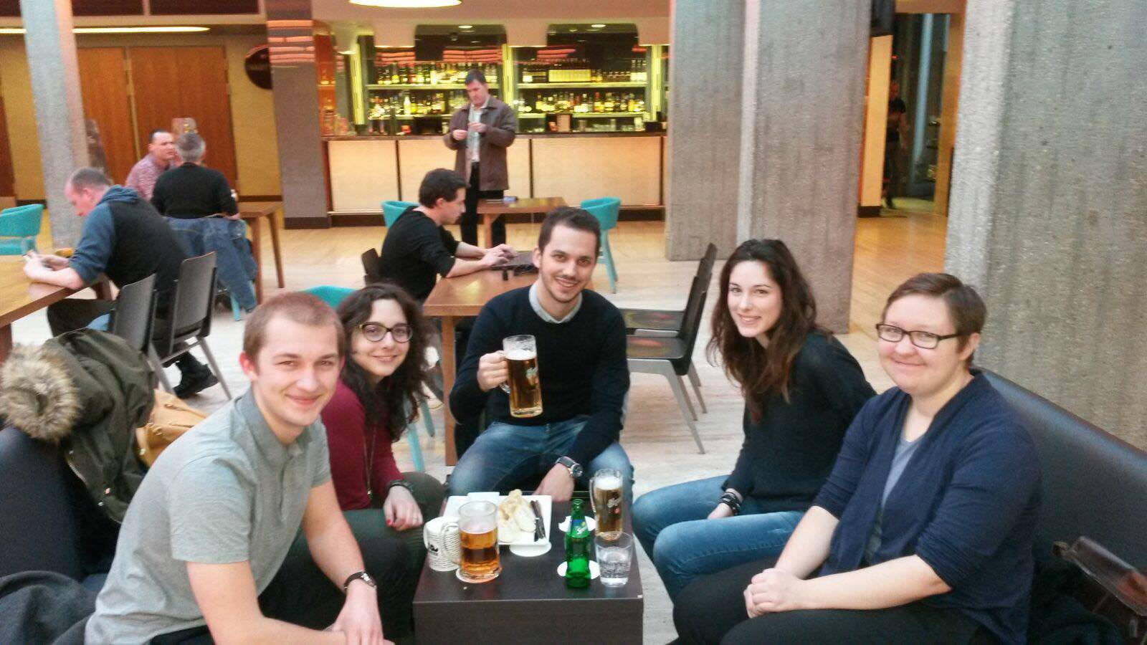
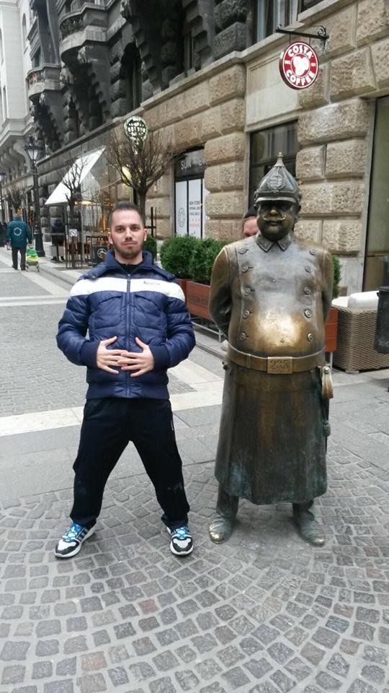

Slide 7
Zweite Woche…
A2: Geschichte der Lexikographie

Slide 8
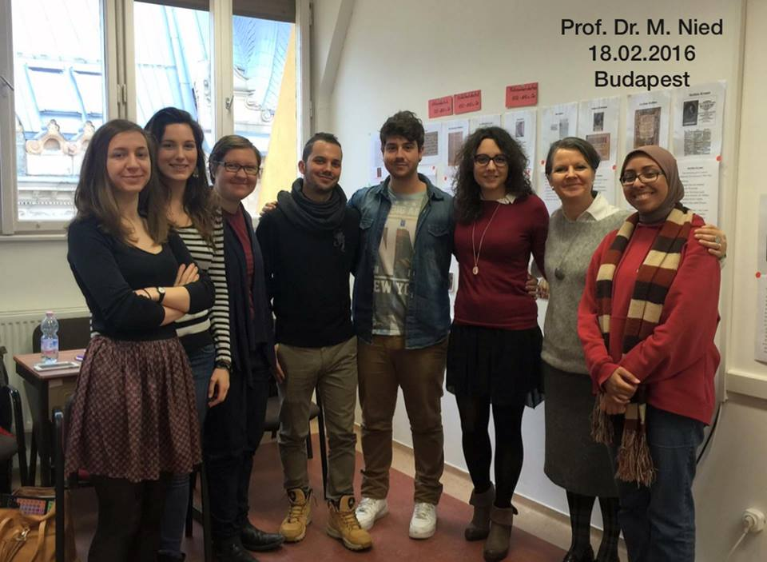
Martina Nied

Slide 9
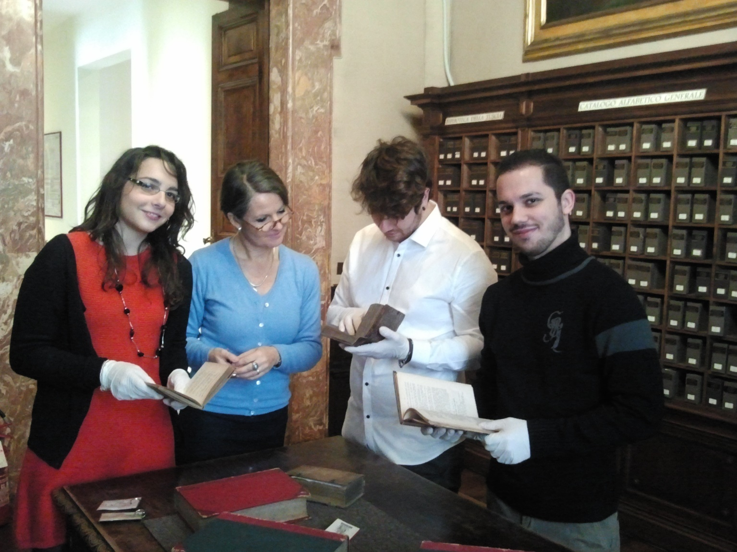
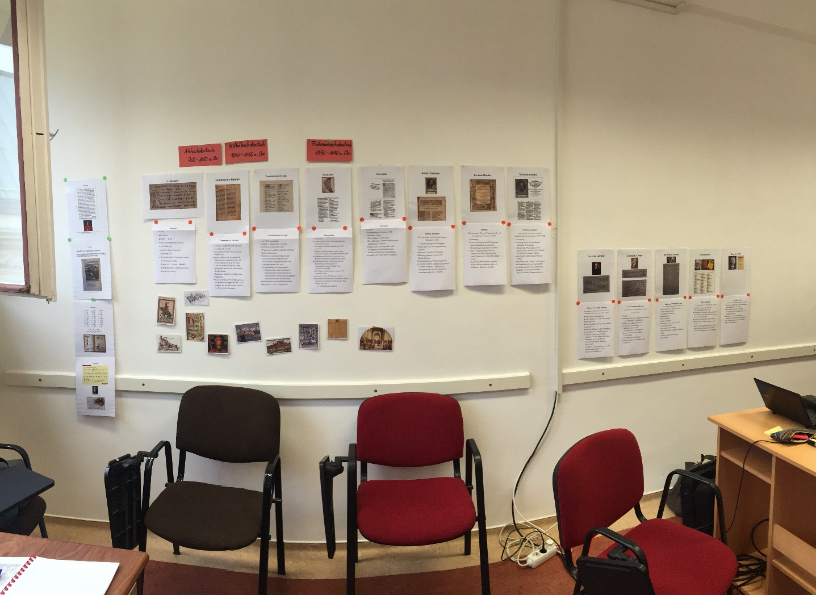
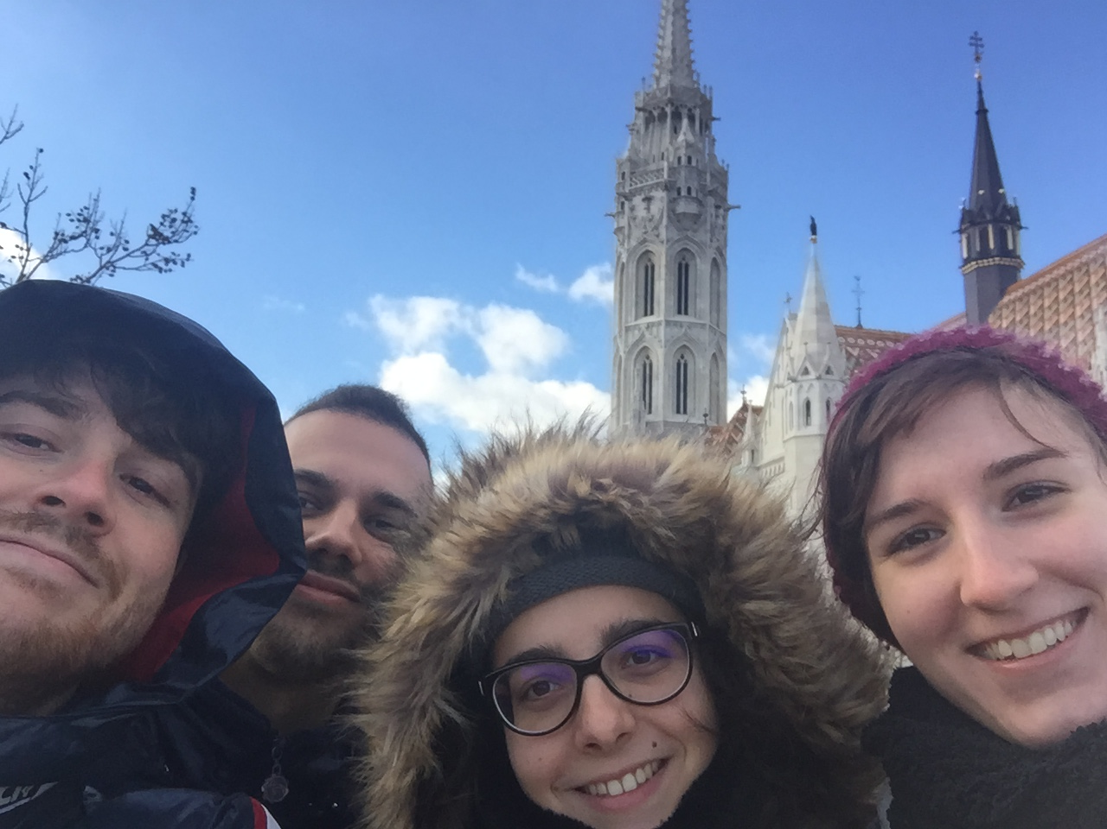
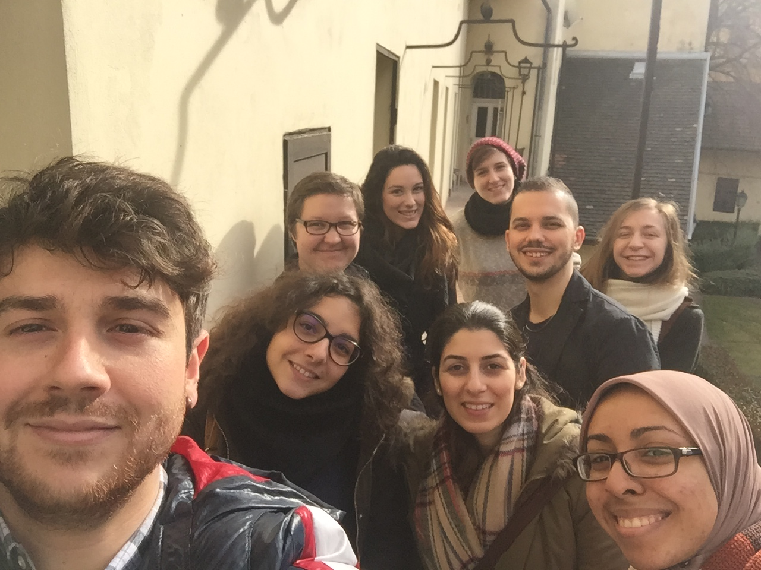
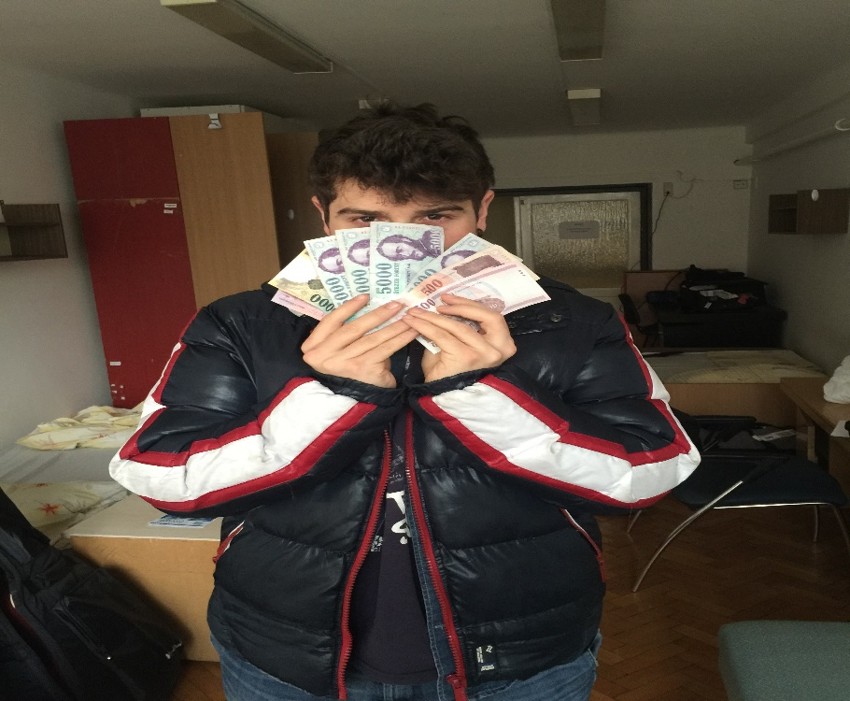

Slide 10
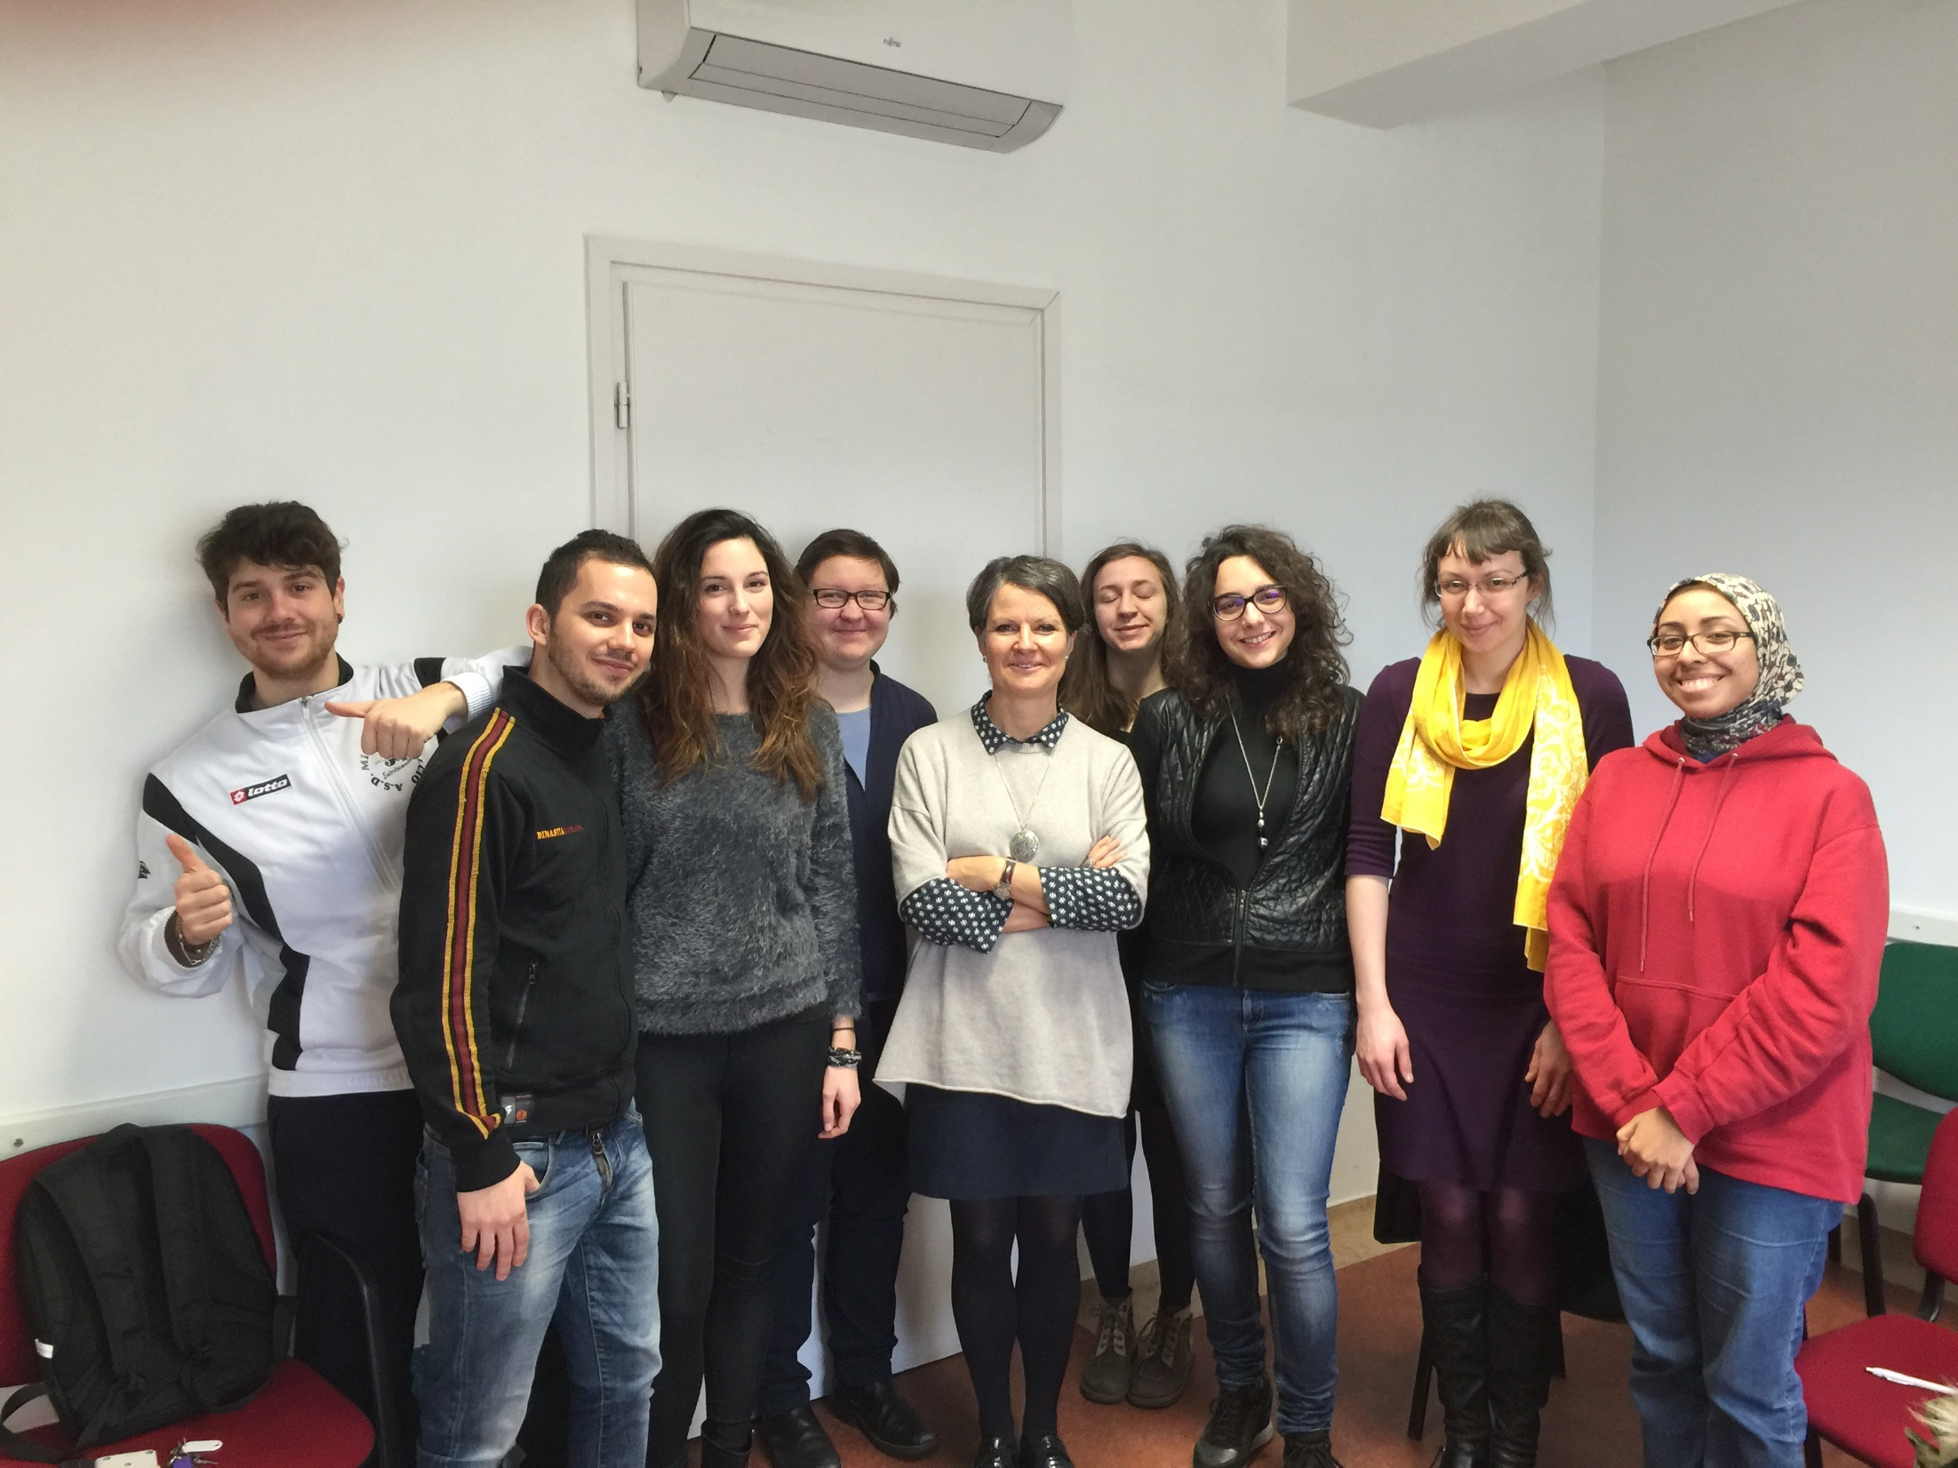
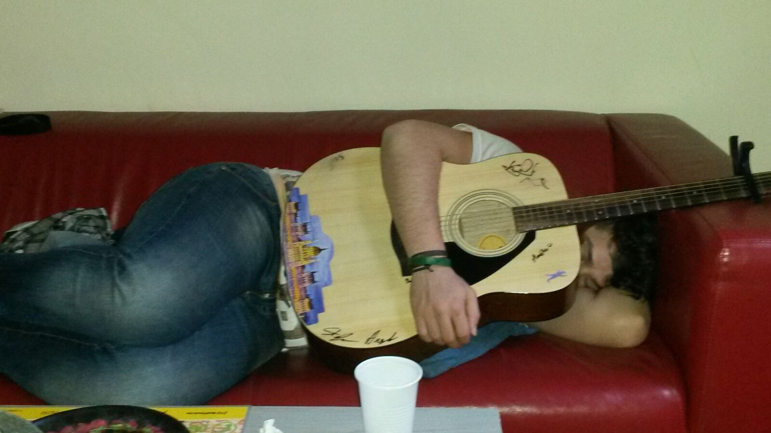
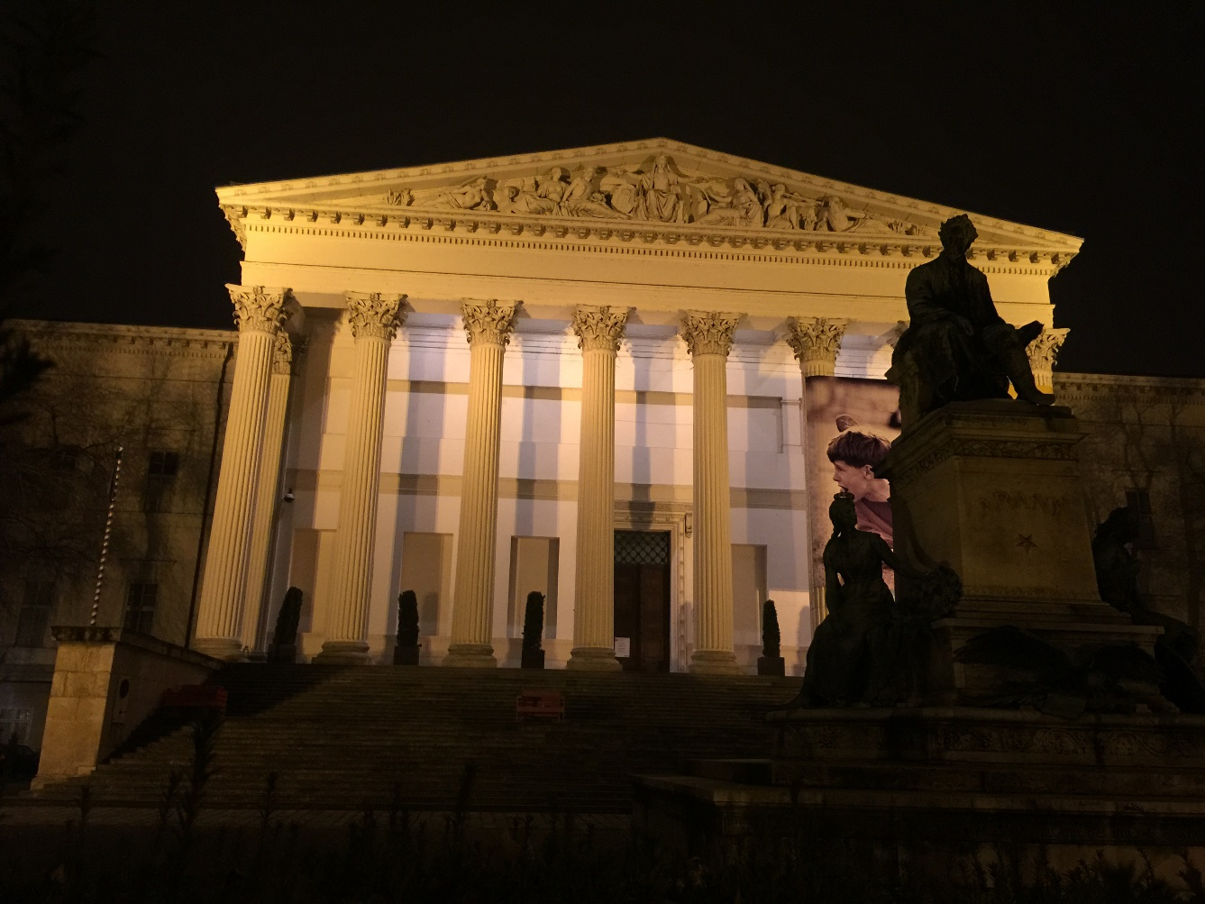
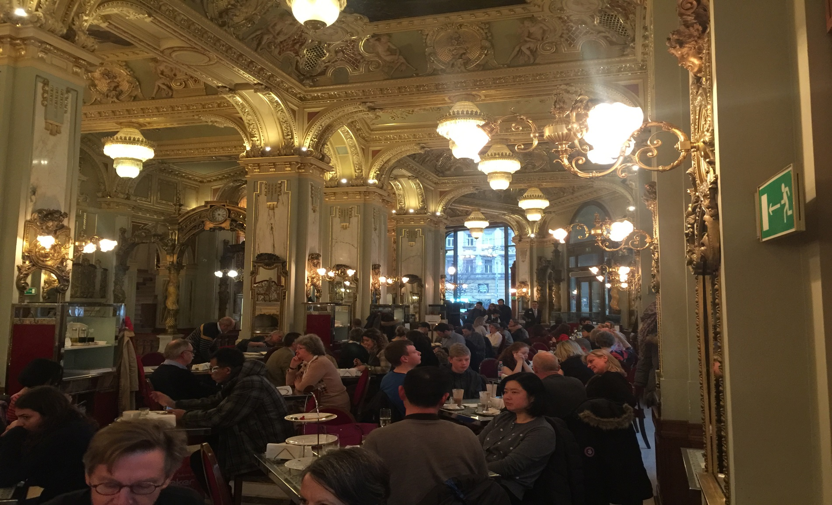
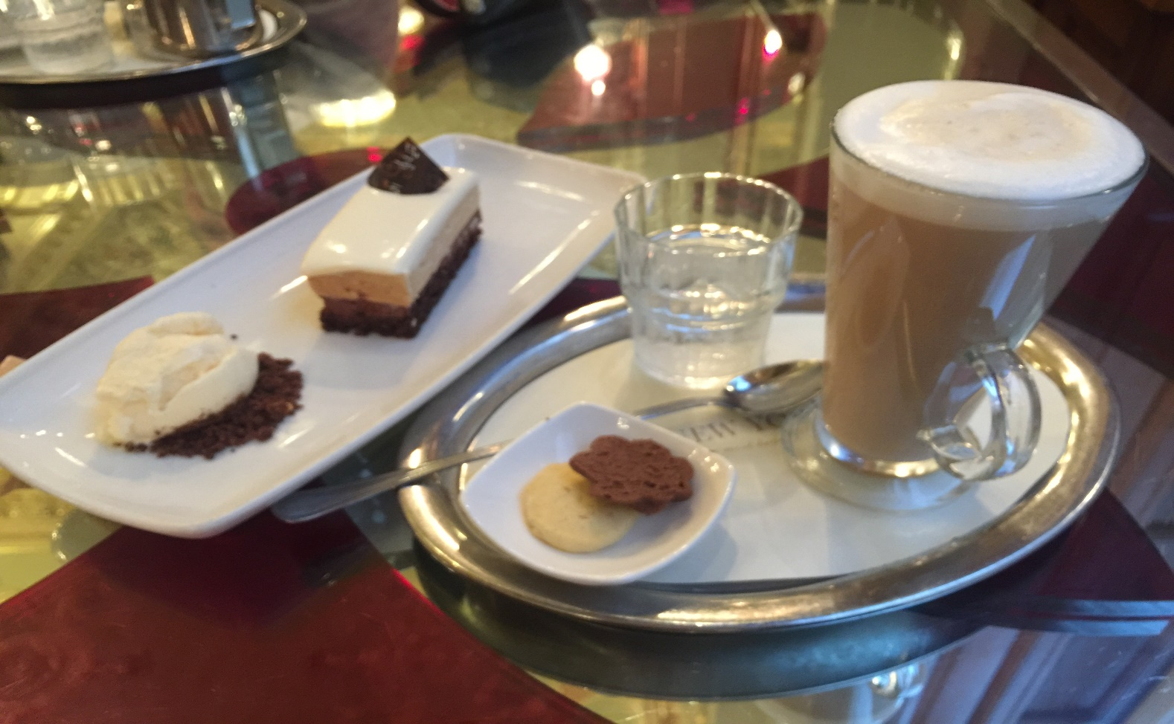
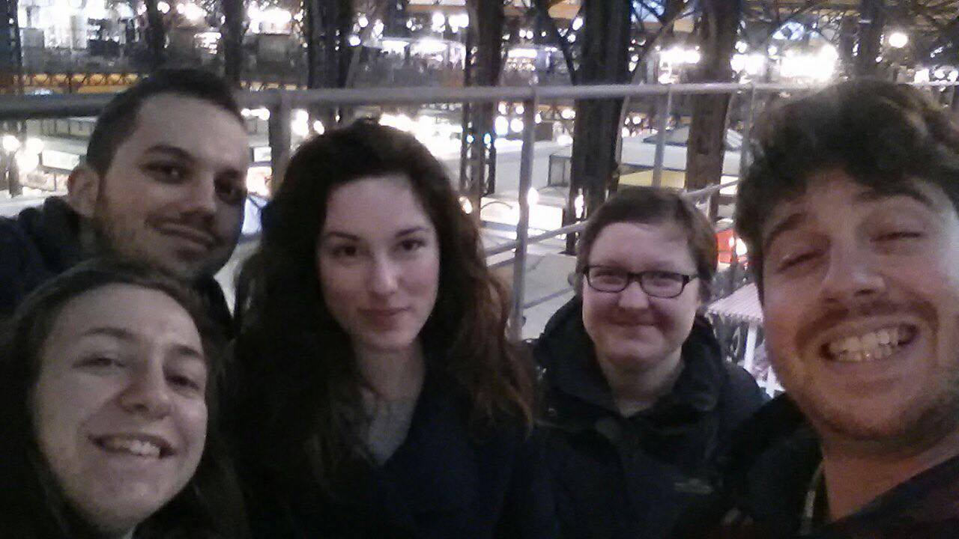

Slide 11
Dritte Woche…
A5: Fachwörterbücher

Slide 12
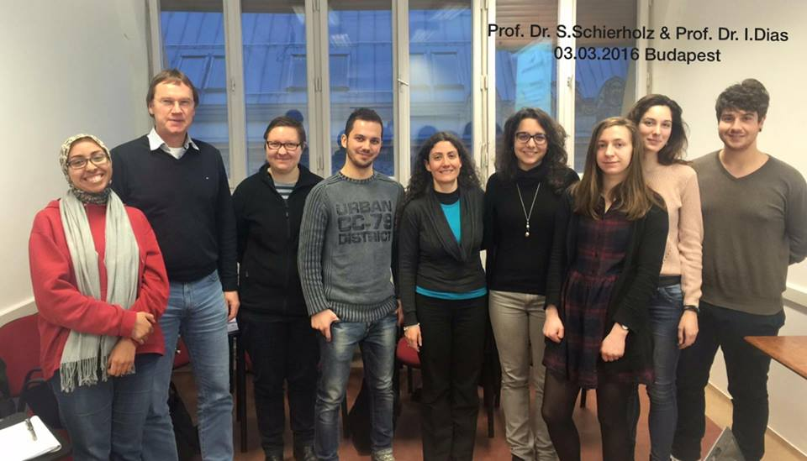
Stefan Schierholz & Idalete Dias

Slide 13
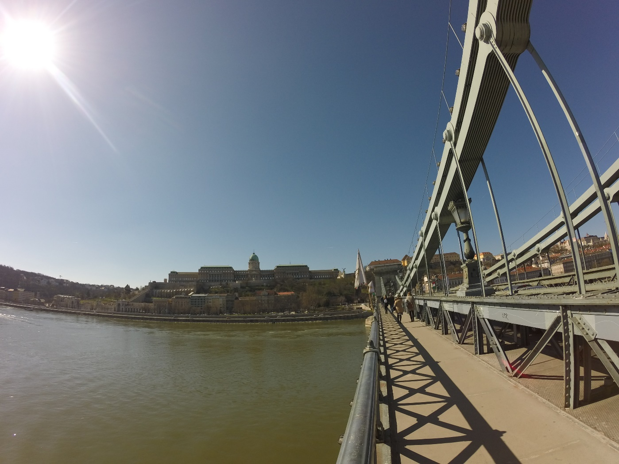
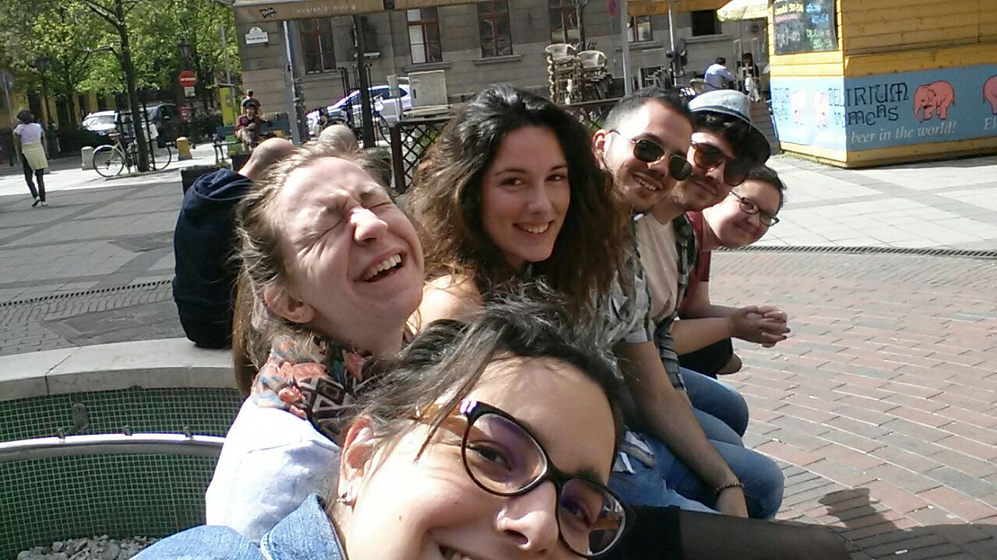
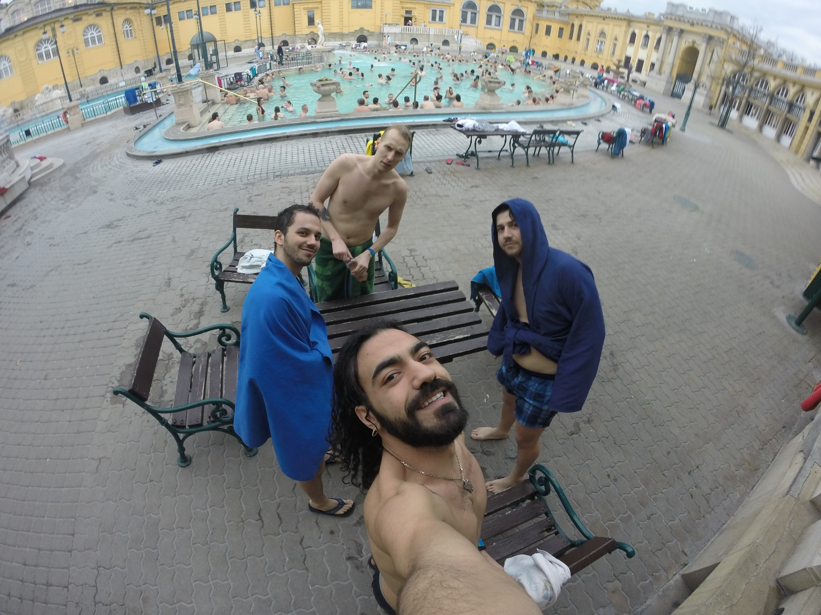
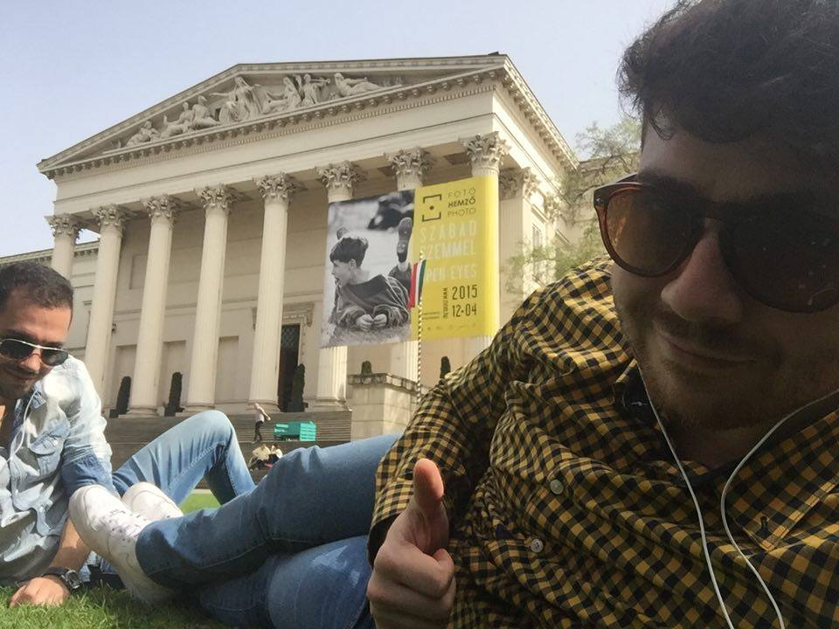
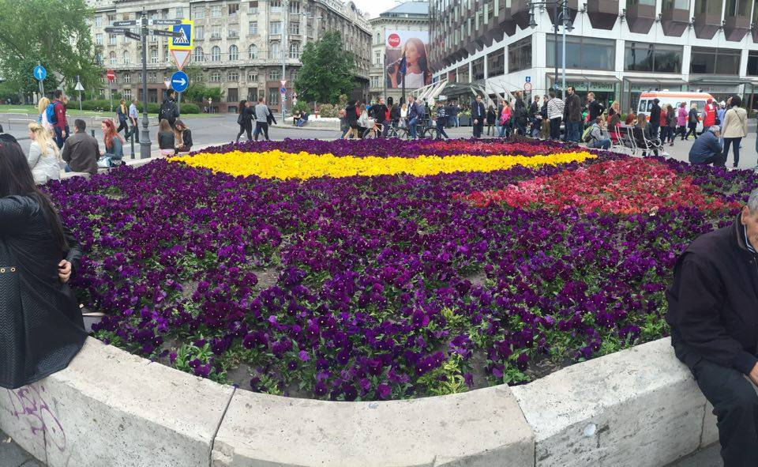

Slide 14
Vierte Woche…
A9: Planning and making a dictionary

Slide 15
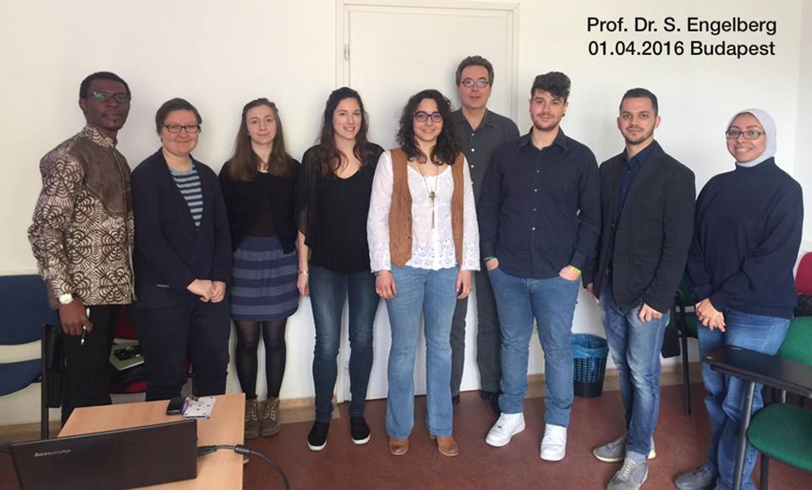
Stefan Engelberg

Slide 16
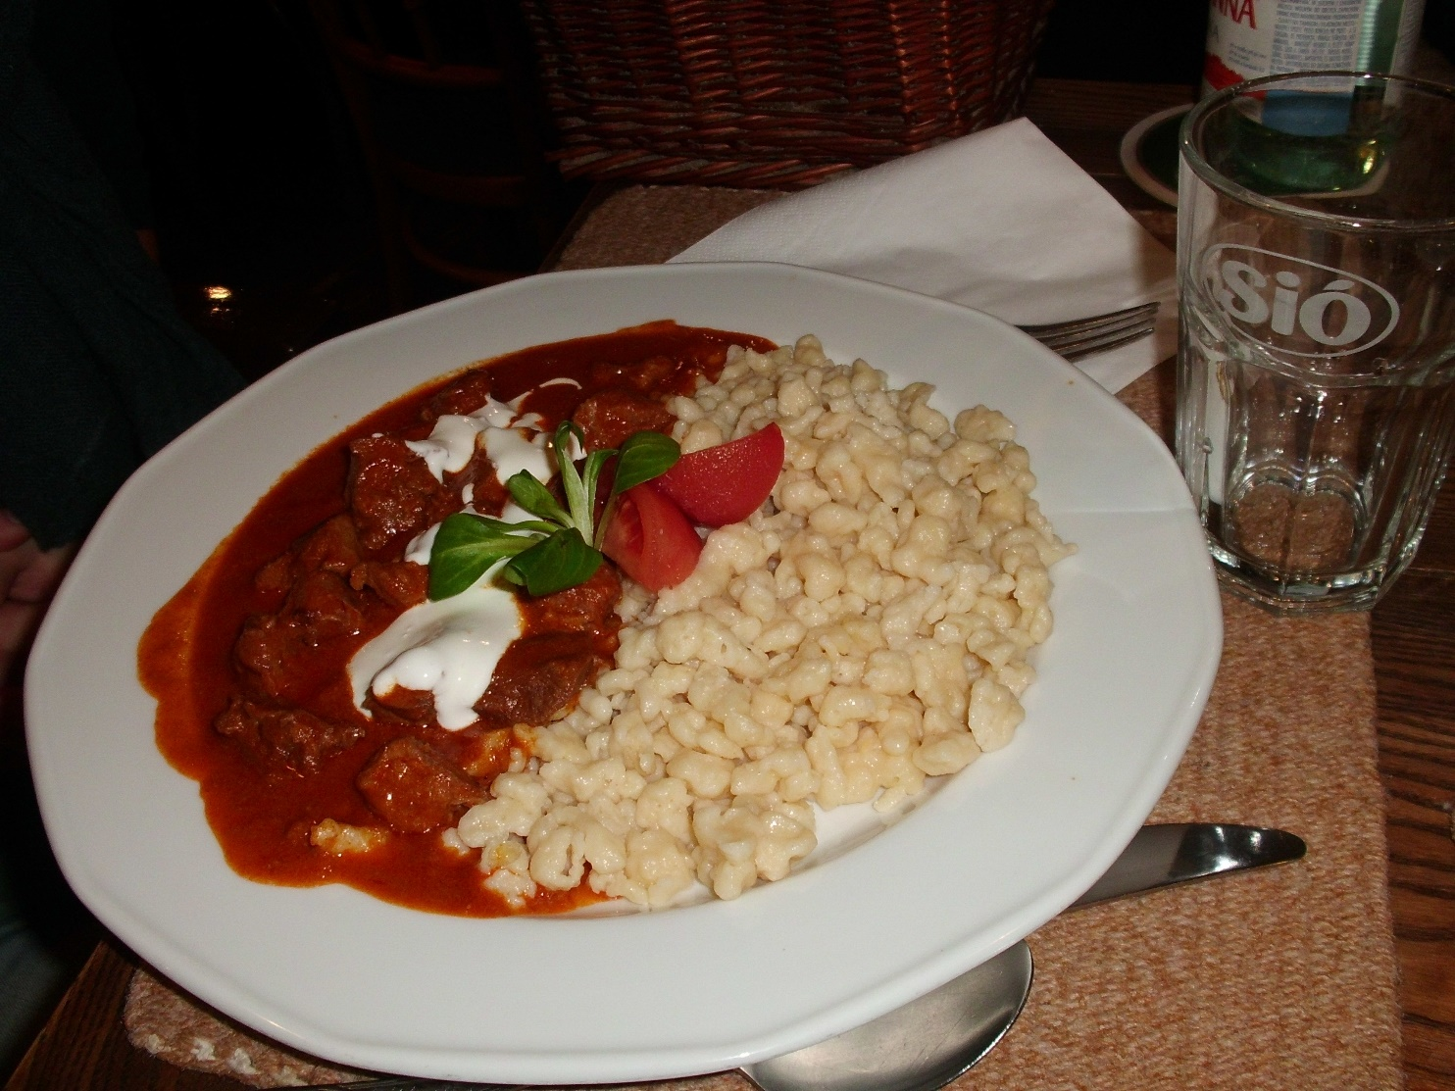
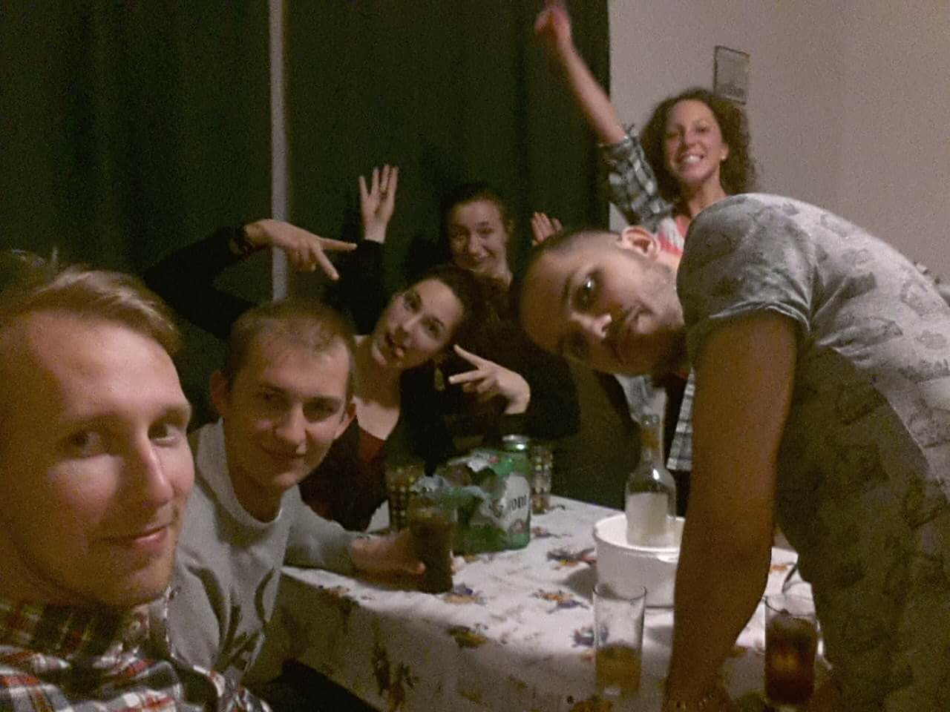
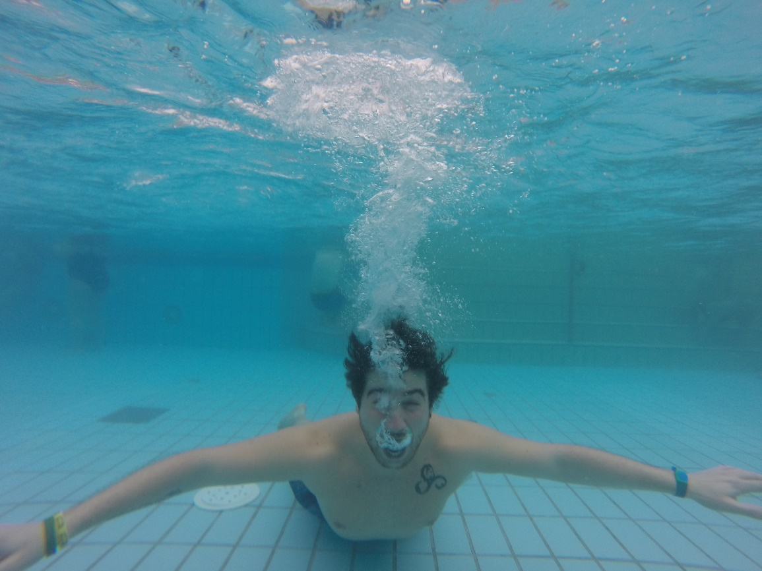
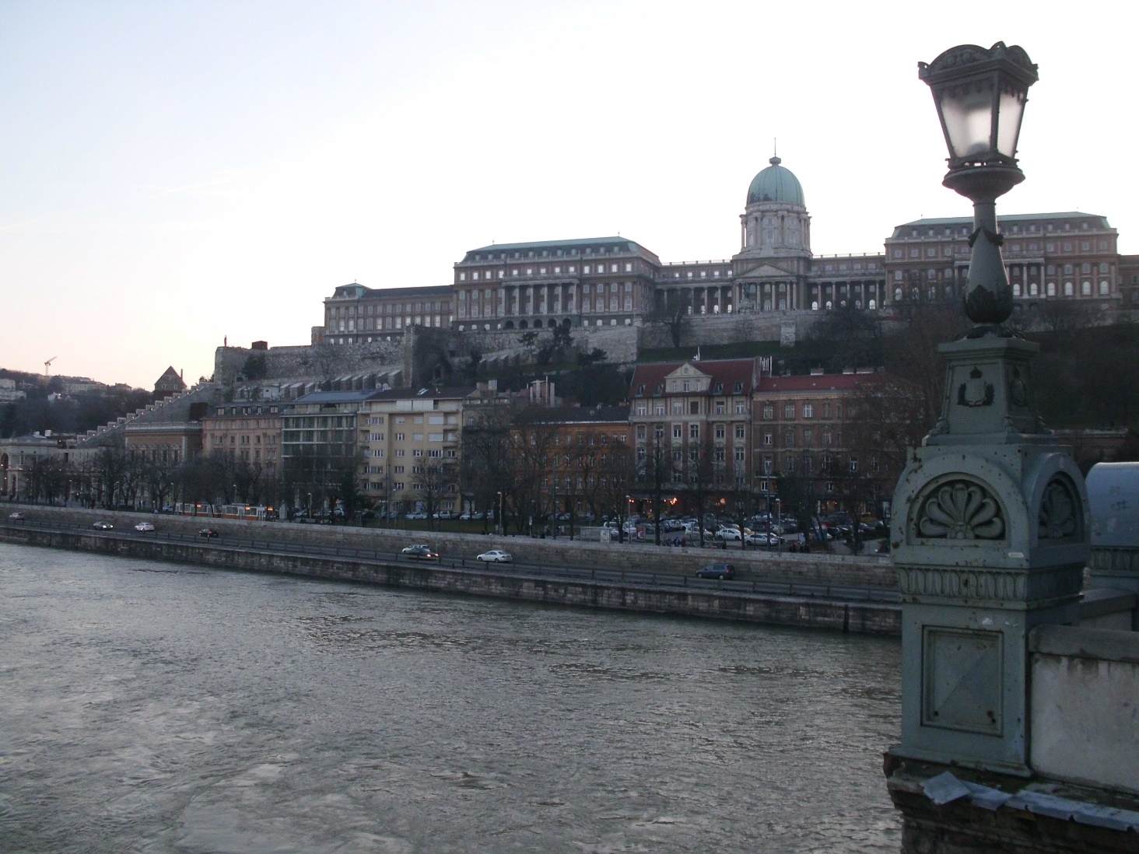
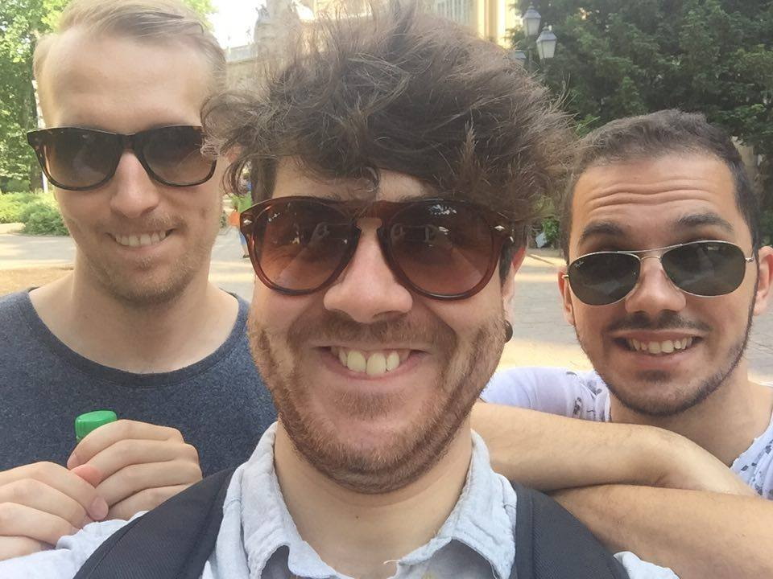
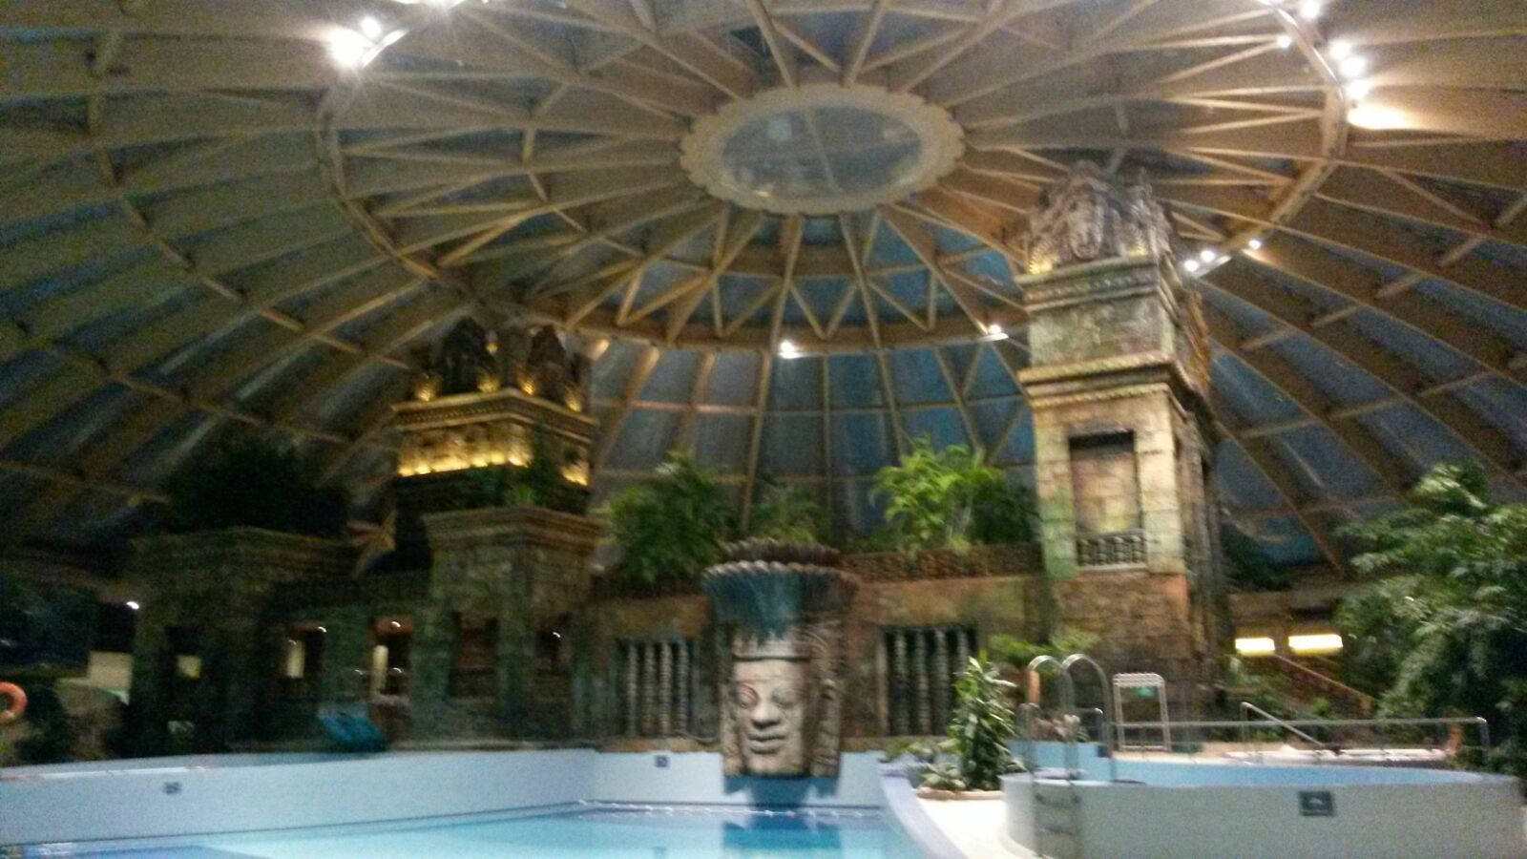

Slide 17
Fünfte Woche…
A4: The dictionary and its use

Slide 18
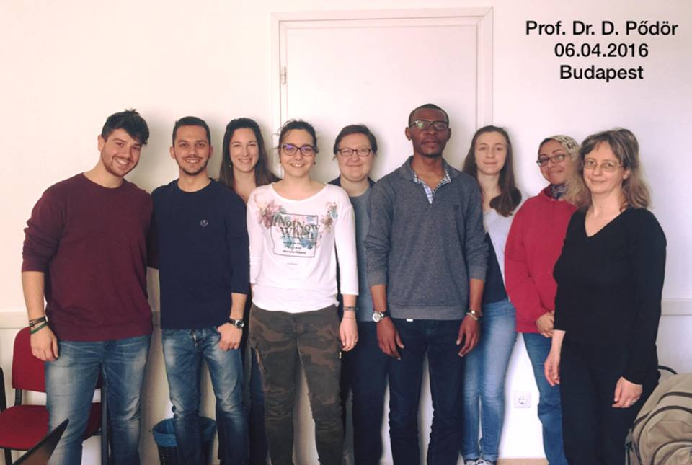
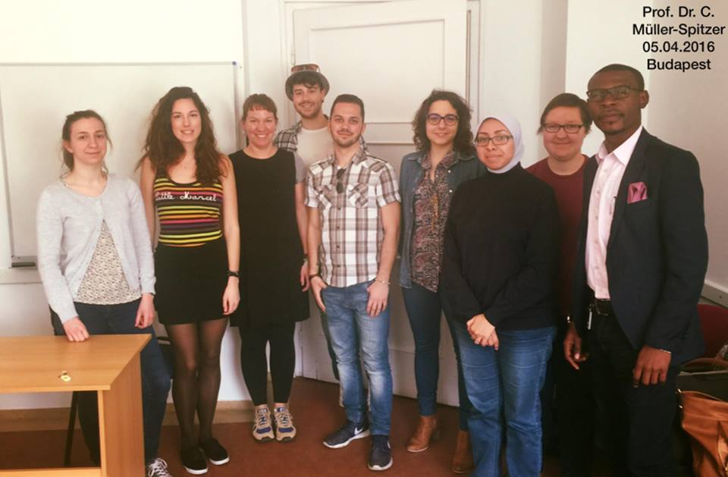
Carolin Müller-Spitzer & Dora Pődör

Slide 19
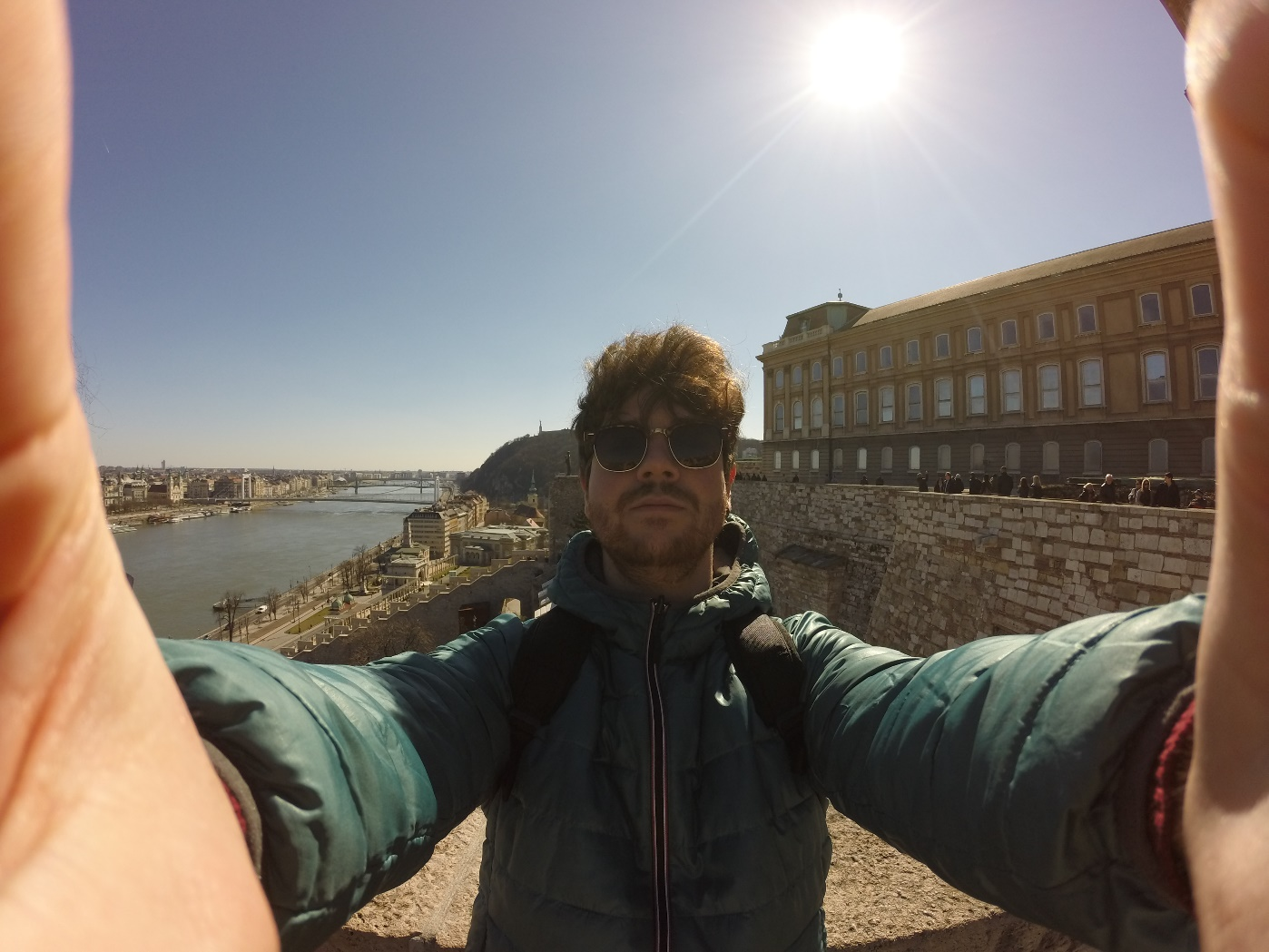
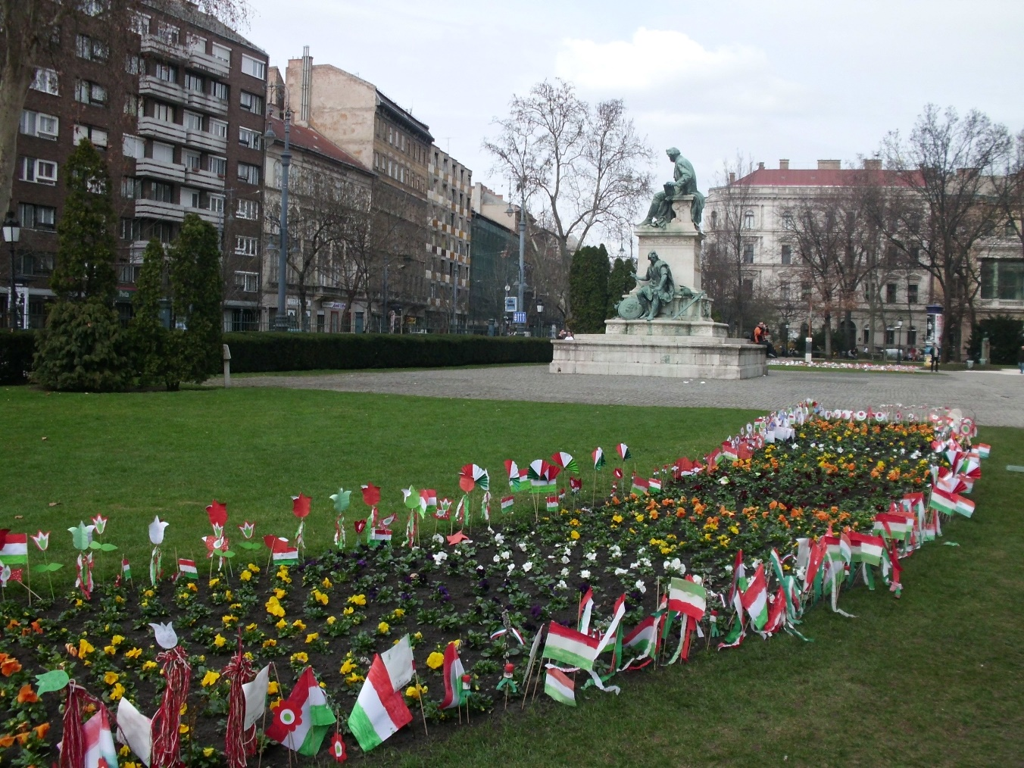
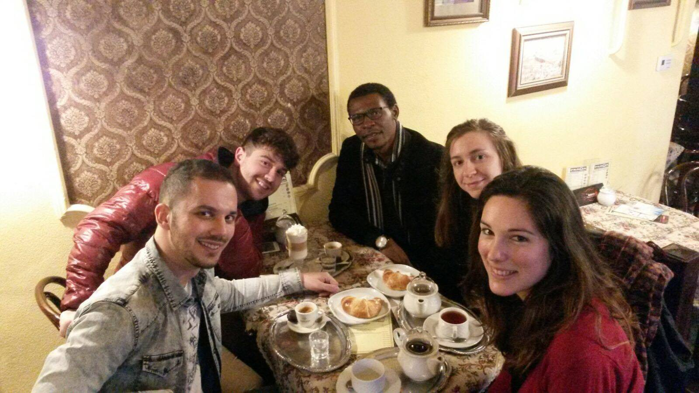
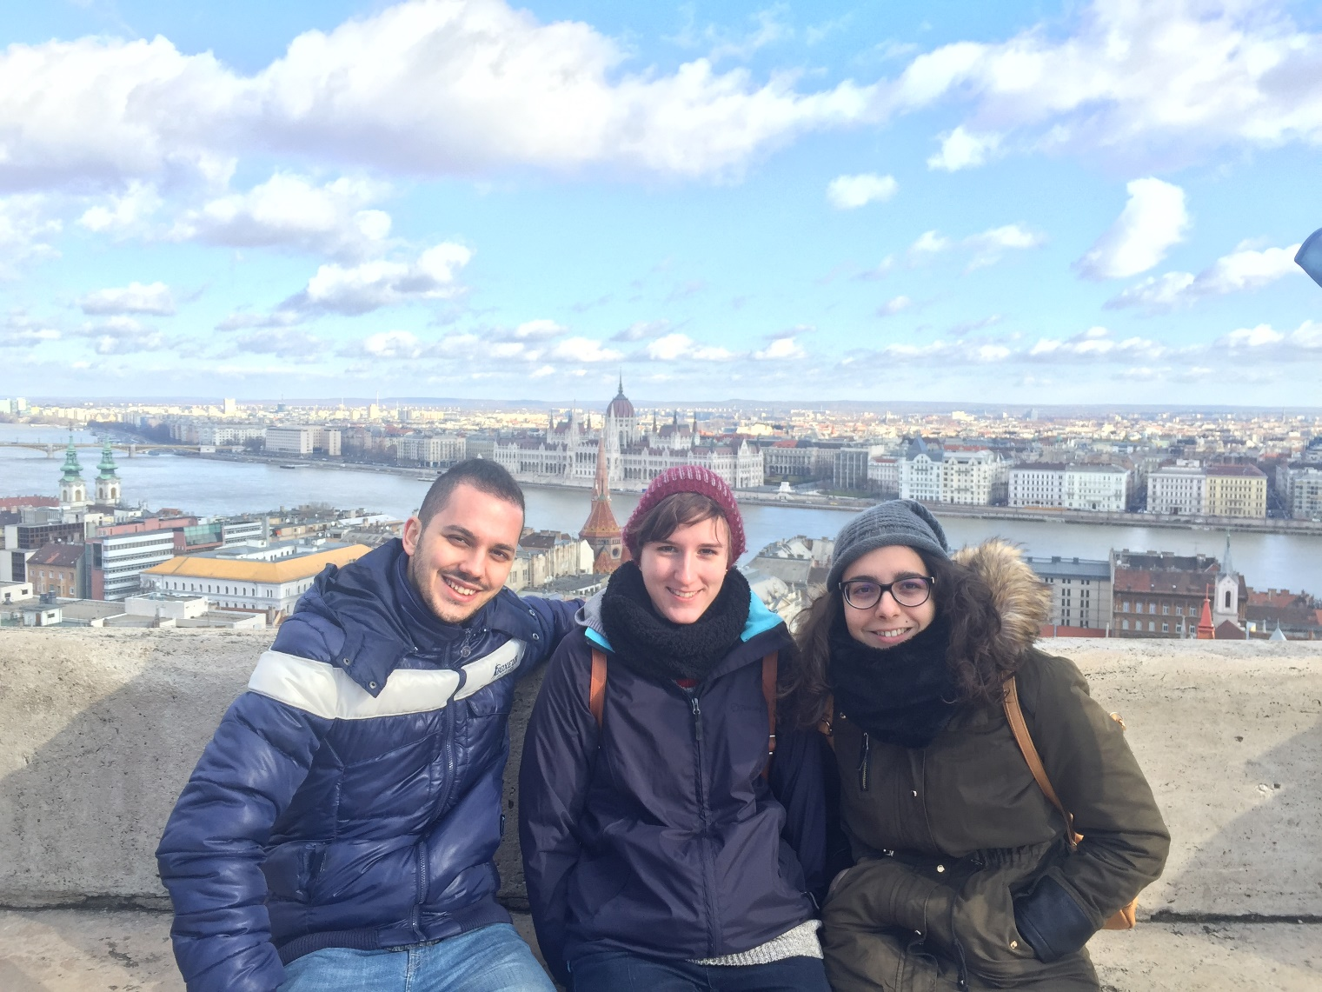
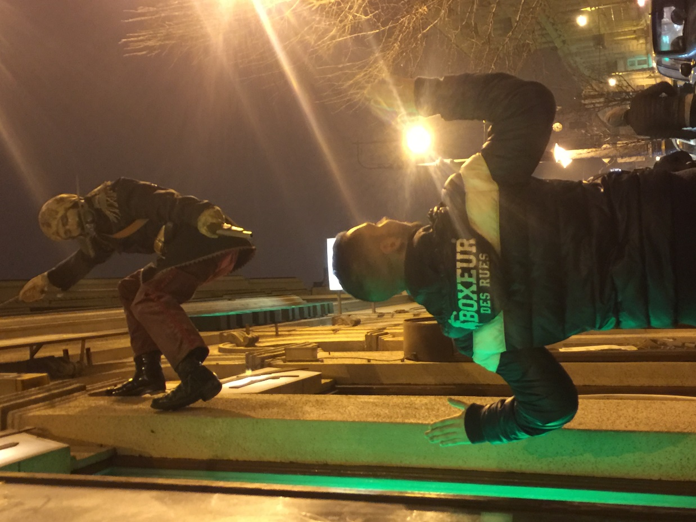

Slide 20
Sechste Woche…
A6: Computational Lexikography

Slide 21
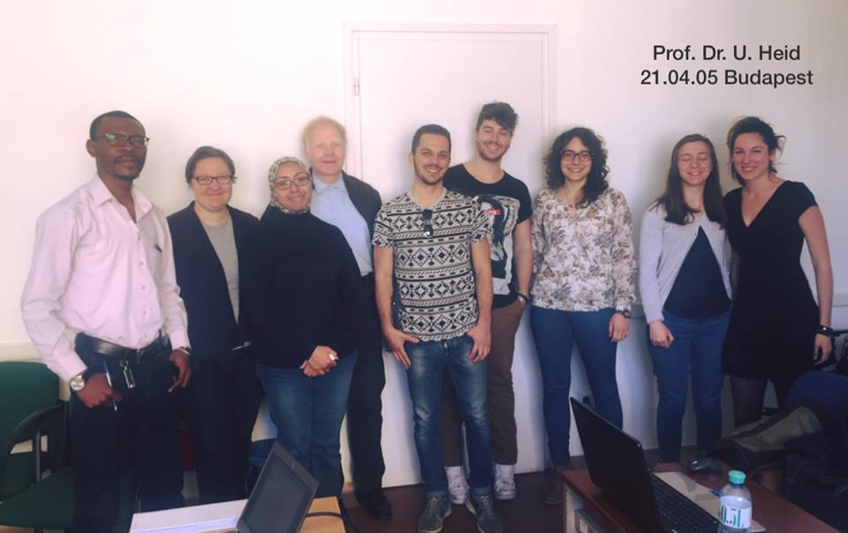
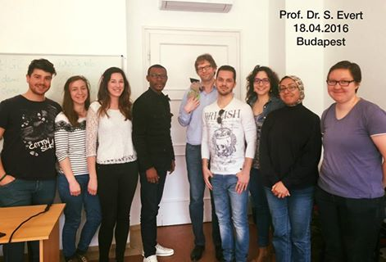
Stefan Evert & Ulrich Heid

Slide 23
Siebte Woche…
A7: Wörterbücher bei der Übersetzung

Slide 24
Maria J. Dominguez & Ewa Myrczek

Slide 27
Achte Woche…
A8: Lexicography and Lexicology

Slide 28
Eva Buchi & Carlos Valcárcel

Slide 30
Trip to Szentendre!

Slide 33
Neunte und letzte Woche…
A3: Lernerlexikographie

Slide 34
Monika Bielinska & Christina Sanchez-Stockhammer
Leider haben wir kein Foto mit
Ihnen gemacht!

Slide 36
“A beautiful city, amazing people, lovely professors and classmates. Thank you very much for having allowed me to live this EMLex experience “
Cristian Bianco
"Meeting people, building new enriching relationships, learning and sharing: a couple of things I really enjoy doing. EMLex is definitely a unique mixture of all that, for I learned as much as I enjoyed meeting and sharing with unique people from various countries and cultures”
Paul-Junior Dilubenzi
“You have never enough of seeing new places, meeting new people and having new experiences. That's all part of your constant searching for a place called home, and home is where the heart is”
Stefano Angelucci
“The European Master in Lexicography learned me a lot. It did not only bring me knowledge about Lexicography, it helps me to know me better, it makes me discover new perspectives, new beautiful landscapes and it allowed me to meet exceptional people. Thank you a lot for this semester in Budapest. It was an extraordinary experience”
Amélie Daloz
“My favourite part of the second EMLex semester was the variety of different classes, professors, teaching styles and opinions from all over the world. It was also great to be able to focus on one particular topic at a time, although it was quite intense and exhausting sometimes”
Anja Pfeiffer
“Emlex is a great experiment of friendship and cultural and linguistic meetings in the large field of lexicography”
Pauline Pierrot
“These five months have gone quickly, but have been gorgeous and amazing! I thank all EMLex professors for encoraging me to follow my purposes and improve my skills in lexicography. Budapest has been my second home, where I met new people and friends from different countries and I will leave a piece of my heart”
Flavia Monarchi
“Travelling, meeting professors and students from different countries, learning new languages, enjoying the interesting courses about lexicography,…For me,it was a wonderful adventure”
Yomna E. Abbass

Slide 37
Die Professoren
Dr. Prof. Stefan Evert
Dr. Prof. Ulrich Heid
Dr. Prof. Maria J. Domínguez
Dr. Prof. Ewa Myrczek
Dr. Prof. Eva Buchi
Dr. Prof. Carlos Valcárcel
Dr. Prof. Monika Bielinska
Dr. Prof. Christina Sanchez-Stockhammer
Dr. Prof. Rufus H. Gouws
Dr. Prof. Zita D. Hollós
Dr. Prof. Martina L. Nied
Dr. Prof. Stefan Schierholz
Dr. Prof. Idalete Dias
Dr. Prof. Stefan Engelberg
Dr. Prof. Carolin Müller-Spitzer
Dr. Prof. Dora Pődör

