Slide 1
Student’s Guide
to Thesis Topic Application
in Neptun
Budapest, 14 May 2020

Slide 2
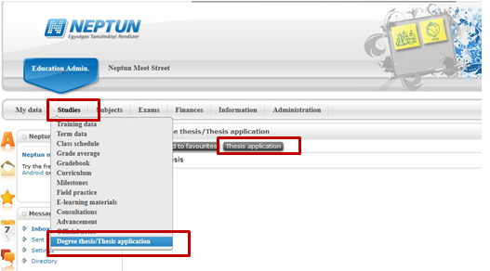
Step 1: Choosing a thesis topic
After entering the NEPTUN please click on Thesis Application in Studies -> Degree thesis/thesis application menu.

Slide 3
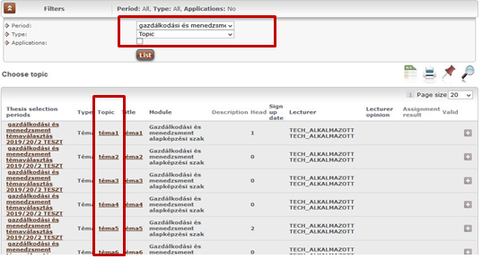
Step 2: Choosing a thesis topic – Selecting the period and type of the thesis application, listing of the thesis topics
After clicking on Thesis application a pop-up window will appear where you are requested to
select the Period of thesis application of the relevant training programme,
choose topic in Type field, and
click on List to indicate the specific topics of the thesis application period.

Slide 4
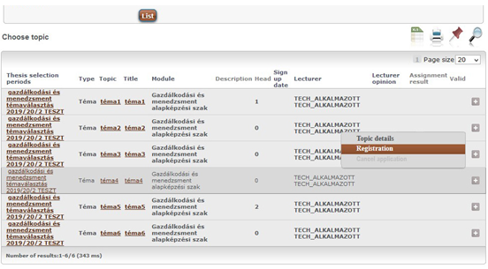
Step 3: Choosing a thesis topic – Application for thesis topic (1)
From the available topics choose the appropriate one, and by clicking on the + sign at the end of the row you can apply for the topic by choosing Registration.

Slide 5
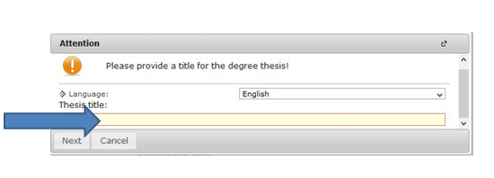
Step 4: Choosing a thesis topic – Application for thesis topic (2)
You may provide your proposed title for the thesis, if this opportunity has been set for the thesis application.
Then clicking on Next you can finalize your registration.

Slide 6
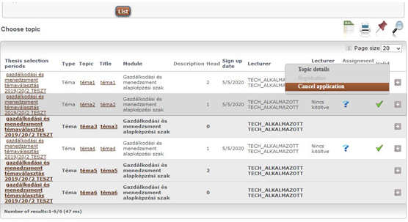
Step 5: Choosing a thesis topic – Cancelling the application
During the registration period you may deregister from the chosen thesis topic. Go to the selected thesis topic and click on the + sign at the end of the row, and in the pop-up menu select Cancel application.

Slide 7
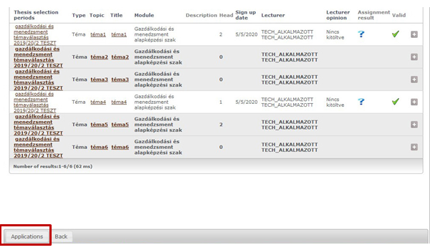
Step 6: Choosing a thesis topic – Finalizing the thesis application
Having selected the thesis topic please click on Applications.

Slide 8
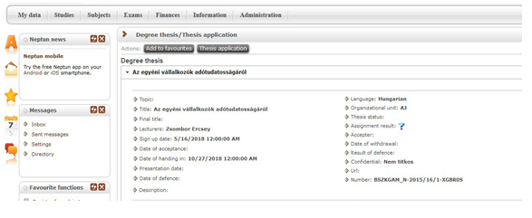
Step 7: Choosing a thesis topic – Thesis application data
If the thesis application is accepted by the organizational unit that announced the thesis topics the thesis application data will appear under Thesis application in Studies-> Degree thesis/Thesis application menu.

Slide 9
Should you have any problem during the thesis application, please contact your faculty at the following email address and attach the print screen of the error message:
Faculty of Law
ajk.tanulmanyi@kre.hu
Faculty of Humanities and Social Sciences
Dancs Beáta: dancs.beata@kre.hu
Faculty of Theology
florik.gyongyi@kre.hu
Faculty of Social Studies and Health Science
Budapest: tanulmanyi.osztaly.szek@kre.hu
Nagykőrös: tanulmanyi.osztaly.szek.nk@kre.hu
Faculty of Teacher Training
Budapest: tfk.szakdolgozatbp@kre.hu
Nagykőrös: tfk.szakdolgozatnk@kre.hu

