Slide 1
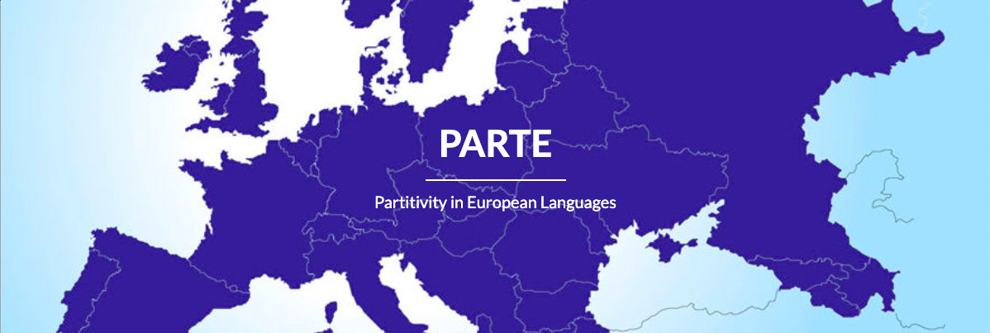
Tabea Ihsane, Olivier Winistörfer and Elisabeth Stark University of Zurich The spatial distribution of partitive articles and invariable DE in Francoprovençal
27 May 2022

Slide 2
Outline
1. Introduction
2. State-of-the-art
2.1 PAs vs. DE in Francoprovençal
2.2 PAs vs. DE in standard French
2.3 Our hypotheses
3. Data and Methodology
3.1 The data
3.2 The methods
4. Results and maps
5. Discussion
6. Conclusion
Research project "Distribution and Function of 'Partitive Articles' in Romance (DiFuPaRo): a microvariation analysis," (https://www.rose.uzh.ch/de/seminar/wersindwir/mitarbeitende/stark/DiFuPaRo.html), directed by E. Stark and C. Poletto, funded by the Swiss National Science Foundation (project number 100012L_172751) and the Deutsche Forschungsgemeinschaft (project number: PO1642/8-1).

Slide 3
1. Introduction
Objectives of the presentation
Show the fine-grained spatial distribution of partitive articles (PA) and invariable DE in the Swiss and Aosta Valley (Italy) varieties of Francoprovençal (FrPr).
Show the spatial distribution of two morphosyntactic features:
the grammatical number of noun phrases with PAs (singular vs. plural)
the appearance of PAs and DE in certain syntactic contexts (for e.g., after quantifiers/quantity expressions like Fr. beaucoup ‘a lot’ and under the scope of sentential negation)
Better understand the Francoprovençal determiner system, especially in contrast to French, with which it is in close language contact.

Slide 4
1. Introduction
Main findings
The Francoprovençal varieties described in the literature as having PAs (FrPr A) and the ones without PAs but with an invariable DE (FrPr B) do not represent two sharply split geographic zones.
In the varieties with PAs (FrPr A), there is an implicational scale in the use of PAs in the different syntactic contexts we investigated.
In the varieties which mainly have invariable DE (FrPr B), the singular PAs and the plural PAs attested do not have the same distribution and, hence, need to be distinguished.

Slide 5
1. Introduction
Terminological note: Partitive Articles (PA)
Indefinite determiners indicating a mass reading in the singular and indefinite reading in the plural (specific and non-specific readings available in the plural only).
Historically, composed of a preposition (Carlier 2007) and the Latin ILLE: e.g., in French, de ‘of’ + allomorph of definite article (with a morphological distinction in gender and number), forming du/de la/de l'/des 'of.the'.
Nominal phrases with a PA are comparable to bare nouns in other languages (e.g., English, German):
(1) a. J’ai acheté du lait. ‘I bought (some) milk.’
b. J’ai acheté des fraises. ‘I bought (some) strawberries.’

Slide 6
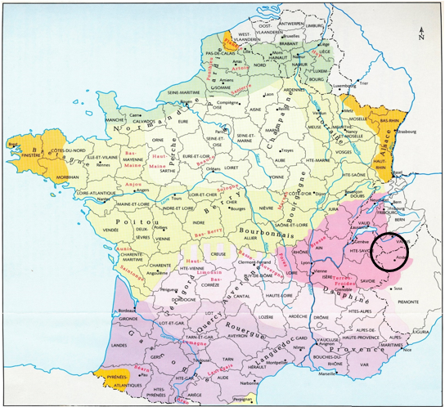
2. State-of-the-art 2.1 PAs vs. DE in Francoprovençal
What is Francoprovençal?
Non standardised Gallo-Romance language (Kristol 2016)
Highly endangered language: 110’000 to 160’000 speakers in France, Switzerland and Italy (Zulato, Kasstan & Nagy 2018:13)
At the crossroads between e.g., Italian Dialects (like Piedmontese), Occitan and French
The varieties of FrPr under study: cf. circle on the map
Holtus, G./Metzeltin, M./Schmitt, C. (ed.) Lexikon der Romanistischen Lin­guistik, vol. V.1 (Tübingen 1990)

Slide 7
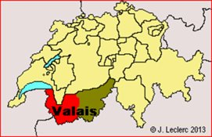
2. State-of-the-art 2.1 PAs vs. DE in Francoprovençal
2 types of FrPr varieties (Kristol 2016):
FrPr A:
Roughly in the north: Western varieties of the Valais (Switzerland)
and the Northern varieties (in France and Switzerland)
With PAs, etymologically de + definite article (with gender/
number distinction), also after the negative particle and
quantifiers, cf. (3)
FrPr B:
Roughly in the south: Southern varieties spoken in France, the
Eastern varieties in the Swiss canton of Valais and in the Aosta ITALY
Valley in Italy FRANCE
No PA per se but a grammaticalized preposition: invariable DE

Slide 8
2. State-of-the-art 2.1 PAs vs. DE in Francoprovençal
PA in FrPr A
With singular mass and plural indefinites, like French
(2)
Kristol 2016: 358
After sentential negation and quantifiers, unlike French
(3) a.
Adapted from Kristol 2014: 40
b.
Stark/Davatz 2021:3

Slide 9
2. State-of-the-art 2.1 PAs vs. DE in Francoprovençal
Invariable DE in FrPr B
(4)
Stark/Gerards 2020: 304

Slide 10
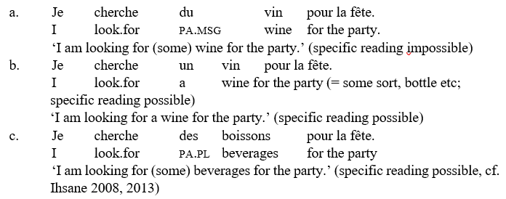
2. State-of-the-art 2.2 PAs and DE in standard French
Functional relation between singular and plural PAs
(5)
Semantics: suggests that du_{SG}– des_{PL} do not form a paradigm: mass-count interpretation, (non-)specificity (cf. Anscombre 1996, Cardinaletti/Giusti 2016 for Italian dei).
Morphology and diachrony: suggest a paradigm du_{SG}– des_{PL} (PAs: fusion of the preposition de ‘of’ plus demonstrative/definite article, see Carlier 2007);(cf. Galmiche 1986, Kupferman 1998).

Slide 11
2. State-of-the-art 2.2 PAs and DE in standard French
Three relevant syntactic contexts
PAs and DE are in complementary distribution in indefinite nominals:
When they introduce a noun phrase (as determiners):
(6) Jean achètera du/*de vin. ‘Jean will buy (some) wine.’
After a quantifier (beaucoup 'a lot', peu 'a little/few'):
(7) Jean achètera beaucoup *du/de vin. ‘Jean will buy a lot of wine.’
In the scope of a negative particle (pas 'not')
(8) Jean n'achètera pas *du/de vin. ‘Jean won't buy (any) wine.’
Strong contrast between the constructions with quantifiers/negative particles in (7)-(8) and the one in (6): the former take DE (not PAs), whereas the latter takes PAs (not DE).

Slide 12
2. State-of-the-art 2.3 Our hypotheses
Hypothesis 1:
We find PAs only in the Francoprovençal A area, including in constructions with quantifiers and negative particles.
Hypothesis 2:
Plural and singular PAs do not form a paradigm and thus show a different spatial distribution.

Slide 13
3. Data and Methods 3.1 The data
DiFuPaRo database (https://difuparo.linguistik.uzh.ch/): around 20’000 NPs
structured around ‘partitive nominal groups’
tagging of 83 different morphosyntactic features (e.g., nominals marked by a PA, tagged for syntactic function, gender, number, case; occurring with a quantifier, with a sentential negation, etc.)
Data from three existing databases: 16'308 noun phrases
ASIt (http://svrims2.dei.unipd.it:8080/asit-enterprise/ ) for the Northern Italian Dialects
ALAVAL (http://alaval.unine.ch/) for Francoprovençal
OFROM (http://www11.unine.ch/) for colloquial Swiss French
Data from fieldwork, gathered with/in different methods/discourse types (e.g., free speech, grammaticality judgment tasks, and translations/questionnaires): 3'564 noun phrases
In Northern Italian Dialects
In Francoprovençal: 1'639 noun phrases:
in 2017 in the Aosta Valley (see Stark/Gerards 2020)
in 2019 in Evolène (see Davatz/Ihsane/Stark accepted)
For our study: 2'608 FrPr nominal phrases

Slide 14
3. Data and Methods
3.1 The data
Different (sub-)samples for spatial analyses (here only data from questionnaires)
All nominal groups (2,608 nominals)
Nominal groups in positive contexts, without quantifiers (1,744)
Nominal groups in positive contexts with quantifiers (420)
Nominal groups in negative contexts, without quantifiers (413)
Nominal groups in negative contexts with quantifiers (31)

Slide 15
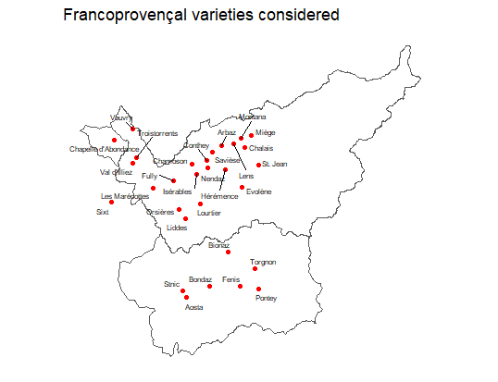
3. Data and Methods
3.1 The data - locations
30 Francoprovençal varieties
Aosta Valley (I)
Auvergne-Rhône-Alpes (F)
Valais (CH)
Different branches of Francoprovençal
Western Valais
Eastern Valais
Valdostean
At least 2 speakers (M+F) per location

Slide 16
3. Data and Methods
3.2 Methods - Spatial analyses
Dependent variables
Absence/ presence of partitive article (relative frequency)
Phonologically overt number marking vs. null number marking on noun (relative frequency)
Independent variables
Number (SG vs. PL)
Gender (M vs. F)
Calculation
Mean of phenomena per location (mean of all speakers’ mean)
Graphic representation (in Rstudio)
Voronoi polygons
Grey (0%), tomato red (highest relative value)

Slide 17
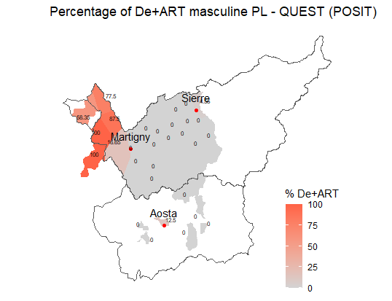
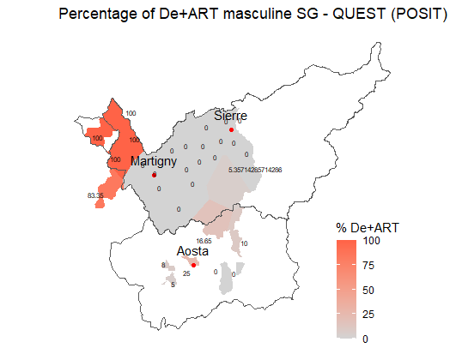
4. Results and maps
Relative frequency of PA with M
Map 1. PA with M.PL (POS).
Map 2. PA with M.SG (POS)

Slide 18
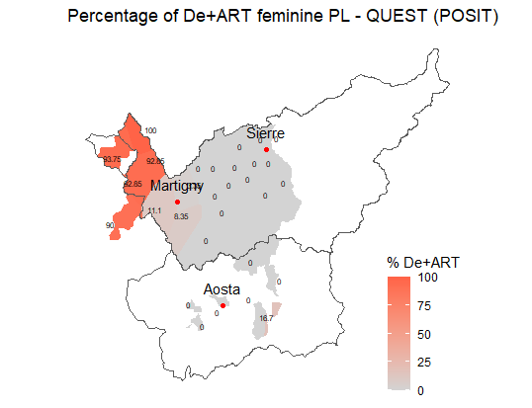
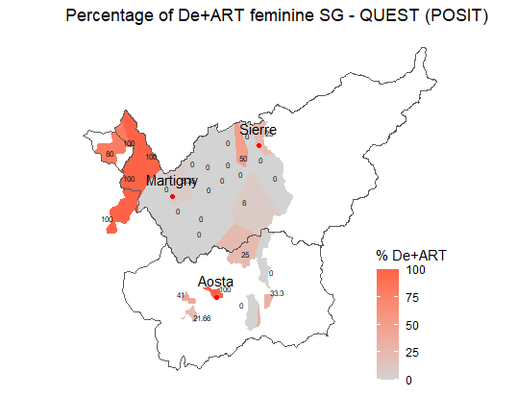
4. Results and maps
Relative frequency of PA with F
Map 3. PA with F.PL (POS).
Map 4. PA with F.SG (POS).

Slide 19
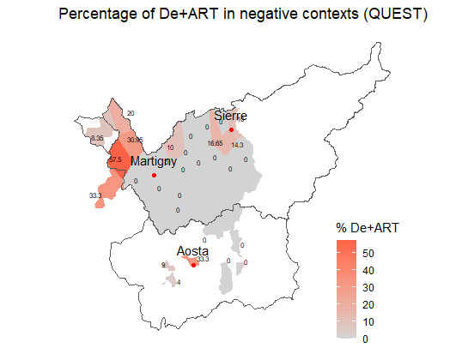
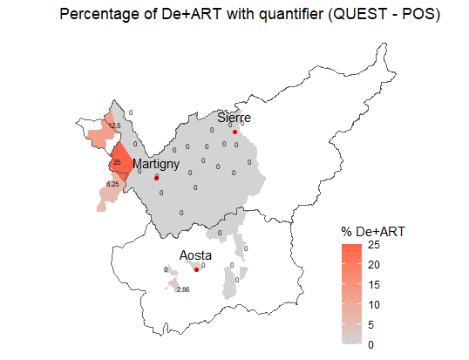
4. Results and maps
Relative frequency of PA with negative particle and with a quantifier
Map 5. PA with negative particle.
Map 6. PA with quantifier (POS).

Slide 20
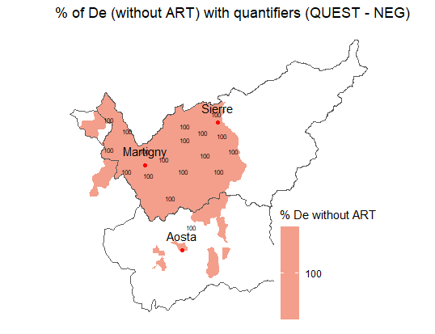
4. Results and maps
Relative frequency of invariable DE with quantifier and negative particle
Map 7. PA with quantifier and negative particle.

Slide 21
5. Discussion – Hypothesis 1
Dependent variable: Absence/ presence of PAs
Morphosyntactic features
1 area in which PAs are prevalent: west-most part of Valais (Troistorrents, Vauvry, Val d’Illiez) and the two data points in France (Chapelle d’Abondance and Sixt) = Kristol’s Francoprovençal A area
However, no sharply-split geographic zones, with PAs and without PAs: more nuanced picture than Kristol's FrPr A and FrPr B varieties (2014, 2016), cf. Stark/Davatz 2021:
In the FrPr A area, the distribution of PAs is not homogeneous; it depends on the syntactic context in which PAs occur (positive, negative, with a quantifier), and DE is used in inverse proportions to PAs;
In the FrPr B area, PAs are used in some varieties, although not predominantly, and their distribution depends on the number of the nominal group (singular vs. plural) in which they occur.

Slide 22
5. Discussion – Hypothesis 1
∼
Dependent variable: Absence/ presence of PAs
Morphosyntactic feature: Syntactic contexts
In the FrPr A area
Predominance of PAs only in the positive constructions without quantifier (∼ 80-100%,1 exception).
In sentences with a negative particle and in sentences with a quantifier: PAs and DE are both attested:
Example: Val-d'Illiez, where PAs are the most used in the FrPr A area:
In sentences with both a negative particle and a quantifier: no PAs at all, only DE
DE is used in FrPr A.
Notes:
Predominance of PAs only in the positive constructions without quantifier (around 80-100%, with only one lower percentage, 56.35% for the masculine plural in Chapelle d’Abondance).

Slide 23
5. Discussion – Hypothesis 1
∼
Dependent variable: Absence/ presence of PAs
Morphosyntactic feature: Syntactic contexts
In the FrPr A area
Val-d’Illiez: speakers use PAs in all three syntactic contexts
To its north and its south:
In positive sentences without a quantifier: PAs are used.
In negative sentences: PAs in a minority of cases (∼ 20-30%).
In positive contexts with a quantifier: no PAs (or very few in Sixt, 6%).
With both a negative particle and a quantifier: no PAs at all, only DE
Slightly different situation in Chapelle d'Abondance: fewer PAs both in contexts with a negative particle and those with a quantifier.
Implicational scale: if PAs in positive contexts with a quantifier, then PAs in negative contexts and in positive contexts without a quantifier.
Negative particles and quantifiers need to be differentiated; cf. Strebel 2022 for a similar conclusion on colloquial Swiss French (Strebel/Ihsane/
Stark 2022).
Map 5. PA with negative particle.
Map 6. PA with quantifier..
Notes:
Predominance of PAs only in the positive constructions without quantifier (around 80-100%, with only one lower percentage, 56.35% for the masculine plural in Chapelle d’Abondance).
The situation in Chapelle d’Abondance is slightly different, as speakers use PAs in positive contexts without quantifier (but somewhat less often with masculine plural nouns: 56.35%), and significantly less both with a negation (8.35%) and a quantifier (12.5%).

Slide 24
5. Discussion – Hypothesis 2 Example: feminine
Dependent variable: Absence/ presence of PAs
Morphosyntactic feature: Grammatical number of the nominal phrase
In the FrPr B area
PAs are found outside the FrPr A area. However, they are not disseminated in the whole FrPr B area.
Study our independent variables, gender and number, to see if they play a role in the distribution of PAs.
Gender of NP: no clear picture emerges.
No specific areas or varieties in which PAs are used only in the feminine and/or in the masculine.
But, PAs seem to be more widespread in the feminine than in the masculine.
Map 3. PA with F.PL (POS).
Map 4. PA with F.SG (POS).

Slide 25
5. Discussion – Hypothesis 2 Plural, zone 1
Dependent variable: Absence/ presence of PAs
Morphosyntactic feature: Grammatical number of the nominal phrase
In the FrPr B area
Grammatical number of NP: PAs in 2 main zones, although not used predominantly (zone 1: 8.35%-16.65%; zone 2: 16.65%- 25%, with a peak at 100% in Bondaz for the feminine singular)
Zone 1: south-east of the FrPrA area (Fully and Les Marécottes): PAs exclusively plural.
Zone 2, geographically non-adjacent: south of Evolène, in the Aosta Valley (Bionaz and Bondaz; in the feminine, also in 2 varieties of Eastern Valais): PAs exclusively singular.
This sharply contrasts with other parts of the FrPr B area, where the PA is not used at all (0%).
Grammatical number plays a major role in the distribution of PAs in the FrPr B area, which is not the case in the FrPr A area.
Map 1. PA with M.PL (POS).
Map 3. PA with F.PL (POS).
Singular, zone 2
Map 2. PA with M.SG (POS).
Map 4. PA with F.SG (POS).
Notes:
(between 8.35% and 16.65% in the first zone; between 16.65% and 25% in the second one, with a peak at 100% in Bondaz for the feminine singular)

Slide 26
6. Conclusion
Hypothesis 1, composed of two claims:
PAs are found only in the Francoprovençal A area.
PAs are used in constructions with sentential negation and quantifiers like beaucoup.
Both claims are falsified by our spatial analyses:
Since PAs are used in at least two zones of the Francoprovençal B area, the first claim is at least overgeneralizing.
Since, in the Francoprovençal A area, PAs are not systematically used in constructions with a quantifier or a negative particle, the second claim is also not correct.
Hypothesis 1 has to be rejected.
Hypothesis 2: speculates on the existence of a difference in the distribution of singular and plural PAs
In the Francoprovençal B area, some varieties only have plural PAs, whereas others, in a non-adjacent area, only have singular PAs.
At this stage, we do not have an explanation for this distribution, but it clearly shows that there are differences between singular and plural PAs that point to a non-paradigmatic relation of the two.
Hypothesis 2 is confirmed.

Slide 27
References
Anscombre, J.-C. (1996). “Partitif et localisation temporelle”. Langue française 109, 80–103.
Carlier, A. (2007). “From preposition to article: The grammaticalization of the French partitive”. Studies in Language 31(1), 1–49.
Cardinaletti, A./Giusti, G. (2016). “The syntax of the Italian indefinite determiner dei”. Lingua 181, 58–80.
Davatz, J./Ihsane, T./Stark, E. (accepted). “Enquêtes dialectologiques à Evolène : les articles dits ‘partitifs’ et leurs équivalents”. In: Aquino-Weber, D./Cotelli Kureth, S./Kristol, A./Reusser-Elzingre, A. (Eds.), volume in homage of Federica Diémoz (Title TBA).
Galmiche, M. (1986). “Notes sur les noms de masse et le partitif”. Langue française 72, 40–53.
Ihsane, T. (2008). The Layered DP: Form and Meaning of French Indefinites. Amsterdam: John Benjamins.
Ihsane, T. (2013). “En Pronominalization in French and the Structure of Nominal Expressions”. Syntax 16(3), 217–249.
Ihsane, T. (2018). “Preverbal Subjects with a partitive article: The case of Francoprovençal in the Aosta Valley.” Talk given at SLE 51, Workshop Preverbal Indefinite Subjects. Tallinn: Tallinn University.
Kristol, A. (2014). “Les grammaires du francoprovençal : l’expression de la partitivité. Quelques leçons du projet ALAVAL”. In: La Géolinguistique dans les Alpes au XXe siècle : méthodes, défis et perspectives. Actes de la Conférence annuelle sur l’activité scientifique du Centre d’études francoprovençales “René Willien”. Saint Nicolas: Région autonome de la Vallée d’Aoste, Bureau régional pour l’ethnologie et la linguistique, 29–44.

Slide 28
References
Kristol, A. (2016). “Francoprovençal”. In Ledgeway, A./Maiden, M. (Eds.), The Oxford Guide to the Romance Languages. Oxford: Oxford University Press, 350–362. https://doi.org/10.1093/acprof:oso/9780199677108.003.0020
Kupferman, L. (1998). “Des : pluriel de du ?”. In: Bilger, M./Van den Eynde, K./Gadet, F. (Eds.), Analyse linguistique et approches de l’oral : recueil d’études offert en hommage à Claire Blanche-Benveniste. Louvain: Peeters, 229–238.
Stark, E./Davatz, J. (2021). “Unexpected Partitive Articles in Francoprovençal”. Studia Linguistica 76(1) (Special issue ed. by F. Pinzin & C. Poletto), 130–166.
Stark, E./Gerards, D. (2020). “‘Partitive Articles’ in Aosta Valley Francoprovençal – Old Questions and New Data”. In: Ihsane, T. (Ed.), Disentangling Bare Nouns and Nominals Introduced by a Partitive Article. Leiden/Boston: Brill (Syntax and Semantics, 43), 301–334.
Strebel, D. (2022). « Trop du travail » et « pas du plaisir » : L’emploi inattendu de l’‘article partitif’ après des quantifieurs et des marqueurs de négation en français parlé de la Suisse romande. Master’s thesis, University of Zurich.
Strebel, D./Ihsane, T./ & Elisabeth Stark. (2022). "The distribution of partitive articles in quantity expressions and negative sentences with pas ‘not’ in colloquial Swiss French and neighboring Francoprovençal varieties." VI Wedisyn Meeting - Westmost Europe Dialect Syntax, University of Zurich, Switzerland. 3 June.
Zulato, A./Kasstan, J./Nagy, N. (2018). “An overview of Francoprovençal vitality in Europe and Northern America”. International Journal of the Sociology of Language 2018(249), 11–29. https://doi.org/10.1515/ijsl-2017-0038

Slide 29
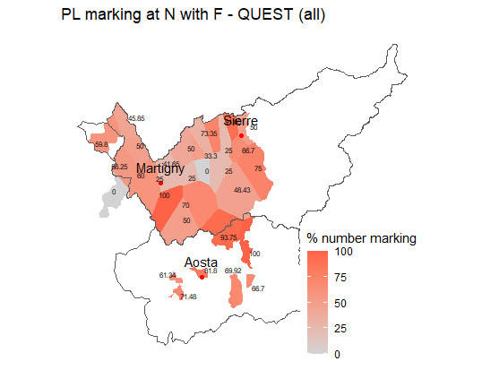
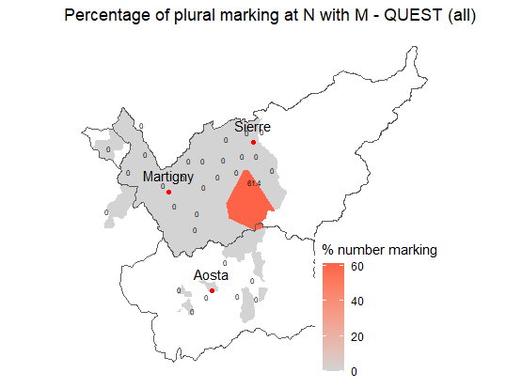
Appendix
Relative frequency of phonologically overt plural marking
Map 8. Overt F.PL marking.
Map 9. Overt M.PL marking.

Slide 30
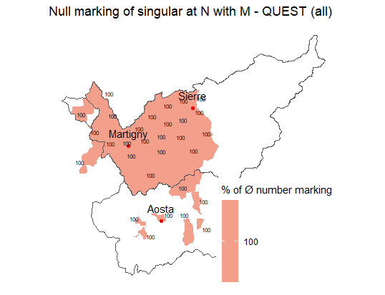
Appendix
Relative frequency of singular null marking (M)
Map 10. Null M.SG marking.

Slide 31
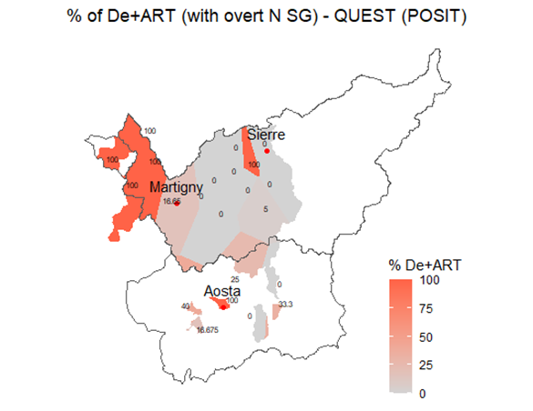
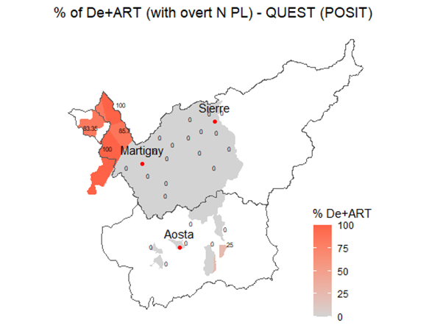
Appendix
Relative frequency of PA (with phonologically overt marking)
Map 11. PA with overt SG marking.
Map 12. PA with overt PL marking.

