Slide 1
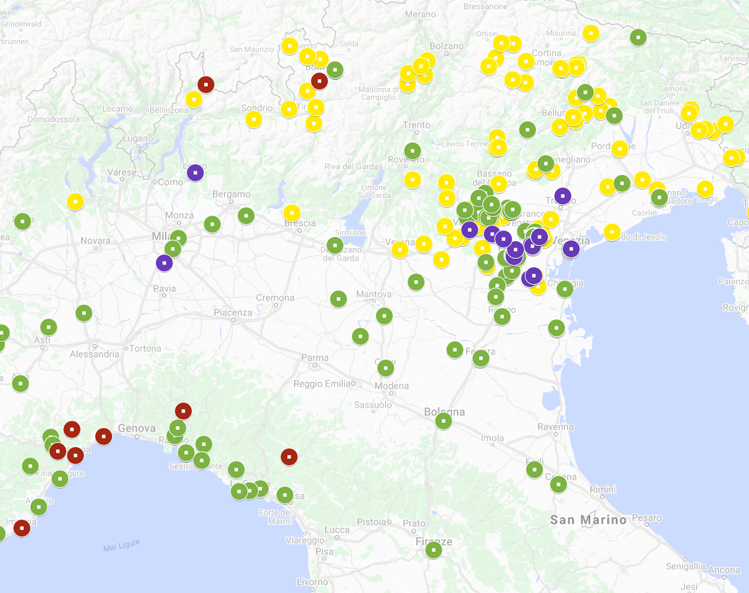
Partitive Articles vs. Bare Nouns in Northern Italy, a morphological parameter
Francesco Pinzin (Goethe Universität Frankfurt am Main)
Cecilia Poletto (Goethe Universität Frankfurt am Main, Università di Padova)

Slide 2
Setting the scene: Romance indefinites
The encoding of indefinite arguments varies within Romance languages (Delfitto & Schroter 1991, Stark 2016 a.o.). BNs in Sp. and PAs in Fr:
SP. FR.
Como pan. / Je mange *(du) pain.
eat.1sg bread / I eat.1sg of.the.m.sg bread
‘I eat bread.’
Como cerezas / Je mange *(des) cerises.
eat.1sg cherries / I eat.1.sg of.the.pl cherries
‘I eat cherries.’

Slide 3
Setting the scene: Romance indefinites
Italian has both BNs and PAs:
Mangio (del) pane.
eat.1sg (of.the.m.sg) bread
‘I eat bread’
Mangio (delle) ciliegie.
eat.1sg (of.the.f.pl) cherries
‘I eat cherries
Is this optionality or rather division of labor?
Do Italian PAs and BNs completely/partially overlap in their distribution or not?

Slide 4
Setting the scene: NIDs, more variation
Kargá d l aldam. (Sermide, MN = PA)
load of the manure
Ćamá: Ø ledaɳ. (Moggio, UD = BN)
load manure
El kárg ul rǘ. (Monza, MI = def article)
he loads the manure
Ćarǵía d yám. (Ala di Stura, TO = bare DE)
load of manure
AIS, map 1179
caricare del letame ‘to load (some) manure’

Slide 5
Research questions
What is the distribution of BNs/PAs/bare DE/def in NIDs?
Do they all compete for the semantic field of indefiniteness?
Definite articles too?
How can we model the variation attested?
What is the grammatical source of such variation?

Slide 6
Hypothesis
There is no optionality between BN and PAs in the languages that have both:
PAs include a quantity BNs do not
Specificity depends on quantity, hence BNs are never specific
The presence of BNs correlates with the presence of number morphology on (regular) masculine Ns.

Slide 7
Methodology: ASIt
In order to assess the variation we analyze:
Data from ASIt.
13 input sentences with BNs/PAs/definite articles. 🡪 2130 output sentences across dialects
Problems:
Unbalanced stimuli for type of indefinite: 6 BNs / 6 def / 1 PA.
Unbalanced polarity. BNs: 5 neg – 1 pos; PAs: 1 neg – 0 pos; def: 2 neg – 4 pos.

Slide 8
Methodology: new fieldwork
In order to avoid the problems of the ASIt data set:
Data from three new fieldwork sessions:
Ligurian (Arenzano, 3 speakers), Mantuan Emilian (Viadana, Dosolo, 8 speakers), West / Central-eastern Friulian (Cordenons, Zoppola / Mossa, Romans d‘Isonzo, S. Lorenzo Isontino, Chiopris, 7 speakers).
Questionnaire (70 sentences balanced for polarity, gender, number, left/right dislocation, PA/BN/definite input + 29 fillers).

Slide 9
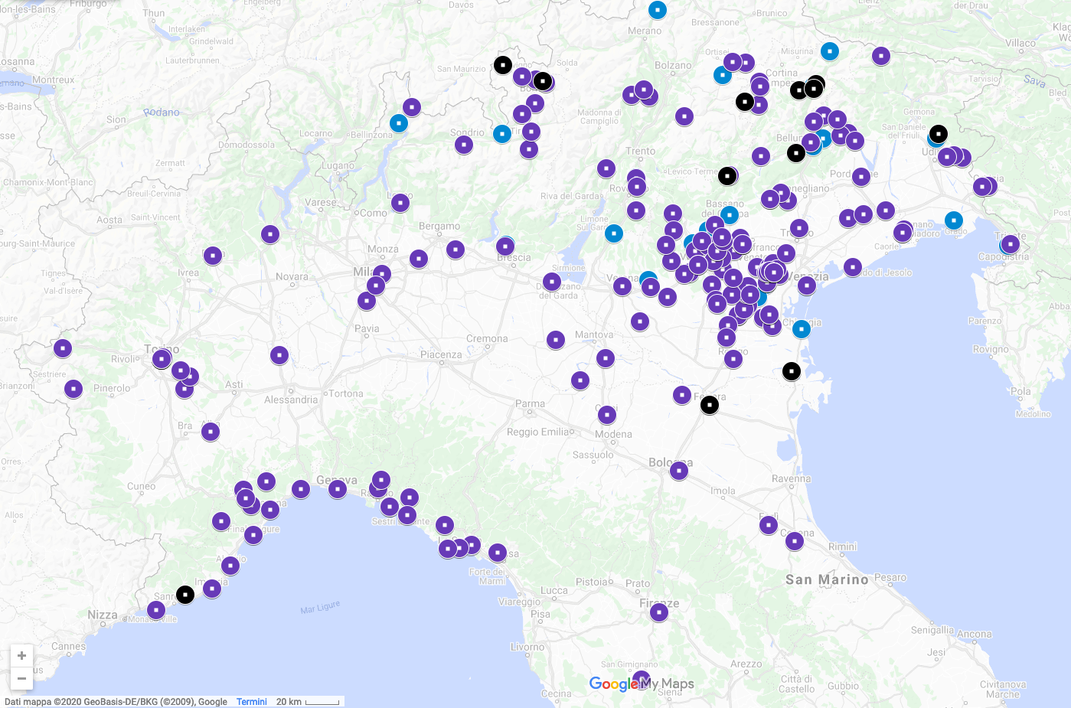
Excluding definites: ASIt
all definites
some definites
no definites
Definite articles from input BNs
Definite articles from input definite articles
Same distribution in all NIDs!

Slide 10
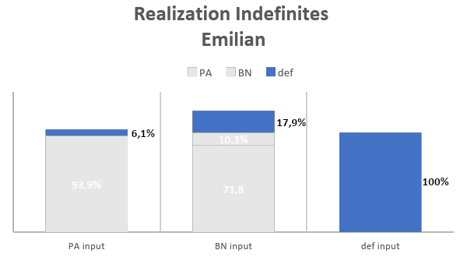
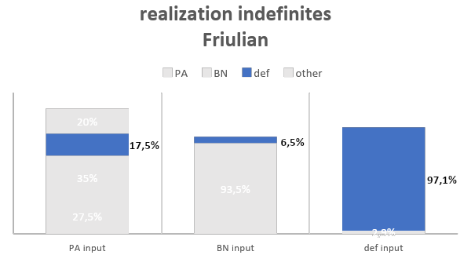
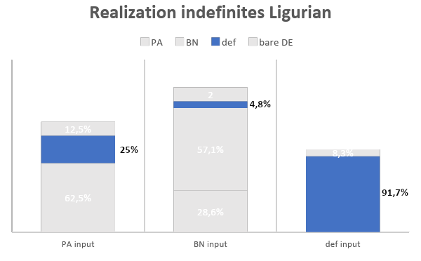
Excluding definites: new data
New data, same pattern:
definite input 🡪 always definite output
BN/PA input 🡪 few cases of definite in the output in each variety
NO VARIATION!

Slide 11
Excluding definites: Generic/weak definites
The cases of definite articles used when the input has an indefinite BN/PA are G/WDs.
NIDs have G/WDs with the same distribution of the other Romance languages. This is unrelated to whether the language has BNs/PAs or other indefinites, and in which contexts.
We exclude them from our analysis of the variation in the realization of indefinite objects in NIDs.

Slide 12
A first answer: RQ2
Do they all compete for the semantic field of indefiniteness?
Definite articles too?
NO
Lack of interdepence between the possible realizations of indefinites and the availability/distribution of G/WDs 🡪 two different semantic fields
Following: Carlson & Sussman (2005), Schwarz (2014) and Aguilar-Guevara (2014), Corblin (2013)

Slide 13
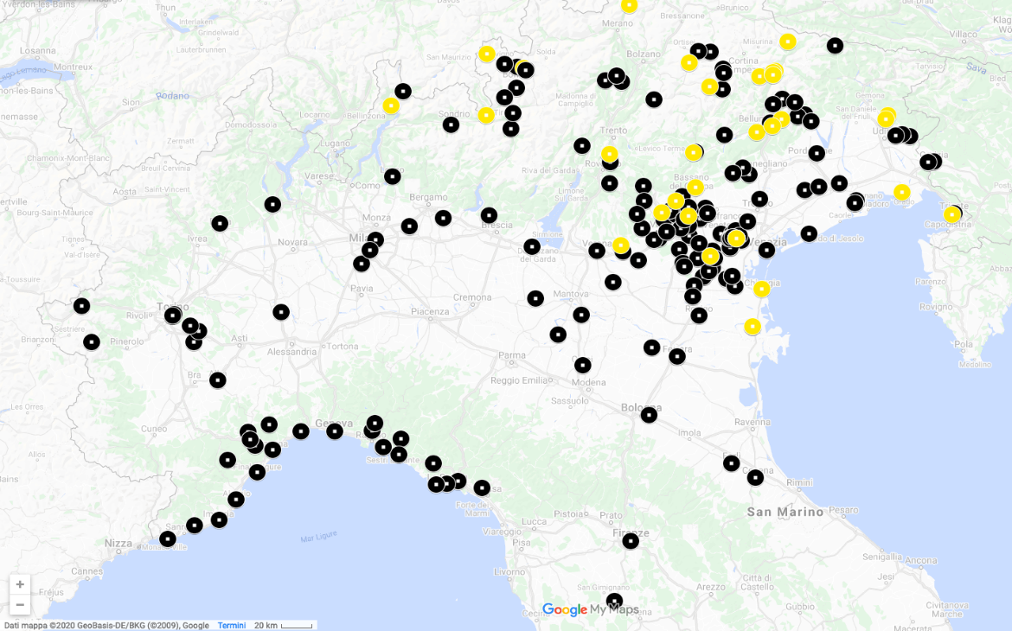
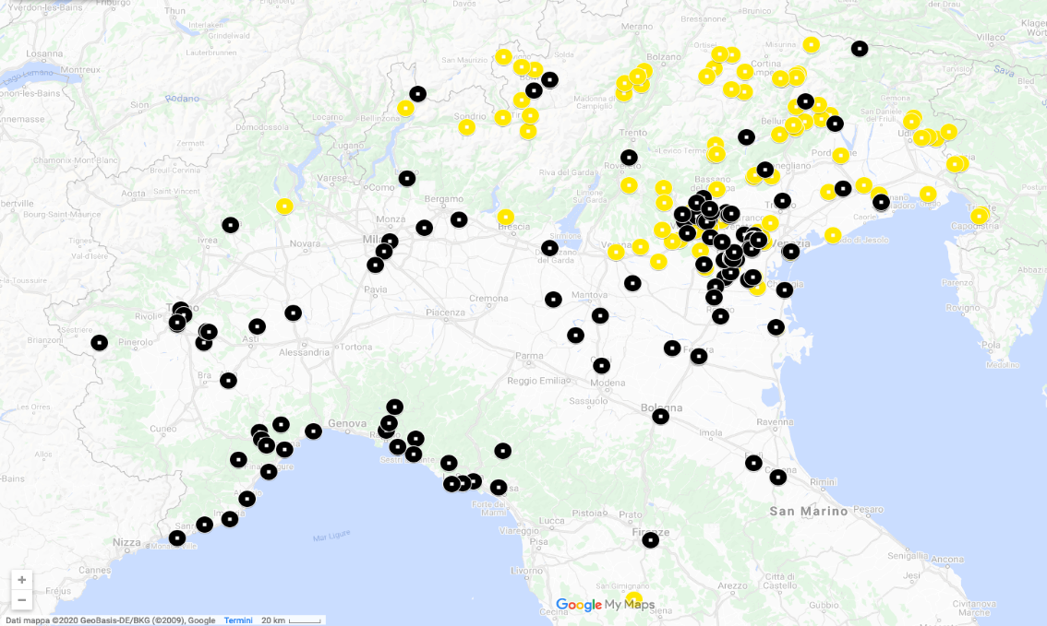
Distribution of BNs: ASIt
1
3
2
1: BN input 🡪 BN output yes-all / yes-some / no
2: PA input 🡪 BN output yes / no
3: Def input 🡪 BN output yes/ no
The “BN area”:
(almost) every BN in the input 🡪 BN
It is attested:
PA 🡪 BN
Def 🡪 BN
Notes:
map 1 shows the BN translations of BNs in the input
Yellow means that all BNs in the input have been translated as BNs
Orange that some BNs in the input have been translated with a BN
Black no BN in the input has been translated with a BN
map 2 shows the same thing but for PAs in the input
map 3, finally, for def in the input
The yellow or BN area is the one in which...
it comprehends...

Slide 14
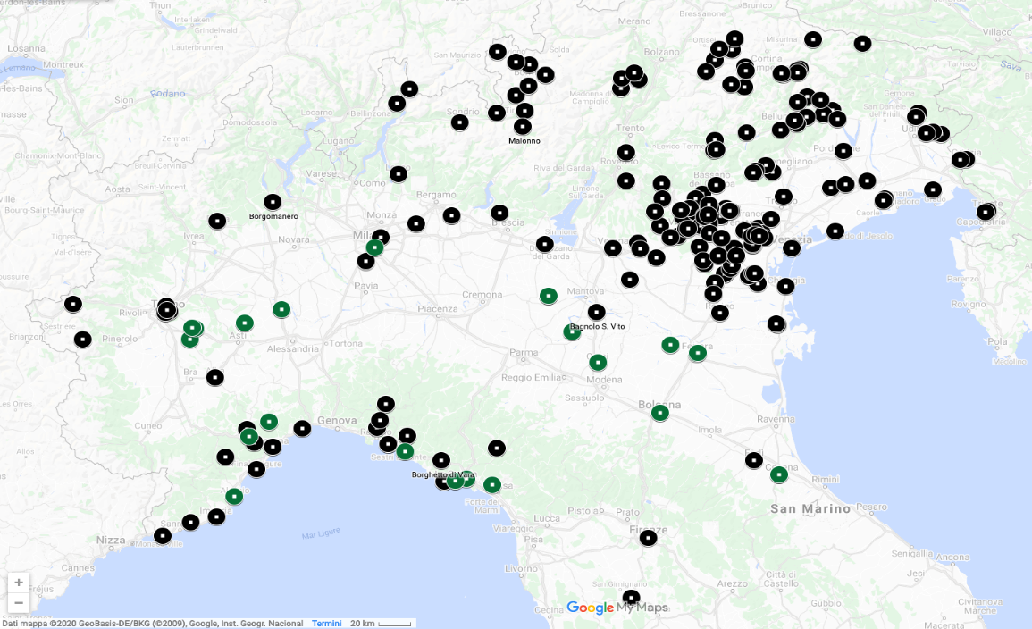
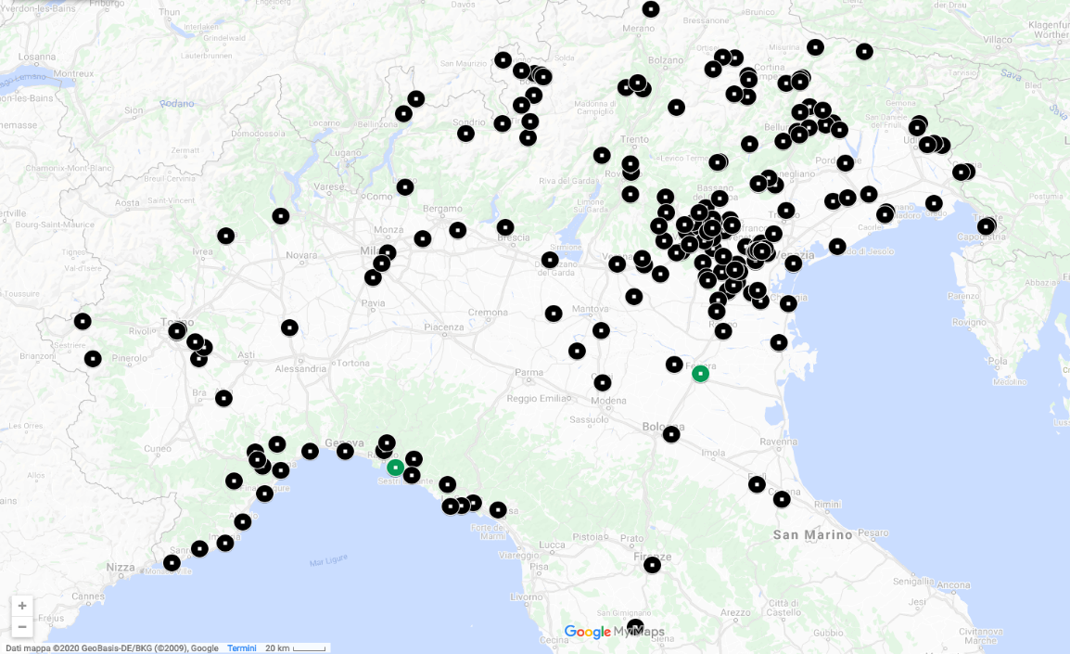
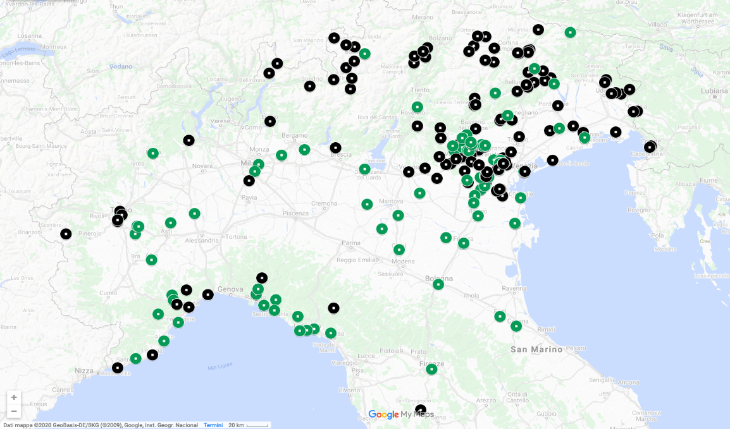
Distribution of PAs: ASIt
1
3
2
1: BN input 🡪 PA output yes / no
2: PA input 🡪 PA output yes / no
3: Def input 🡪 PA output yes / no
The “PA area”.
(almost) every PA in the input 🡪 PA
It is attested:
BN 🡪 PA
Def 🡪 PA
Notes:
We did the same thing for PAs
The green/PA area is the one in which...
it comprehends...

Slide 15
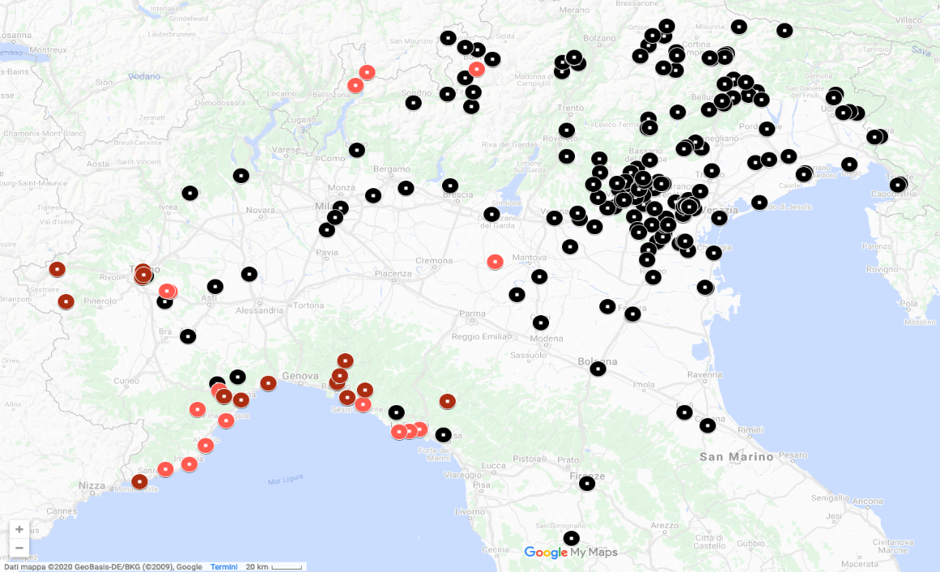
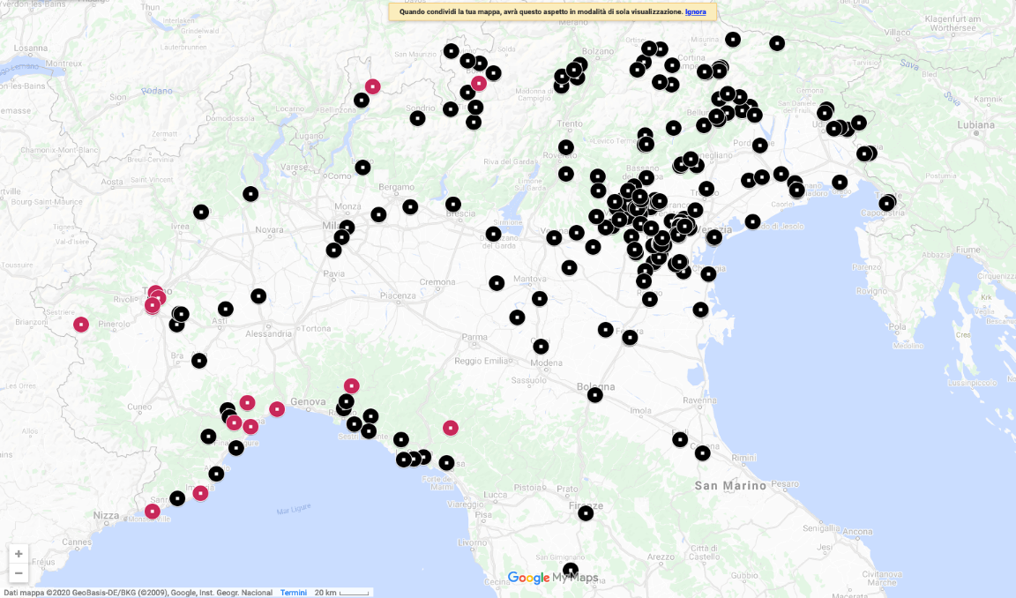
Distribution of bare DE: ASIt
1
3
2
1: BN input 🡪 bareDE output yes-all / yes-some / no
2: PA input 🡪 bareDE output yes / no
3: Def input 🡪 bareDE output yes / no
The “bare DE area”:
It is attested:
BN 🡪 bare DE
PA 🡪 bare DE
Def 🡪 bare DE
Notes:
Finally, we did the same for bare DE.
the red/bare DE area is the one in which...
it comprehends...

Slide 16
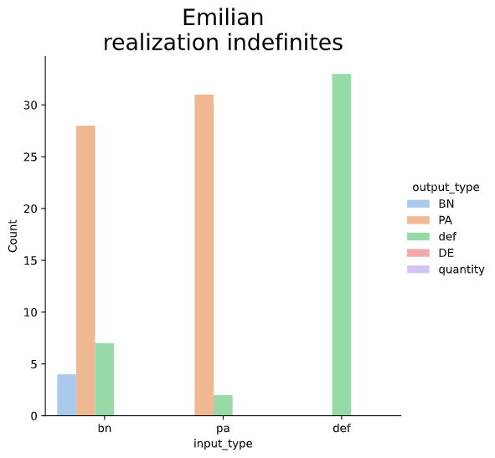
Our fieldwork: Emilian Only PAs
*

Slide 17
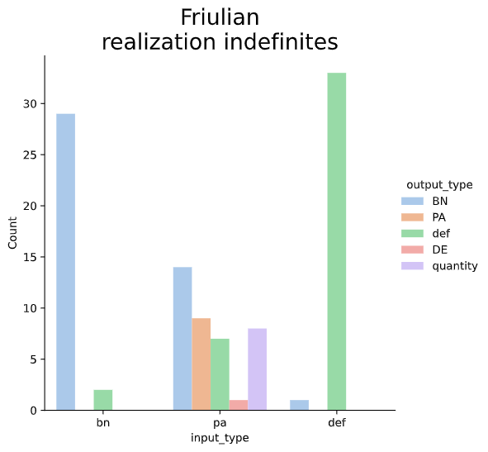
Our fieldwork: Friulian BNs+quantity quantity = un pok/alk ‘a bit’; kualki ‘some’
*

Slide 18
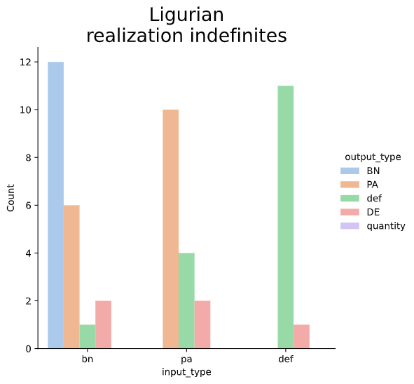
Our fieldwork: Ligurian A new entry: bare DE
*
Notes:
New entry: bare DE
Usual distribution for definite determiners: only option with def as input, plus some “background noise” for the other inputs.
Partitives well attested, but BNs too! (compare it with Emilian).

Slide 19
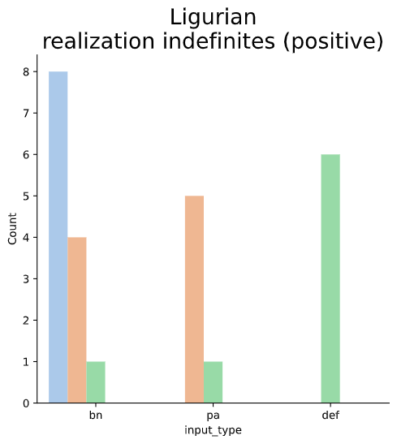
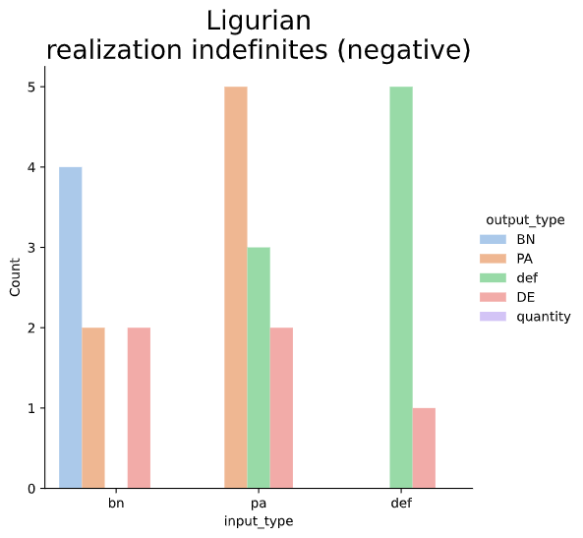
Our fieldwork: Ligurian Negation and bare DE
Bare DE and negation
The presence of bare DE is dependent on negation.
Bare DE can only appear with negative polarity (Battye 1990)
See Garzonio & Poletto (2020) for further details on the distribution of bare DE in these varieties and in Valtellina

Slide 20
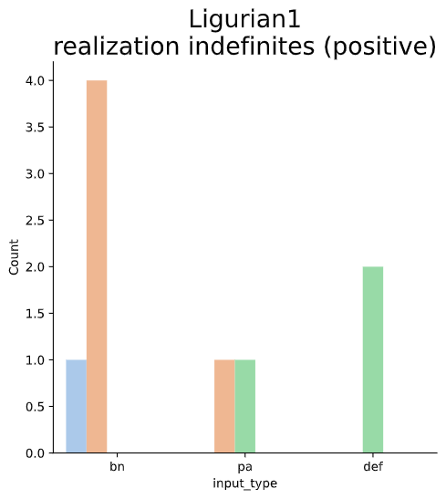
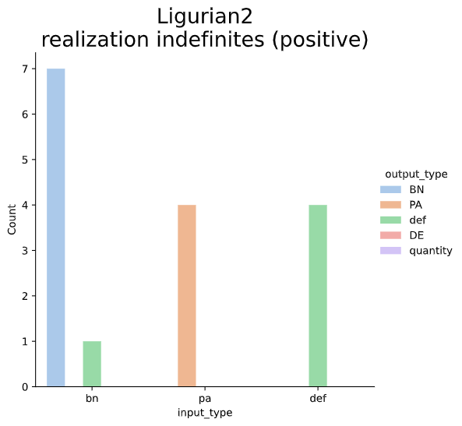
Our fieldwork: Ligurian Two varieties: Lig1 / Lig2
BN input 🡪 PAs
(one BN, given as an additional option for a PA; example in the appendix)
BN input 🡪 BNs

Slide 21
Distribution of indefinites: RQ1
What is the distribution of BNs/PAs/bare DE in NIDs?
Emilian
BN input 🡪 PA
PA input 🡪 PA
≅ French
(modulo no bare DE with neg)
Friulian
BN input 🡪 BN
PA input 🡪 BN + quantity
≅ Spanish
quantity = un pok/alk ‘a bit’; kualki ‘some’
Ligurian1
BN input 🡪 PA (+ bare DE under neg)
PA input 🡪 PA
= French
Ligurian2
BN input 🡪 BN (+ bare DE under neg)
PA input 🡪 PA
≅ Italian
(modulo bare DE with neg)

Slide 22
Varieties with BNs+PAs (Italian, Lig2)
Optionality or division of labor? Do Italian/Lig2 PAs and BNs overlap in their interpretation or not?
Italian
Costruisco (#delle) case da quando sono
build.1sg of.the.f.pl houses from when am
nato.
born
‘I’ve been building houses since I was born.’
*(Del) vino non l’ ha sprecato,
of.the.m.sg wine not it have.3sg wasted,
*(dell’) altro sì.
of.the.m.sg other yes
‘He did not waste some of the wine but some other he did.’
Ligurian2
Kustruiʃu (#dee) kɛ da kwando so
build.1sg of.the.f.pl houses from when am
naʃyu.
born
‘I’ve been building houses since I was born.’
*(Du) vin, nu n a grejau:,
of.the.m.sg wine not NE have.3sg wasted
*(de l) atru ʃi.
of.the.m.sg other yes
‘He did not waste some of the wine but some other he did.’
Long-term habitual activities
✓BN/✘PA
Specific contexts
✘BN/✓PA

Slide 23
Varieties with BNs+PAs (Italian, Lig2)
We formalize the distinction with this privative syntactic-semantic feature:
q(uantity) 🡪 the denotation of the nominal is restricted to an undefined quantity within its extension. (absence of q = no quantity is implied).
xNP | xNP+qP | xNP+qP+specificity
BNs | PAs
Specificity requires q to be present 🡪 only PAs can be specific, BNs cannot.
Notes:
absence of q = the nominal may range over any possible part of its extension, the total set, the empty set and the singletons too, if present.

Slide 24
Varieties with only PAs (French, Lig1, Emilian)
Modulo the presence of bare DE under negation (orthogonal to the classification, see the appendix):
French, Lig1, Emilian 🡪 PAs cover both q(uantity) and absence of q(uantity):
I ɛ an ke kostriusi *(adli) ka, ma a n
it is years that build.1sg of.the.f.pl houses, but CL.subj not
u mai vist atse brøti. (Emilian)
have.1sg never seen so ugly.
‘I‘ve been building houses for years, but I‘ve never seen such ugly ones.’
*(Dal) vɛjn, a t n a mia struʃa, *(adl) ater si. (Emilian)
of.the.m.sg wine CL you CL.part have not wasted of.the.f.sg other yes
‘He did not waste a part of the wine but another part he did.’
For French examples see appendix and Ihsane (2008: 138).

Slide 25
Varieties with only PAs (French, Lig1, Emilian)
We formalize the distinction with this privative syntactic-semantic feature:
q(uantity) 🡪 the denotation of the nominal is restricted to an undefined quantity within its extension. (absence of q = no quantity is implied).
xNP | xNP+qP | xNP+qP+specificity
PAs
Specificity requires q to be present 🡪 only PAs can be specific, BNs cannot.
Notes:
absence of q = the nominal may range over any possible part of its extension, the total set, the empty set and the singletons too, if present.

Slide 26
Varieties with BNs + quantity (Spanish, Friulian)
BNs reach up to the feature below q(antity), as in Italian and Lig1:
I fa:s cases di kuant k i soi nasu:t. (Friulian)
CL.subj make.1sg houses from when that CL.subj am born
‘I‘ve been building houses since I was born.’
PAs are absent and other quantity markers take care of lexicalizing q(uantity):
Un pok di vin, lo à strasa:t, e un pok no. (Friulian)
a bit of wine, CL.obj has wasted, and a bit no
‘He wasted a part of the wine but another part he didn’t.’

Slide 27
Varieties with BNs + quantity (Spanish, Friulian)
We formalize the distinction with this privative syntactic-semantic feature:
q(uantity) 🡪 the denotation of the nominal is restricted to an undefined quantity within its extension. (absence of q = no quantity is implied).
xNP | xNP+qP | xNP+qP+specificity
BNs | quantity
Specificity requires q to be present 🡪 only PAs can be specific, BNs cannot.
Notes:
absence of q = the nominal may range over any possible part of its extension, the total set, the empty set and the singletons too, if present.

Slide 28
Modeling the variation: Two factors
Availability of BNs: Friulian, Spanish, Lig2, Italian
Availability of PAs: French, Lig1, Emilian, Lig2, Italian
French/Emilian/Lig1
Italian/Lig2
Spanish/Friulian
BNs and PAs are not basic Lexical Items/morphs, i.e., their distribution cannot be directly modeled as a lexical parameter (i.e., Ln-x has the “BN morph” while Ln-y does not).
Is the distribution of PAs/BNs related to the distribution of basic Lexical Items/morphs in the language?
xNP | xNP+qP | xNP+qP+specificity
PAs
BNs | PAs
BNs | quantity

Slide 29
Hypothesis
Following the literature (Delfitto & Schroter 1991, Stark 2016, Pomino 2019, Gerards & Stark 2020, Stark & Gerards 2020):
Distribution of BNs/PAs related to the morphology of gender/number on N in the language.
No number morphs on N 🡪 no BNs
Autonomous number morphs on N (same for m and f) 🡪 no PAs (Stark 2016, Gerards & Stark 2020, Stark & Gerards 2020)

Slide 30
Number marking: ASIt
We checked the realization of the sg-pl couples we found in the ASIt:
Masculine: ragazzo-ragazzi, libro-libri, amico-amici, bambino-bambini
Feminine: ragazza-ragazze, donna-donne, sorella-sorelle, (sta)sera-sere
Only regular marking, no lexically specific classes (e.g., palatal plurals in Friulian: /na:s/-/na:ʃ/, see Vanelli 2010).

Slide 31
Number marking: ASIt, masculine
Ø plural marking on N in Emilia, west Lombardy and Piedmont.
Plural marking with an additional marker (= fem) in Friuli and some Ladin varieties in Trentino.
Plural marking with vowel alternation in Veneto, east Lombardy, alpine Lombardy and Liguria.
‘the boy’ – ‘the boys’
🡪 sg -Ø – pl -Ø (Forlì: e ragaz-Ø – i ragaz-Ø)
🡪 sg -Ø – pl -z [=fem] (Remanzacco: el frut-Ø – i fru(t)-s) 🡪 sg -Ø – pl -z [≠fem] (Cairo Monten.: er matot-Ø – i matot-i)
🡪 sg -x – pl -y (Padova3: el tos-o – i tos-i)
Notes:
Ø-z pattern in Savona: due to apocope of /u/ in the singular masculine, and the lack of this phenomenon in the plural (/l amiz-Ø/-/li amiz-i/).
Different from Friulian, where we have the same plural marker (/s/) both for masculine and feminine (/frut/-/fru(t)s and /frute/-/frut-i-s/).

Slide 32
Number marking: a correlation
Presence of number marking on N at the masculine 🡪 presence of BNs
Feminine nouns behave differently in these varieties (see the appendix for details):
The presence of overt number marking at the feminine does not invalidate the previous generalization.

Slide 33
Concluding remarks
We have shown that the distribution of definites in these varieties is tangential to the competition between BNs and PAs (G/W definites).
We have shown that the distribution of BNs and PAs in the languages that have both is not randomic: PAs display a quantity reading, which in turn is implied in contexts where the indefinite is specific. BNs cannot be specific since they do not have a quantity reading.
We have shown that the link between noun morphology and the absence of BNs is related to the absence of number morphology in the masculine.

Slide 34
Methodological generalizations
It is possible to draw evidence for the presence/absence of syntactic structures from the way test subjects react to stimuli in the standard language.
If a given structure is just not present in the dialect, test subjects avoid it in the dialect and use an alternative strategy, which can be helpful to understand the semantic value of the original structure in the input: Friulian speakers tend to translate Italian PAs with a „some/a little“ quantity marker.
Some speakers display interference with the standard, at present we do not know whether this is a sign of linguistic change or not.

Slide 35
Thank you for your attention

Slide 36
References

Slide 37
AIS = Jahberg K. & Jud, J. 1928–1940. Sach- und Sprachatlas Italiens und der Südschweiz. Zofinger, Ringler.
ASIt = Atlante Sintattico d’Italia. http://asit.maldura.unipd.it/
Ackema, P. Neeleman, A. 2018. Features of Person: From the Inventory of Persons to Their Morphological Realization. Cambridge MA: MIT Press.
Aguilar-Guevara, A., Le Bruyn, B. & Zwarts, J. 2014. Weak Referentiality. Amsterdam/Philadelphia: John Benjamins.
Aguilar-Guevara, A. 2014. Weak definites, semantics, lexicon and pragmatics. Utrecht: LOT.
Battye A. C. 1990. La quantificazione nominale, il veneto e l'italiano a confronto con il genovese e il francese. Annali di Ca’ Foscari 29, 27–44.
Benincà, P. 2007. Clitici e ausiliari: gh ò, z é. Sui dialetti italo-romanzi. Saggi in onore di Nigel Vincent. eds. D. Bentley & A. Ledgeway, 27–47. Cambridge: Cambridge University Press.
Biberauer, T. & Roberts, I. 2015. Rethinking formal hierarchies: A proposed unification. Cambridge Occasional Papers in Linguistics 7, 1–31.
Bobaljik, J. 2012. Universals in Comparative Morphology. Cambridge, MA: MIT Press.
Buchstaller, I. & Corrigan, K. 2011. ‘Judge not lest ye be judged’: Exploring methods for the collection of socio-syntactic data. Language Variation – European Perspectives III. eds. F. Pedersen, P. Quist & J. Parrot, 149–160. Amsterdam/Philadelphia: John Benjamins.
Caha, P., De Clercq, K. & Vanden Wyngaerd, G. 2019. The fine structure of the comparative. Studia Linguistica 73, 470–521.
Cardinaletti, A. & Giusti, G. 2016. The syntax of the Italian indefinite determiner dei. Lingua 181, 58–80.
Cardinaletti, A. & Giusti, G. 2018. Indefinite determiners, variation and optionality in Italo-Romance, Advances in Italian Dialectology. eds. R. D’Alessandro & D. Pescarini, 135–161. Leiden/Boston: Brill.

Slide 38
Cardinaletti, A. & Giusti, G. 2020. Indefinite determiners in informal Italian: A preliminary analysis, Linguistics 58, 679–712.
Carlson, G., & Sussman, R. 2005. Seemingly indefinite definites. Linguistic evidence: Empirical, theoretical, and computational perspectives, eds. S. Kepser & M. Reis, 71–85. Berlin: De Gruyter Mouton.
Carlson, G., Sussman, R., Klein, N. & Tanenhaus, M. 2006. Weak definite noun phrases. Proceedings of NELS 36. eds. C. Davis, A.-R. Deal & Youri Zabbal, 179–196. Amherst, MA: GLSA.
Carlier, A. & Lamiroix, B. 2014. The grammaticalization of the prepositional partitive in Romance. Partitive Case and Related Categories. eds. S. Luraghi & T. Huumo, 477–522. Berlin: De Gruyter Mouton.
Chierchia, G. 1997. Partitives, Reference to Kinds and Semantic Variation. Proceedings of Semantics and Linguistic Theory VII. ed. A. Lawson, 73–98. Ithaca, NY: CLC Publications.
Cinque, G. 1999. Adverbs and functional heads: A crosslinguistic perspective. Oxford: Oxford University Press.
Corblin, F. 2013. Weak definites as bound relational definites. Recherches linguistiques de Vincennes 42, 91–122.
Cornips, L. & Poletto, C. 2005. On standardising syntactic elicitation techniques (part 1). Lingua 115, 939–957.
Davatz, J. P., Stark, E. this issue. Unexpected partitive articles in Francoprovençal. Studia Linguistica ??/?, ? –?.
Delfitto, D. & Schroter, J. 1991. Bare Plurals and the number affix in DP. Probus 3, 155–185.
Enç, M. 1991. The semantics of specificity. Linguistic Inquiry 22, 1–25.
Falco, M. & Zamparelli, R. 2019. Partitives and partitivity. Glossa 4, 1–49.
Garzonio, J. & Poletto, C. 2020. Partitive objects in negative contexts in Northern Italian dialects. Linguistics 58, 621–650.
Gerards, D. P. 2020. Bare Partitives in Old Spanish and Old Portuguese. University of Zurich. PhD Diss.
Gerards, D., & Stark, E. 2020. Why ‘Partitive Articles’ Do Not Exist in (Old) Spanish. Bare Nouns vs. 'Partitive Articles': Disentangling Functions. ed. T. Ihsane, 105–139. Leiden/Boston: Brill.

Slide 39
Hoeksema, J. 1996. Partitives: studies on the syntax and semantics of partitive and related constructions. Berlin: De Gruyter Mouton.
Ihsane, T. 2008. The Layered DP: Form and meaning of French indefinites. Amsterdam: John Banjamins.
Jackendoff, R. 1968. Quantifiers in English. Foundations of Language 4., 422–442.
Krifka, M., Carlson, G., Chierchia, G., Link, G., Pelletier F. J. & Meulen A. T. 1995. Genericity: An Introduction. The Generic Book. ed. G. Carlson & F. J. Pelletier, 1–124. Chicago: University of Chicago Press.
Kristol, A. 2014. Les grammaires du francoprovençal : l‘expression de la partitivité. Quelques leçons du projet ALAVAL. La géolinguistique dans les Alpes au XXe siècle: méthodes, défis et perspectives. ed. R. Champrétavy, 29–44. Région autonome de la Vallée d’Aoste: Bureau régional pour l’ethnologie et la linguistique.
Kristol, A. 2016. Francoprovençal. The Oxford Guide to the Romance Languages. eds. A. Ledgeway & M. Martin, 350–362. Oxford: Oxford University Press.
Milner, J. 1982. Ordres et raisons de langue. Paris: Seuil.
Paoli, S. 2019. Avér o gavér? Questo è il dilemma! Microvariazione negli esiti del latino habere nel nord d’ Italia. Revue Romane, online first.
Pomino, N. this issue. French portmanteau morpheme: du as DP vs. du as PP. Studia Linguistica ??, ? –?.
Renzi, L. 1982. Il vero plurale dell'articolo uno. Lingua Nostra 43, 63–68.
Rickford, J. 1987. The haves and have nots: sociolinguistic surveys and the assessment of speaker competence. Language in Society 16, 149–177.
Sanga, G. 1991. I metodi della ricerca sul campo. Rivista italiana di dialettologia 15, 165–183.
Savoia, L. M., Baldi, B. this issue. Partitives and indefinites: Phenomena in Italian varieties. Studia Linguistica ??. ? –?.

Slide 40
Selkirk, E. O. 1977. Some remarks on noun phrase structure. Studies in formal syntax. eds. A. Akmajian, P. Culicover & T. Wasaw, 285–325. London: Academic Press.
Stark, E. 2016. Nominal morphology and semantics – Where’s gender (and ‘partitive articles’) in Gallo-Romance? Proceedings of the VII Nereus international workshop. eds. S. Fisher & M. Navarro, 131–149. Konstanz: Fachbereich Sprachwissenschaft der Universität Konstanz.
Stark, E., Gerards, D. 2020. ‘Partitive Articles’ in Aosta Valley Francoprovençal – Old Questions and New Data, Bare Nouns vs. 'Partitive Articles': Disentangling Functions. ed. T. Ihsane, 301–334. Leiden/Boston: Brill.
Starke, M. 2009. A short primer to a new approach to language. Nordlyd 36, 1–6.
Storto, G. 2003. On the status of partitive determiner in Italian. Romance Languages and Linguistic Theory 2001. Selected papers from ‘Going Romance’, Amsterdam, 6–8 December 2001. eds. J. Quer, J. Schroten, M. Scorretti, P. Sleeman & E. Verheugd-Daatzelaar, 315–330. Amsterdam: John Benjamins.
Zamparelli, R. 2008. Dei ex machina. A note on plural/mass indefinite determiners. Studia Linguistica 62, 301–327.

Slide 41
Appendix

Slide 42
Number marking: ASIt, feminine
Plural marking with vowel alternation + additional marker (= m /s/) in Friuli.
Plural marking with vowel alternation in Veneto, east Lombardy, Piedmont, north Emilia, Liguria.
“inverse” plural marking with vowel deletion in central Lombardy and south Emilia.
Same marker for f.sg and m.pl in alpine Lombardy.
‘the woman’ – ‘the women’
🡪 sg -x – pl -y+z (Remanzacco: la femin-a – lis femin-i-s)
🡪 sg -x – pl -y (Padova3: a don-a – e don-e)
🡪 sg -x – pl -Ø (Bologna2: la don-a – al don-Ø)
🡪 sg -x – pl -x (Livigno2: la fém-a – li fém-a)

Slide 43
Excluding definites: Generic/weak definites
Proposal: definite articles have a generic/weak interpretation in all NIDs (as well as in Italian, French and Spanish, see Aguilar-Guevara et Al. 2014).
G/WDs = definites referring to a non-definite non-salient entity in the discourse. They are lexically constrained:
Mia sorella compra arance/case tutti i giorni.
My sister buys oranges/houses all the.m.pl days
Mia sorella compra le arance/# le case tutti i giorni.
My sister buys the oranges/the houses all the.m.pl days
‘My sister buys oranges/houses every day.’

Slide 44
Varieties with only PAs (French, Lig2, Emilian)
N.B., We take the presence of bare DE under negation to be orthogonal to the present classification
French
Je construis *(des) maisons depuis 30 ans.
I build.1sg of.the.f.pl houses from 30 years
‘I’ve been building houses for 30 years.’
*(Des) filles étaien blondes, d’autres avaient
of.the.pl girls were blond others had
les chevaux foncés.
the.pl hair dark
‘Some girls were blond, others had dark hairs.’
(Ihsane 2008:141)
Emilian
I ɛ an ke kostruisi *(adli) ka.
it is years that build.1sg of.the.f.pl houses
‘I’ve been building houses for years.’
*(Dal) vɛjn, a t n a mia
of.the.m.sg wine CL you CL.part has not
struʃa, *(adl) ater si.
wasted of.the.f.sg other yes
‘He did not waste a part of the wine but another part he did.’
Long-term habitual activities
✓BN/✘PA
Specificity inducing contexts
✘BN/✓PA

Slide 45
Varieties with only PAs: Lig1
Even if the usual translation of a BN in Lig1 is a PA, in the following sentence both BNs and PAs are acceptable (≠ French/Emilian)
Ɛ trent anni ke tiu ʃy (dee) kɛ. (Lig1)
is 30 years that pull.1sg up of.the.f.pl houses
‘I’ve been building houses for 30 years.’
Je construis *(des) maisons depuis 30 ans. (Fr.)
I build.1sg of.the.f.pl houses from 30 years
‘I’ve been building houses for 30 years.’
In order to assess the consistency of this possibility within the speakers of Lig1 we will conduct further questionnaires as soon as the conditions will make it possible again.

Slide 46
Bare DE in negatives, orthogonal feature
Bare DE under negation is attested both in varieties which realize the positive counterpart with a PA and with varieties which realize it with BNs.
Il a du papier. / Il n’ a pas de papier. (Fr.)
he has of.the paper / he neg has not of paper
‘He has paper,’ / ‘He doesn’t have paper. (Ihsane 2008: 145)
Al vent nóma Ø café. / Te n crompesc mai de póm. (Frontale di Snd.)
he sells only coffee / you not buy.2sg never of apples
‘He only sells coffee.’ / ‘You never buy apples.’

Slide 47
Number marking: a correlation
Presence of number marking on N 🡪 absence of BNs
AND
The relation needs to hold for masculine. It is not necessary for feminine to be involved.
For now, we found only the following „mixed“ pattern:
m. unmarked number on N + f. marked number on N

Slide 48
Excluding definites: new data
Influence of the language variable (Emilian/Ligurian/Friulian) on the distribution of the output_types:
Chi2 = 43.4413 p-value = 0.000 Degrees of freedom = 2 (0.000 < 0.005)** BN
Chi2 = 53.771 p-value = 0.000 Degrees of freedom = 2 (0.000 < 0.005)** PA
Chi2 = 0.954 p-value = 0.621 Degrees of freedom = 2 (0.621 > 0.005) def
Chi2 = 16.742 p-value = 0.000 Degrees of freedom = 2 (0.000 < 0.005)** DE
Chi2 = 12.225 p-value = 0.002 Degrees of freedom = 2 (0.002 < 0.005)* quantity

Slide 49
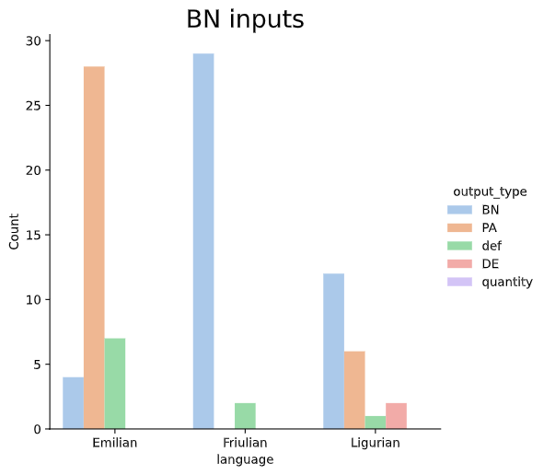
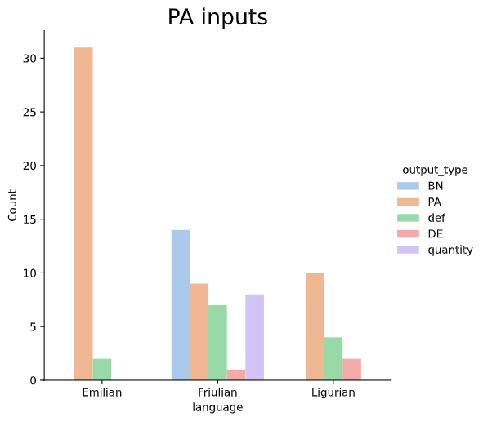
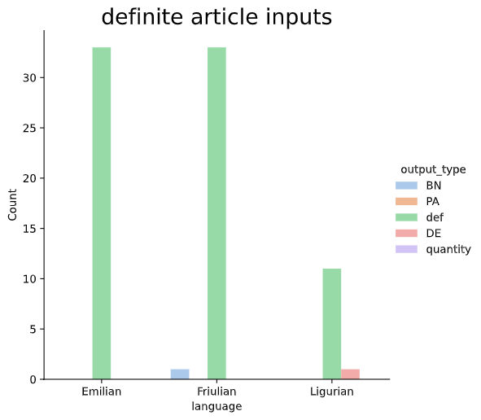
Excluding definites: new data
The same is valid for every subset of inputs, BN/PA/def:
In each case, no influence of the language variable on the distribution of the value “def” of the variable output_type has been found. The value “def” is always normally distributed across the three languages.
The “BN”, “PA”, “def” values in output_type, on the other hand, are in each subgroup differently distributed among the languages in a significant way.

Slide 50
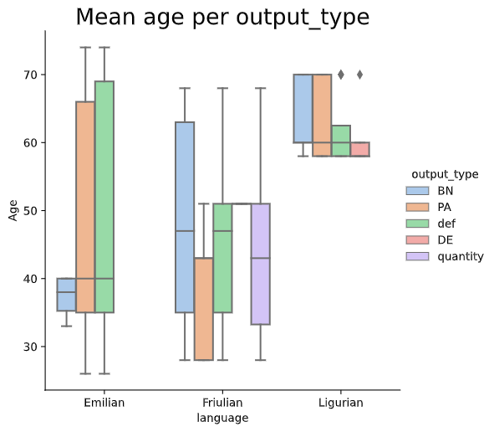
Mean age per output_type for each language

