Slide 1
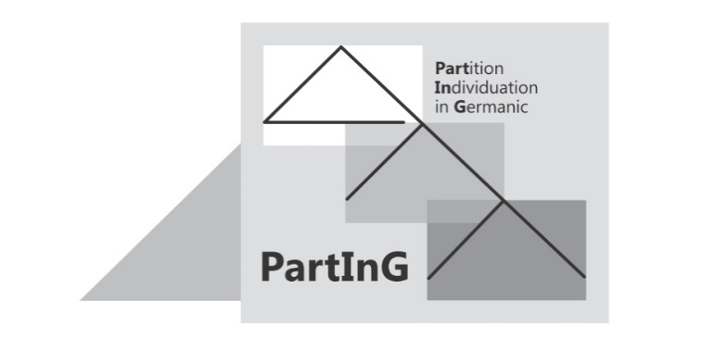
How many indefinite articles do we have and how much is in them?
Ellen Brandner, Universität Stuttgart PARTE, September 2022

Slide 2
Introduction – IDs with mass nouns
I(ndefinite) D(eterminer) with mass nouns:
Bavarian:
(1) Host a geld dabei? have-you ID cash with(you), cf. Merkle (1976)
main area: Bavaria and Austria
and the adjacent part of Alemannic

Slide 3
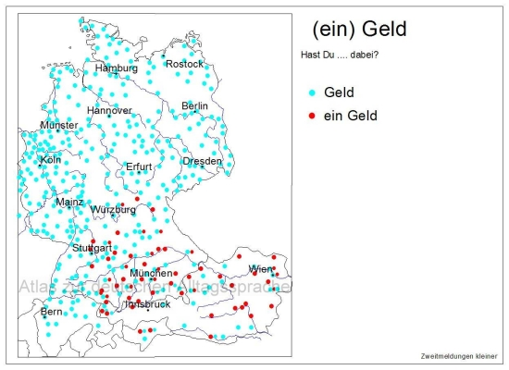
Introduction – IDs with mass nouns
Immediate question:
How can a lexical item, which derives presumably from the numeral 'one', contribute to such a partitive meaning?
Have you … with you? cash
a cash
Identify (all ;-) the occurrences if the ID including derivations, ein-ig- (=some); k-ein (indefinite negative); also its different forms (Dutch ’n; German nen, etc)
What is the lowest common denominator in these contexts?
What are possible alternative lexical items? (within one language and cross-linguistically)
Where and how do their meaning components overlap with the ID (and vice versa)?
How can this situation be modeled in the syntax?
→ goal of the project 'Partition and Individuation in Germanic'
http://www.atlas-alltagssprache.de/runde-3/f08d/

Slide 4
A bit of background on SynAlm
Syntax of Alemannic
funded by the DFG (Deutsche Forschungsgemeinschaft) between 2011-16
Informants: 1000 at the beginning – still more than 500 for the last questionnaire
Area: Germany (Baden-Württemberg), Switzerland, Austria (Vorarlberg), France (Alsace)
Seven questionnaires were sent out, containing:
translation tasks
judgment tasks (1-5 Likert scale; 1-3 (knowledge), Y/N questions
sentence completion tasks
choice tasks
(covering e.g.: relative clauses, long wh-extraction, negative concord, adjectival agreement, preposition doubling,…)
'layered' method: results of the translation tasks were transformed into a judgment task in a later round, with the relevant variables controlled for in a systematic way
→ different results reveal insights into the organization of the grammar, Featherston (2005), Brandner & Rehn (in press)

Slide 5
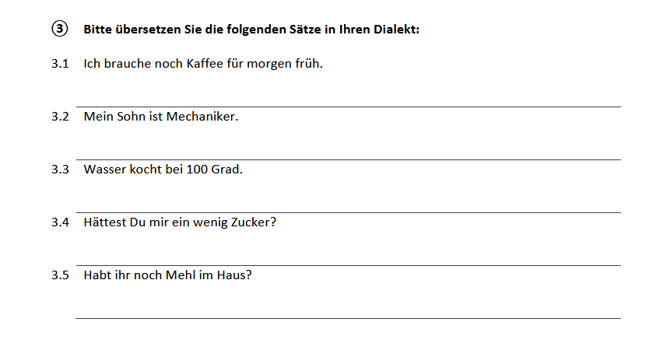
A bit of background on SynAlm
Translation of a Standard German sentence
Habt ihr noch ein Mehl im Haus?
Habt ihr noch Mehl im Haus?
Have you-2pl still a flour in-the house?

Slide 6
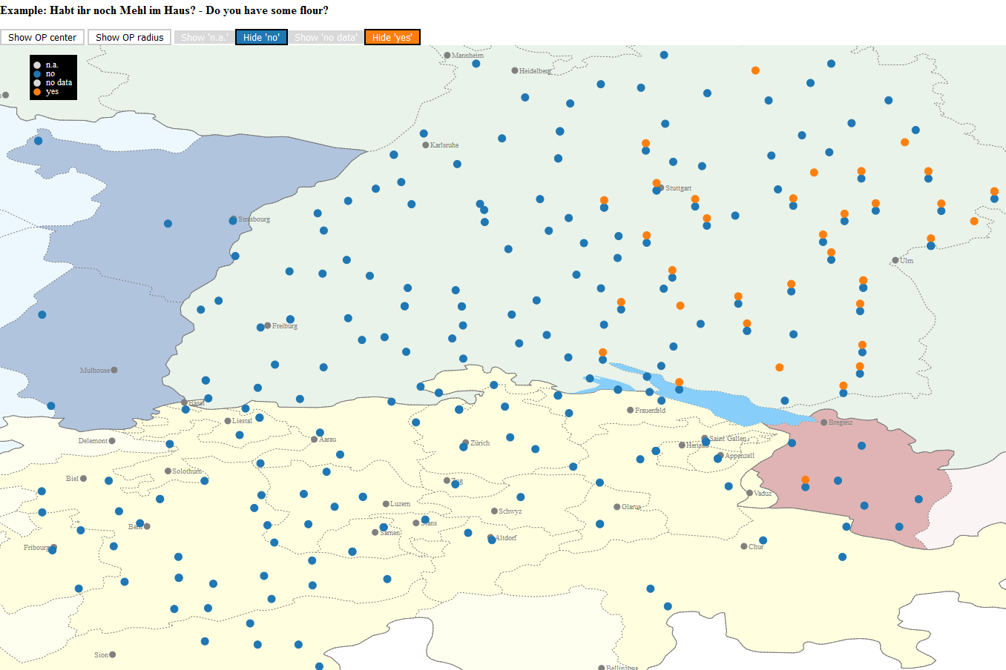
Habt ihr noch ein Mehl im Haus?
Habt ihr noch Mehl im Haus?
Have you-2pl still a flour in-the house?
Areal pattern in translation task
Translation task, sentence given:
Habt ihr noch ø Mehl im Haus?
FB3 / 3-5-1, n=757, 8% with ID

Slide 7
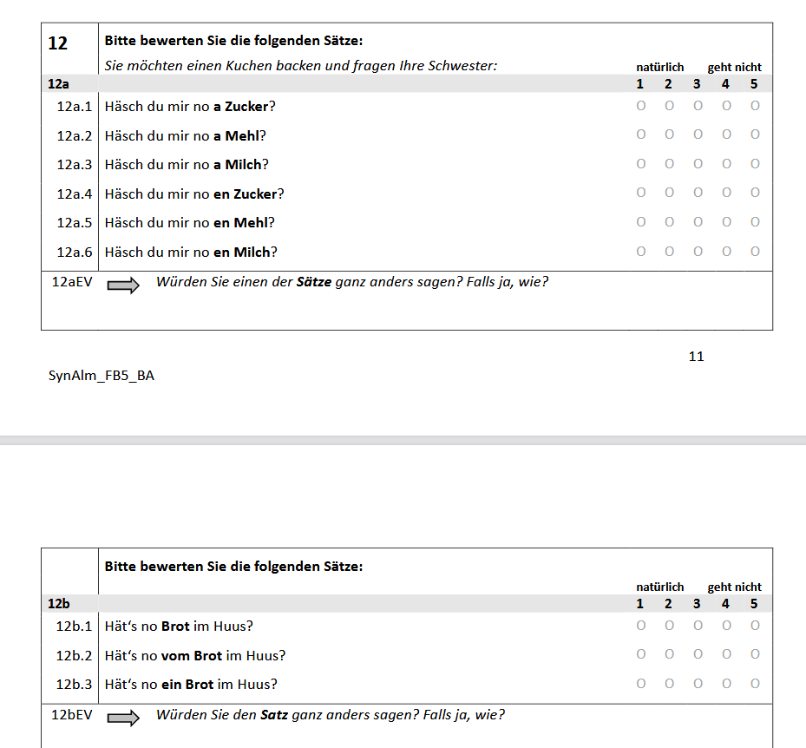

Slide 8
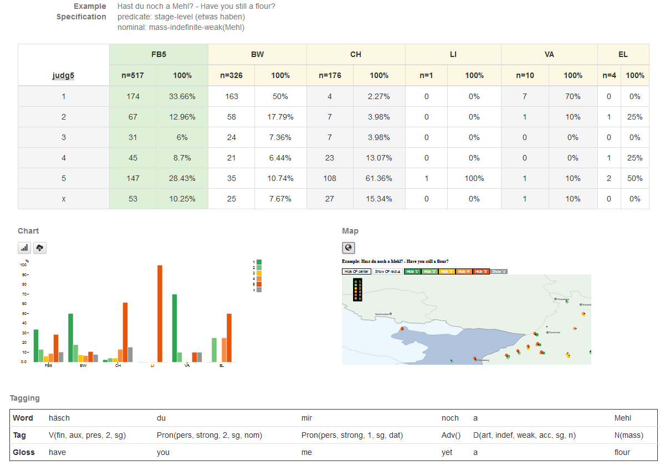
Judgment task, scale 1-5 (1= best; 5 = worst); x = no judgment
Introduction
BW =
Baden-Württ. (D)
CH = Switzerland
VA = Vorarlberg (Austria) EL = Elsass (France)
Resultats:
overall: 46% acceptance (1-2)
BW: 68%
CH: 6%
VA: 80% (n=517)

Slide 9
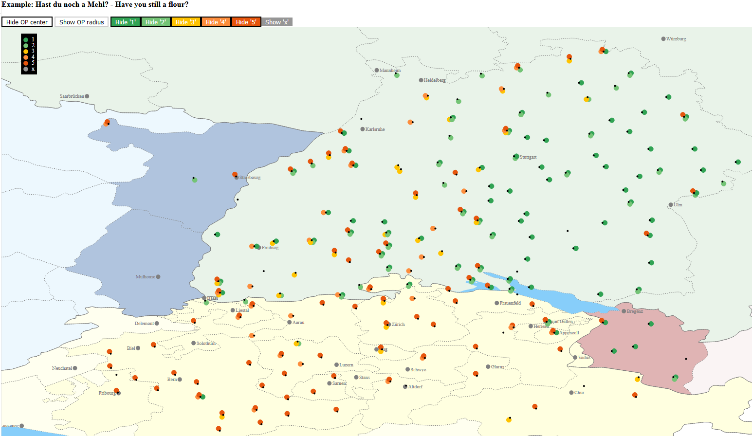
Habt ihr noch ein Mehl im Haus?
Have you-2pl still a flour in-the house?
Areal pattern in judgment task

Slide 10
IDs with mass nouns in ALM
Similar pattern occurs with…
Weak quantifiers: (2) ein wenig (a) + mass noun a bit ID (a)
ID as partitive pronoun, see e.g. Strobel (2015) (3) …Geld…do liegt no oas …cash there is still ID (some of…)

Slide 11
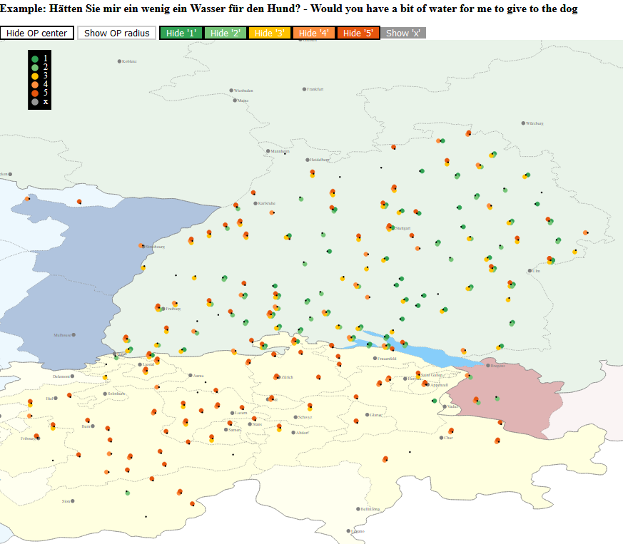
a bit ID (≈ of) water
FB4-4_1

Slide 12
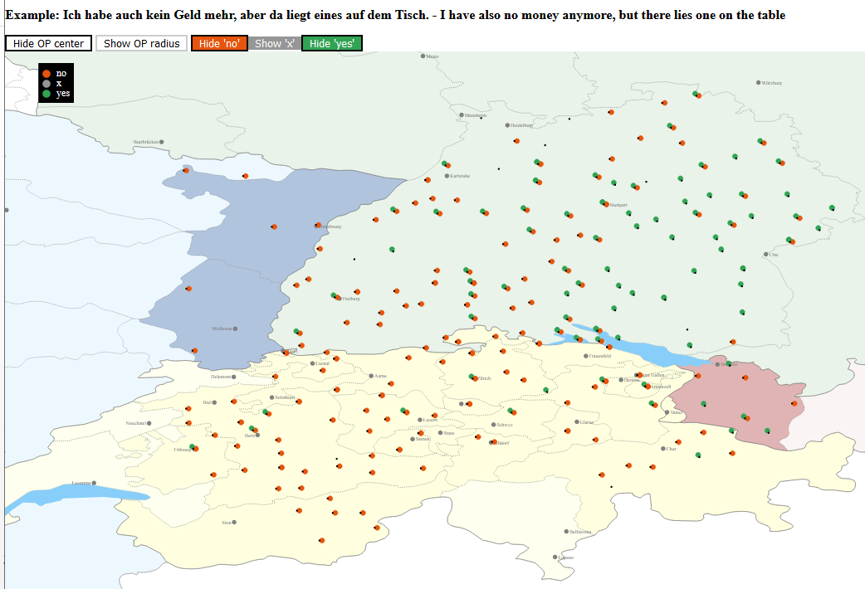
I've got no cash anymore, but there is ID (≈ some) on the table
patterns with Bavarian
ALM A
patterns with Standard German
ALM B
FB2-4_3

Slide 13
IDs with mass nouns in ALM
overt/non-overt realization of a "very low" universal functional head within DP that is responsible for a (pseudo-)partitive reading, e.g. Borer's (2005) Div-Head:
ALM A: ALM B: ID realizes overtly <e>_{DIV} zero variant of <e>_{DIV}
Romance-like Germanic-like de+article partitive zero partitive
Ho comprato del vino Ich habe __ Wein gekauft [I] have bought de.art wine I have __ wine bought

Slide 14
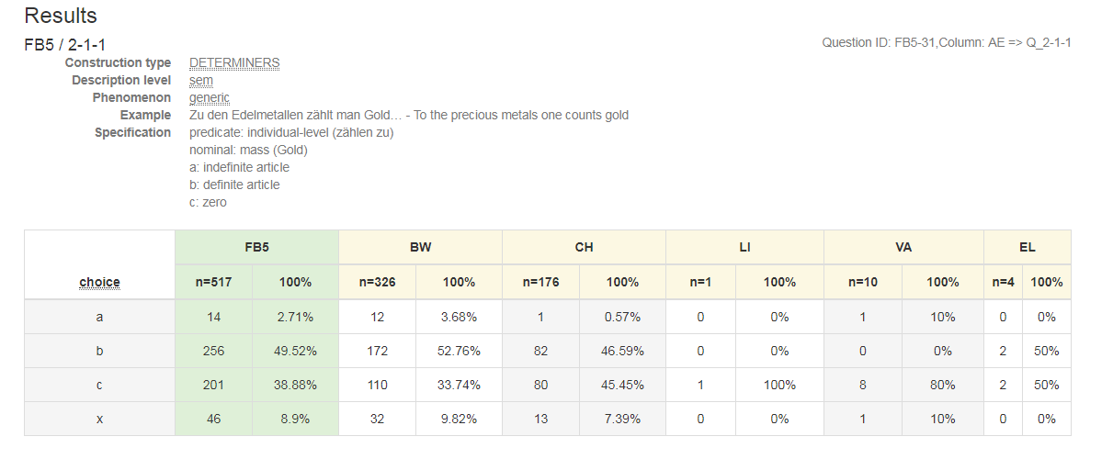
Mass nouns without an ID
Zu den Edelmetallen zählt man a. ein Gold b. das Gold c. Ø Gold „Gold belongs to the precious metals“
ID in generic statement:
Only 3 % acceptance!

Slide 15
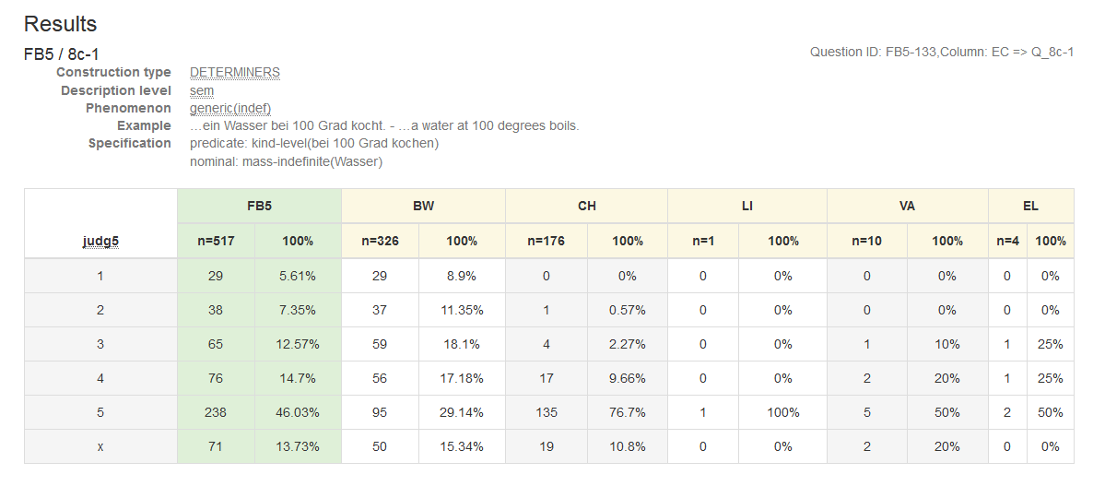
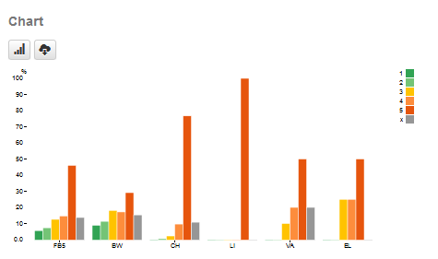
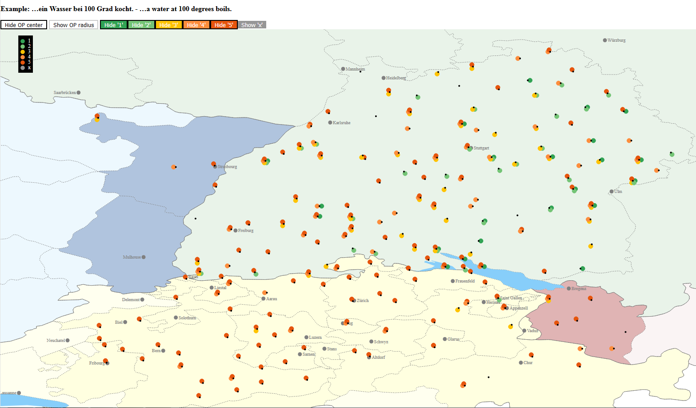
'A water boils at 100 degrees'
An unexpected high percentage of acceptance in BW (about 20%), again in the area close to Bavaria… overgeneralization?
Subject – object contrast???
ein Wasser…
overall: 13% acceptance (1-2)
BW: 20% !
CH: 0%
VA: 0%

Slide 16
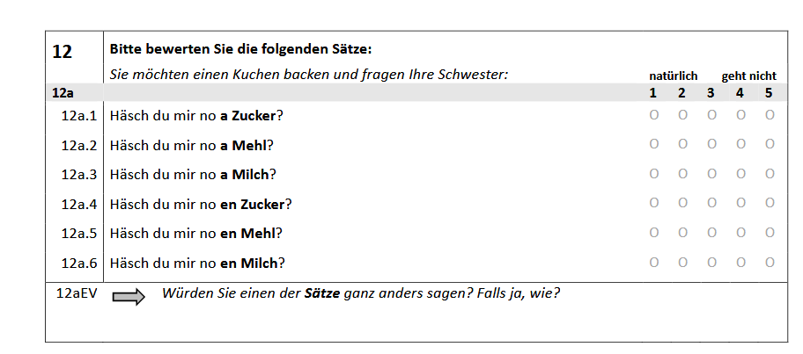
The ID is really an ID: it agrees with the noun in gender:
24%
68%
red: wrong gender
green: correct gender
68%
68%
5%
4%
Case morphology | masc. | neuter | feminine
nom/acc | en | a | a
→ No silent ‘container’ noun

Slide 17
IDs with mass nouns in Standard German
There are also limited occurrences of an ID with mass nouns in Standard German:
…so ein Wein (such a wine)… (like this one)
→ qualifier construction
…and in this case, ALM B shows the indefinite article as well!

Slide 18
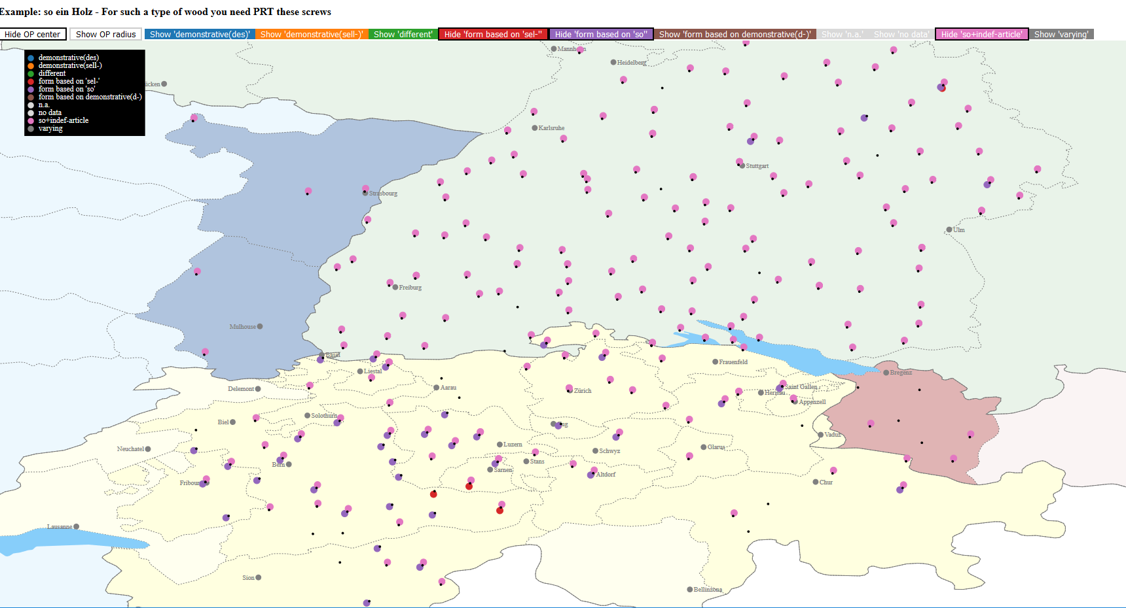
Für so ein Holz,…
For such a wood ,…
Forms based on so:
(ein) so-n-ig-es
(ein) so-tt-ig-es
Translation task, sentence given:
Für so ein Holz,…
FB3 / 6-1_4, n=757, 65% with ID

Slide 19
Summary of the data
 | ALM A (Bavarian) | ALM B (St. German)
Partitive ID | √ | *
Qualifier ID | √ | √
Generic ID | * (√) | *
What is the difference between these types of IDs?

Slide 20
Semanto-Syntactic Background
The proposal is based on Borer‘s (2005) exo-skeletal approach with further refinements by using a nano-syntactic f(unctional) sequence, Starke (2010), among others Bare nominal: the "starting point" is always mass; the respective reading evolves in the course of the derivation by adding functional material:
The lowest functional head provides a (proper) subset of the same substance (= bounded mass)
The ‚higher‘ we go, the more distinctions/differentiations are made, (conceptual) entailments → adjacent nodes → syncretism

Slide 21
Syntactic Background
BM = real subset relation, (Barker 1998)
fseq above the noun
see Hachem (2015) and Rehn (2018), also Grimm (2012) :
D Number(plural,Q) collective individual bounded mass noun
link to discourse
definite article (iota-operator)
strong quantifiers
different morpho-syntactic realizations, among them:
gender, see Hachem, 2015, based on Leiss (2000)
case (genitive) - older stages of German(ic)
Prepositions - an/von (partitive)
indefinite determiner
"classical" Chinese classifiers, see e.g. Zhang (2013)

Slide 22
ein- realizes BM - diachronic evidence
Middle High German:
(4) dâ legen uns an ein gras NL 1623,3 there lay-down us at a grass
(5) dô was ein snê gevallen GL 1196,4 there was a snow fallen (cited after Paul et al 1998²⁴:387), s. also Presslich (2000)
even in the plural: (6) so sint einu liute dabi, haizent Arimaspi thus are ID-pl people there-with, named A. (cited after Paul et al 1998²⁴:388)

Slide 23
BM with genitive- diachronic evidence
More typical with genitive:
(7) jâ sah er ligen umbe sich der liute sam der steine Prt saw he lay around him the-gen people together the-gen stones (cited after Paul et al 1998²⁴:341)
Even 'combination' of genitive-marking and ID:
(8) er âz daz brôt und tranc dâ zuo eines wazzers daz er vant he ate the bread and drank there-with ID-gen water-gen that he found (Iw, V. 3310 – 3311)

Slide 24
BM with genitive- diachronic evidence
with weak quantifiers:
(9) a. ich han ein wening öl-s I have a bit oil-gen b. mit ein-em wenig rosenwasser-s,… with a-dat bit rosewater-gen (from DWB:BD 29,1)
The same holds for the other weak quantifiers like: vil (much/many), genug (enough), mêre (more), minner (less), lützel (little)
(10) da er … ziemlich viel d-es stark-en Wein-s genossen hatte because he … quite much the-gen strong-wk wine-gen enjoyed had (11) daƺ ist vil koufleut-e site that is many trader-syncr. custom (Paul 1919:297)

Slide 25
Replacement of the genitive - prepositions
An with bounded mass: genug/viel/wenig/mehr…
… an Wasser (water)
…*an dem Wasser
…an Aufmerksamkeit (attention)
…*an deiner Aufmerksamkeit
→an occupies a functional head within one DP
Von with „real“ partitive:
ein Teil… (= part of)
…*von Wasser
…von dem Wasser
…*von Aufmerksamkeit
… von deiner Aufmerksamkeit
→ Two DPs with a complete D-layer for each, cf. the determiners

Slide 26
Differences due to the predicate (and its actual interpretation)
The interpretation of a DP is not solely dependent on its morpho-syntactic ingredients but interacts with the predicate chosen; Borik & Espinal (2015) V-driven genericity:
kind level predicates (be extinct, be common, …)
individual level predicates (be intelligent, …)
stage level predicates (typical activity verbs: eat, drink,…)
The possibility of a generic statement (kind-reading) depends on the actual aspectual-temporal interpretation and not solely on the lexical entry of the predicate itself:
A blue whale eats an average of three tons of food a day (and is the largest mammal in the world)

Slide 27
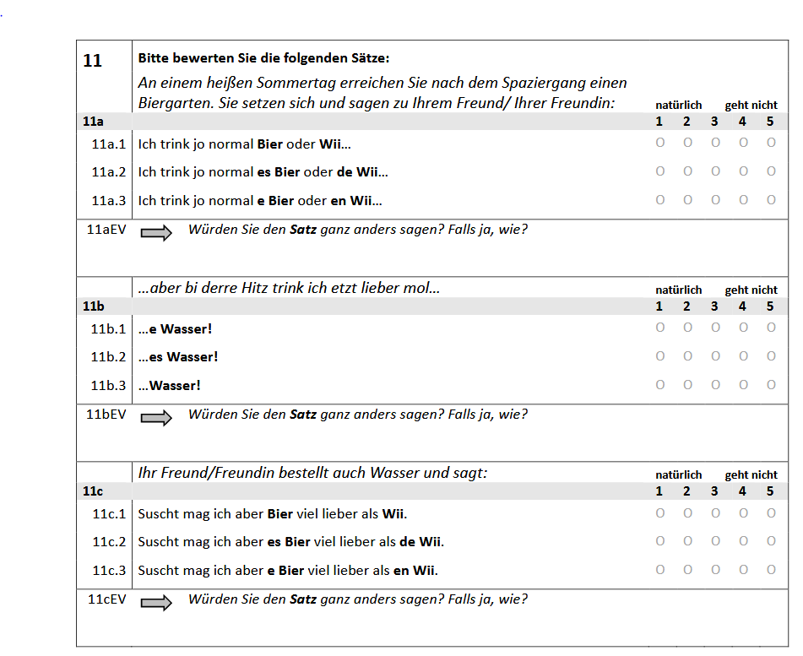
Differences due to the predicate (and its actual interpretation)
I usually drink wine….
Stage level
Habitual
But today I will drink water
Stage level
Actual
Otherwise, I like wine….
Individual level

Slide 28
Differences due to the predicate (and its actual interpretation)
stage level, but pluralized
→ episodic and generic, (characterizing)
Expectation: no def. D, but ID possible
difference between BW and CH
stage level, actual instantiation (right now) → episodic Expectation: no def. D, but ID (highest rate),
difference between BW and CH
individual level predicate (like) → generic Expectation: def. D ok, ID (lowest rates) difference between BW and CH in

Slide 29
Differences due to the predicate (and its actual interpretation)
Acceptance (%): grading 1-2 FB 5-11, n = 517
BW | CH
78 | 93
-- | --
72 | 38
BW | CH
89 | 42
-- | --
80 | 92
BW | CH
79 | 84
42 | 33
66 | 24

Slide 30
Situational partitivity
But:
ID only licit if the clause as a whole has a stage-level interpretation; it is only possible if there is an actual event realized
still mass, but a proper subset of it
BM does not introduce an individuated discourse referent, no pronoun possible in a follow up:
Häsch mir no a mehl? # I gib's dir grad
Have.you me.dat prt a flour? I give it you immediately
Ich ha dir Ø/oas/a weng I have (for) you ID/a bit
ꓱe
VP
BMP
V⁰
possible in all varieties
amount
BM‘
BM⁰
NP
Bavarian
ALM A
an ein-
ø
-s
Standard German
ALM B
MHG

Slide 31
Interim summary:
The realization of the BM-head in ALM A and BAV is the overt reflex of situational partitivity
This reading can also be obtained by pragmatic means and thus the variation (borrowing via contact, resp. the very high acceptance rates in contrast to the rather low production rates) is indeed PF-Variation.
Crucially, the head for bounded mass is present in all varieties and it is responsible for the (simple subset) partitive reading.

Slide 32
Subset is not enough…
In Standard German – and also in ALM B - there is an instance of ID + mass noun:
Qualifier construction
SG: a. ein so __ guter Wein __ so ein guter Wein a so good wine so a good wine
b. *ein so __ Wein __ so ein Wein a so wine so a wine
What kind of interpretation is connected with the ID in this case?
How close is the interpretation to the cases just discussed?
What is the role of the adjective?

Slide 33
The interpretation of so-ein-N
Idea: so-ein-N induces a sub-kind reading
It can be combined with determiners that presuppose alternatives, e.g. a demonstrative: This tiger lives (only) in the jungle Such a tiger lives (only) in the jungle
→ at least one differing property from other instances of the nominal, 'characterizing' generics, Krifka (1995), Cohen (2001):
A potato contains vitamin C (contrast with other types of veg.)
#A (ok: the) potato grew originally only in South America
'contrastive' subset → can be conceived of as an individual

Slide 34
The interpretation of so-ein-N
Given that a so-ein-NP is individualized, a pronoun in the follow up should be possible:
So einen Wein wie wir gestern hatten, möchte ich wieder.
So a wine as we yesterday had want I again.
Der/Er war wunderbar. Pron-masc was wonderful
→ The ID is situated in the individualizing position

Slide 35
The structure of so-ein-N
In a nano-syntactic framework, the projection of the IndP entails the projection of the BM-head:
For ALM A (and Bavarian), the ID, base generated in BM, moves higher up – in the other dialects, the ID is base-generated in this position.
IndP
so
Ind'
Ind⁰
BMP
ein-
BM‘
BM⁰
NP
ein-
Wein

Slide 36
The closeness of partitivity and subkinds
Expectation: in earlier stages, we should find genitive marking also in the qualifier construction…
waƺ wunder-s in der werlte vert what wonder-gen in the world goes
waƺ mannes er waere what man he was.subj Paul (1919:301)
Today: replaced by the preposition für:
was für ein Wunder...
was für ein Mann…

Slide 37
The closeness of partitivity and subkinds
In both constructions, we are dealing with a real sub-set relation ein-N(mass): proper subset (subtraction) there must be some "stuff" left, (cf. the R-operator in Zamparelli (2008), Barker (1998)) so-ein-N: implies that there are other sub-kinds (subtraction)
→ ID is the same lexical item for ‚subtraction‘ – on different but neighboured 'levels' in the functional layer

Slide 38
Why the indefinite determiner?
Usual assumption in grammaticalization: started with the numeral and subsequent bleaching, Givón (1991), Heine (1997), but see Petrova (2015) for evidence against this ‚path‘: Numeral presentative specific non-specific generalized
Furthermore: one is a special number, Barbiers (2007):
there is no ordering (trivially); ordering occurs only from two (probably three) on, (cf. one and the other, dual!); when we multiply/divide with „one“ → no effect! (adding of course is different)
suppletive forms for the cardinal (*one-th vs. first) instead: no internal division (no counting), indefiniteness (no ordering)
singling out/subtracting one member of a set
Overlap with the meaning of DE!

Slide 39
Thank you

Slide 40
so-ein-N with an adjective
An adjective brings in an individualizing (subkind) interpretation, since it presupposes that there are other (different) kinds of N. However, it originates in the BM position, as semantically, it builds first a proper subset of the N:
IndP
so as a category neutral particle,
may also adjoin to the adjective directly:
IndP
so
Ind'
Ind'
Ind⁰
BMP
Ind⁰
BMP
ein
ein
gut-
BM‘
BM‘
BM⁰
NP
so
gut-
NP
BM⁰
Wein
Wein

Slide 41
so-ein-N with an adjective
Overgeneration?
IndP
This order indeed exists:
English:
…so nice a girl… …many a man…
Ind'
Ind⁰
BMP
ein
BM‘
so
gut-
NP
BM⁰
???
Wein

Slide 42
so-ein-N with an adjective
Why not in German?
Inflection:
*so gut-er ein Wein
Inflection must be adjcacent to the noun:
*ein groß-er genug Teller
#ein groß genug-er Teller a big enough plate
note: genug is an adverb that (usually) does not inflect!
but never: *ein groß-er genug-er Teller

Slide 43
Was-für-(ein)-N
In this case, für heads the Ind-projection, cf. the preposition an in the partitive, and the ID is situated in the BM position.
Expectation: in CH, the ID should be rejected to a much higher rate than in BW.
Note that in written Standard German, the ID is nearly obligatory!
was
IndP
Ind'
Ind⁰
BMP
für
BM‘
BM⁰
NP
(ein-)
Wein

Slide 44
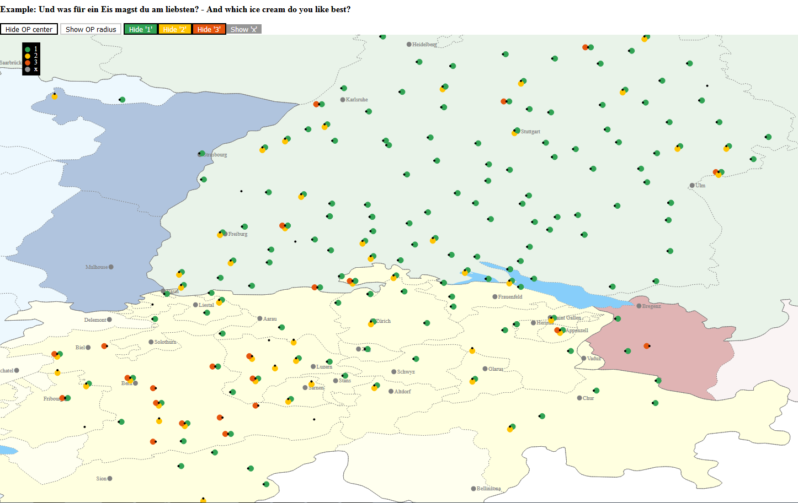
was für ein- NP

Slide 45
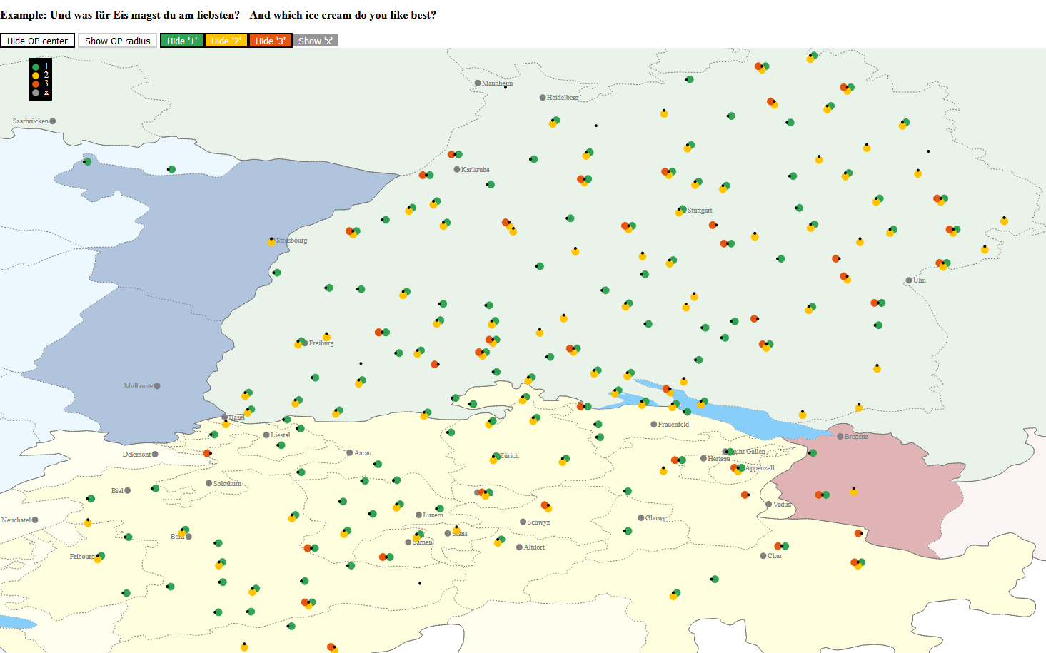
was für ø NP

Slide 46
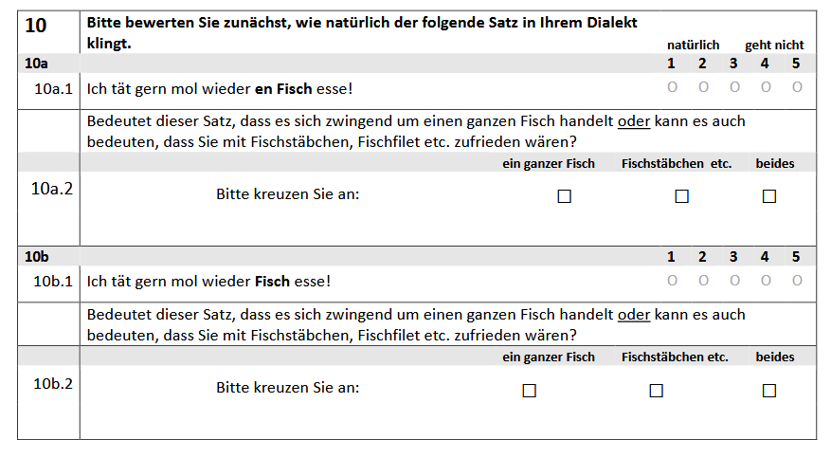
Interpretation of ein- with a prototypical CN
Interpretation | BW | CH
whole, complete fish | 35 | 73
fish must be part of it | 7 | 3
both possible | 54 | 22
Interpretation | BW | CH
whole, complete fish | 7 | 5
fish must be part of it | 14 | 11
both possible | 74 | 81
Swiss German speakers require to a much higher degree the whole/complete interpretation for a DP with ein-
→ ein- may only lexicalize the Ind-head

Slide 47
Final issue: doubling
Recall: a weng a Wasser a bissle a Wasser ID quant ID water
However: *a viel a Wasser (much,many)
*a gnueg a Wasser (enough) *a mee a Wasser (more)
→ not a productive pattern!
Recall furthermore:
one of the possible 'substitutions' for the genitive is the preposition an (or von, with container nouns also mit) These would be situated then in the BM-head, cf. für in the Ind-head)
ein wenig (also ein bisschen) has a second life as a degree particle;
it can even combine with a weak quantifier like viel:
des isch etz e weng/a bissle viel dummes Gschwätz this is now ID bit much stupid talking
Speculation: both, bisschen and wenig have an origin as nouns; the ‚higher‘ ID has amalgamated with the noun and does not occupy a functional head within the the DP.
But:
Bavarian: real indefinite article (partitive), even with indefinite plural, patterning thus with Romance (French):
I mächt oi kerschn I want indef.pl cherries (Glaser 2008)

Slide 48
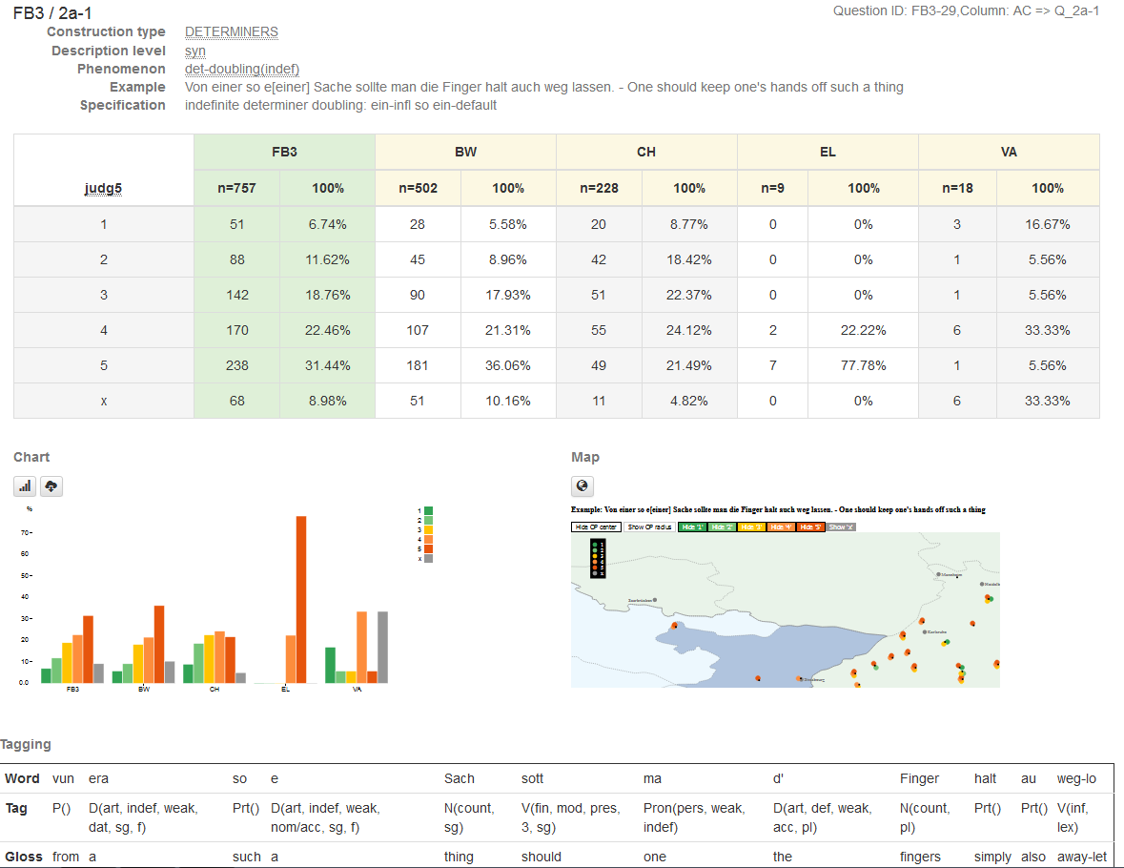
doubling:
vun era so e sach…..
from a-infl such a thing

Slide 49
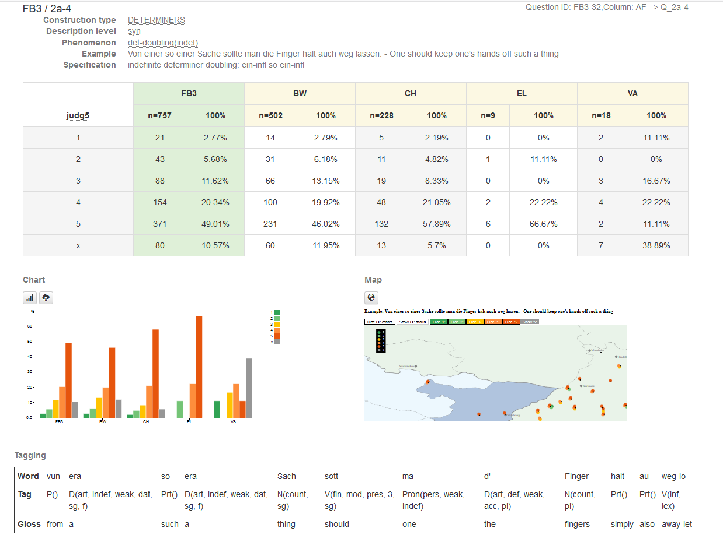
doubling:
vun era so era sach…..
from a-infl such a-infl thing

Slide 50
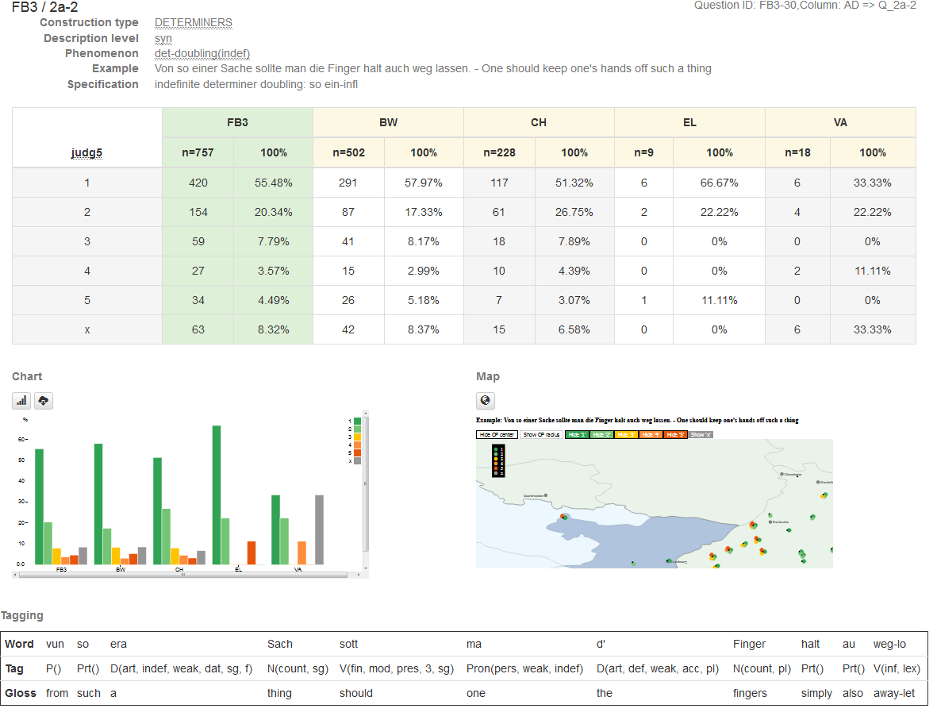
no doubling:
vun so era sach…..
from such a-infl thing

Slide 51
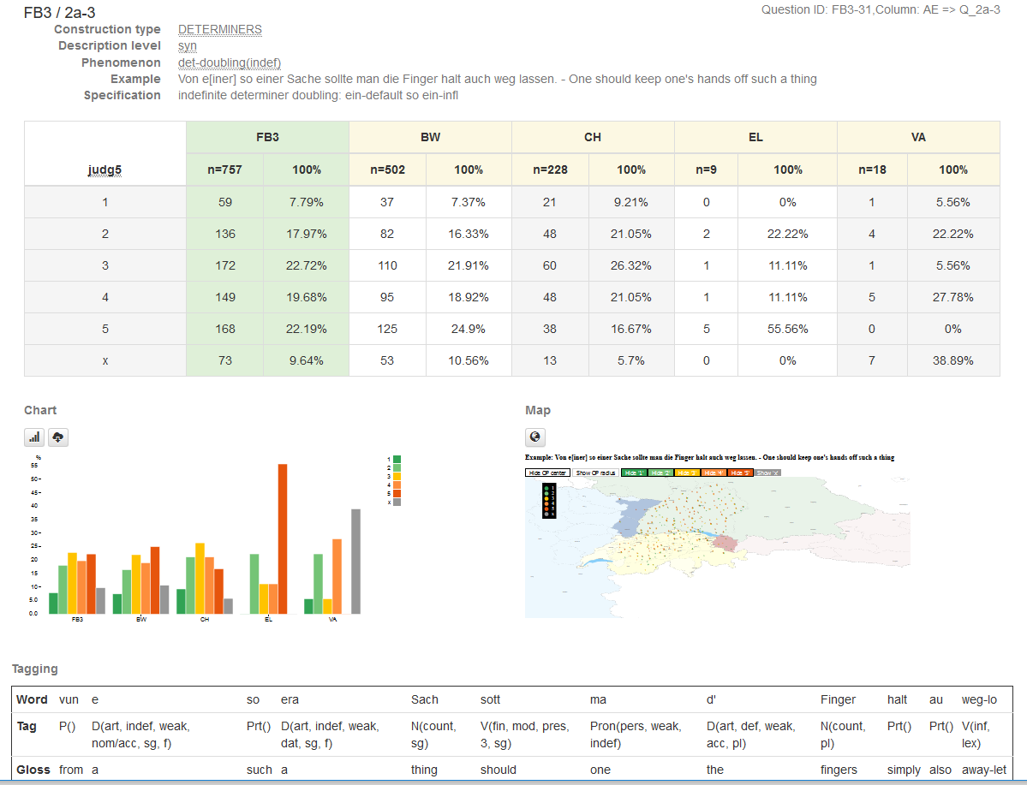
doubling:
vun e so era sach…..
from a such a-infl thing
so has a second form in Alemannic:
eso (<also)
der het eso g'macht he has so made
'He behaved like that'
→ occurs outside of a DP, has nothing to do with the determiner!

Slide 52
Summary
Starting from a rather superficial language contact phenomenon, it turned out that it gives new insights into the finer grained structure above NP; specifically a layer called ‘bounded mass’
BM has a lexical realization either as the preposition an (in German) or as the ID.
The ID lexicalizes the ‘individuating’ (= Number) as well; the common semantic core is ‘subtraction’.

Slide 53
Thank you!

Slide 54
Selected References
Borer, H. 2005, Structuring Sense, Vol I. Oxford: Oxford. University Press
Borik, O., & Espinal, M. T. 2015. Reference to kinds and to other generic expressions in Spanish: definiteness and number. The Linguistic Review, 32(2), 167-225.
Glaser, E., 2008. Syntaktische Raumbilder. Ernst, Peter/Patocka, Franz (Hg.): Dialektgeographie der Zukunft. Stuttgart, pp.85-111.
Grimm, S. (2012). Number and individuation. Unpublished doctoral dissertation, Stanford University.
Hachem, M., 2015. Multifunctionality: The internal and external syntax of D-and W-items in German and Dutch. Utrecht University.
Leiss, E., 2000. Gender in Old High German. TRENDS IN LINGUISTICS STUDIES AND MONOGRAPHS, 124, pp.237-258.
Paul, H. 1919. Deutsche Grammatik III. Niemeyer.
Rehn, A. 2018. Adjectives and the Syntax of Germanic DPs. PhD dissertation, University of Konstanz
Ruys, E.G., 2017. Two Dutch many's and the structure of pseudo-partitives. Glossa, 2(1)
Sapp, C., & Roehrs, D., 2016. Head-to-modifier reanalysis: The rise of the adjectival quantifier viel and the loss of genitive case assignment. Journal of Germanic Linguistics, 28(2), 89-166.
Strobel, T., 2015. Die syntaktische Variable ›pronominale Partitivität‹ in den deutschen Dialekten. Syntaktische Variation: Areallinguistische Perspektiven, 2, 151.
Zhang, N.N., 2013. Classifier Structures in Mandarin Chinese (Vol. 263). Walter de Gruyter.

Slide 55
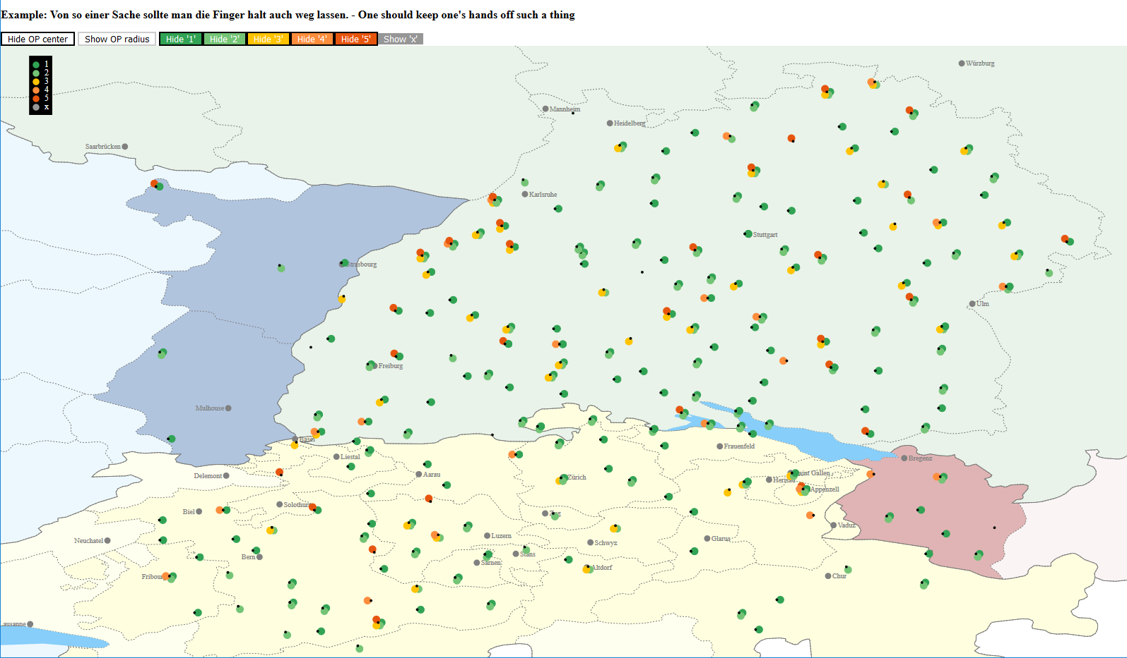

Slide 56
Parking lot …….Problem
With count nouns, the weak quantifiers viel etc. require a plural marking on the noun
Before, we said plural marking occurs much higher up in the tree (above collective)
So why do we not have "viel Buch"??? (but: many a man!)
In the literal sense it should then be parts of substances of a book - which is indeed true
possible solution: The plural marking is in this case indeed collective (syncretic with plural), cf. Leiss (2000)!
This then would mean to posit the collective head below the individualizing head
Understand better what is exactly the difference between collective and plural?

Slide 57
Generic reading with a mass noun:
A water boils at 100 degrees
An unexpected high percentage of acceptance in BW (about 20%), again in the area close to Bavaria… (overgeneralization?!?!)
Recall judgment task: about 67% in BW acceptance with:
Do you have you a flour (for me)?
still, a clear difference
ein Wasser…
overall: 13% acceptance (1-2)
BW: 20% !!!
CH: 0%
VA: 0%

Slide 58
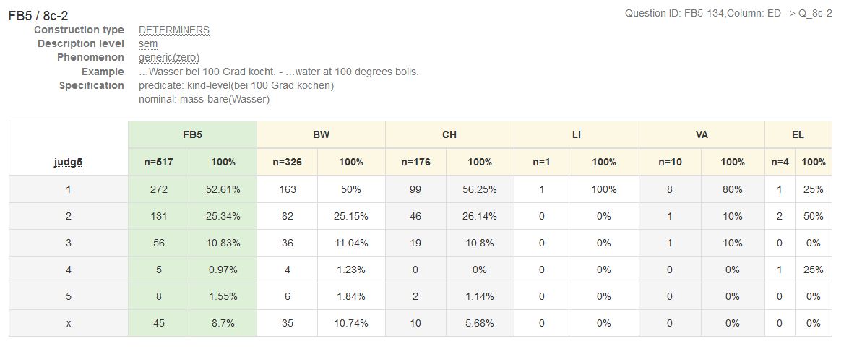
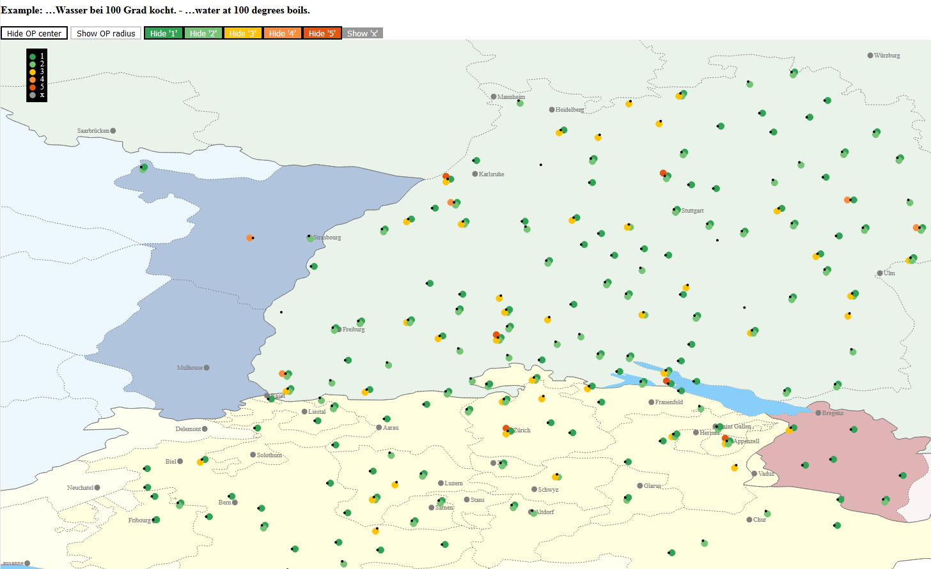
Generic reading with a mass noun:
Water boils at 100 degrees
overall:
78 % acceptance (1-2)
Wasser…
78% percent accept the bare noun;
this is conform with the general pattern in the Germanic languages

Slide 59
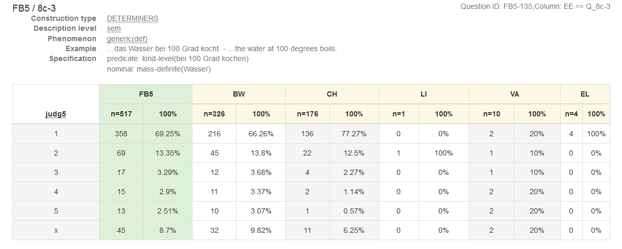
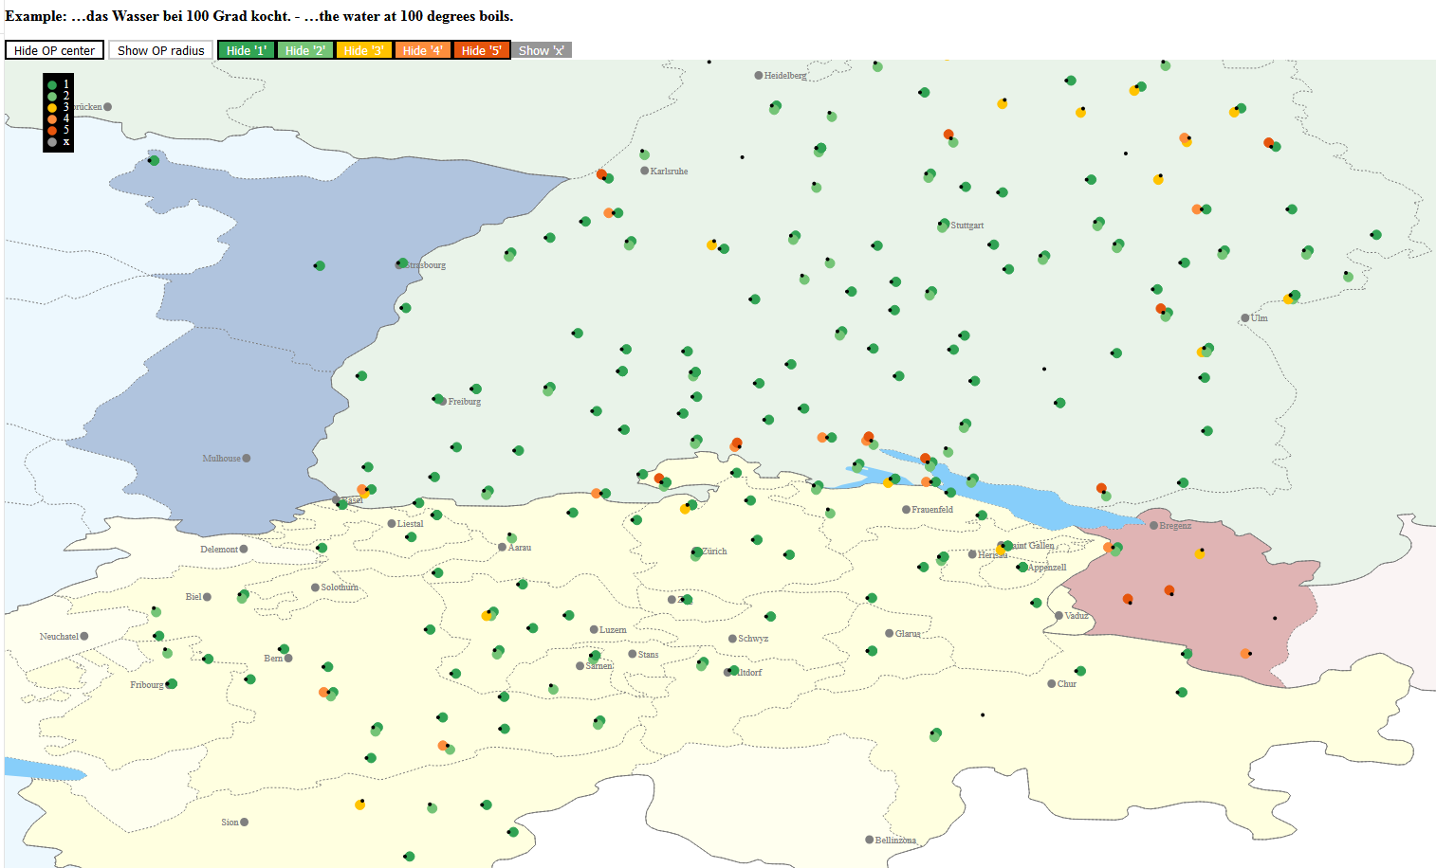
Generic reading with a mass noun:
The water boils at 100 degrees
The definite article has the highest acceptance rate (83%),
ALM thus patterns more like Romance, see Stegmann (2016), although the bare noun is possible as well.
Note the slight difference between BW and CH. CH has an even higher acceptance rate of the def. D!
overall:
83% acceptance (1-2)
das Wasser…

Slide 60
ein- replaces partitive genitive – as one possibility…
In earlier stages, weak quantifiers were nominal in character and were even able to govern agreement with the finite verb:
dô kam vil ritter und frowen (Walther 106, 25) there comes(3sg) many knights and women
vil schilde der ganzen wurden dâ zerfüeret many shields the.gen whole became-pl there destroyed (Wolfram Willeh. 383, 6)

Slide 61
ein- replaces partitive genitive – as one possibility…
Later, they could also behave adjective-like (→ inflection); in this case, they are situated higher in the structure (above the individualizing head), see also Sapp & Roehrs (2016).
Crucially they are neither determiners nor real quantifiers,
(see Ruys 2017) for very subtile semantic differences in Dutch (that hold for German as well)

Slide 62
